Slide 1
North Yorkshire Safeguarding Adults Board (NYSAB)
Local Safeguarding Partnerships
)

Slide 2
www.safeguardingadults.co.uk
www.safeguardingadults.co.uk
Follow us on Twitter: @NYSAB1
Follow us on Twitter: @NYSAB1
Overview of the Local Safeguarding Partnerships (LSPs)
In October 2019, the Local Safeguarding Adult Groups (LSAGs), Children’s Safeguarding Strategy Groups (CSSGs) and the non-operational element of the North Yorkshire Local Delivery Team (LDT) meetings merged to form Local Safeguarding Partnerships (LSPs).
We agreed to do this to ensure that we work closer together as partners as well as across the Board and Partnerships and provide high quality and a consistent approach to safeguarding all adults, children and young people across North Yorkshire.
By bringing together partners from each local area the LSPs can focus on the key safeguarding issues in their area. It allowed us to improve awareness raising at a local level and look at particular issues within the localities.
The LSPs are accountable to the North Yorkshire Safeguarding Adults Board (NYSAB), North Yorkshire Safeguarding Children Partnership (NYSCP) and the North Yorkshire Community Safety Partnership (NYCSP). Their work is shared with and monitored by the Board and Partnerships to ensure they work in line with our strategic priorities.
NYSAB Strategic Priorities for 2020-2023
Introduction

Slide 3
www.safeguardingadults.co.uk
www.safeguardingadults.co.uk
Follow us on Twitter: @NYSAB1
Follow us on Twitter: @NYSAB1
The purpose of the LSP’s is to:
Raise awareness of local safeguarding issues in the locality;
Respond to local need;
Identify learning needs;
Share good practice and;
Deliver the priorities set out within the three respective partnerships business plans at a local level
Role of the Local Safeguarding Partnerships
NYSAB Strategic Priorities for 2020-2023

Slide 4
www.safeguardingadults.co.uk
www.safeguardingadults.co.uk
Follow us on Twitter: @NYSAB1
Follow us on Twitter: @NYSAB1
Local Priorities
As well as local delivery of the overarching strategic priorities of the Board and Partnerships, it is also the responsibility of the LSPs to identify priorities at a local level.
To ensure delivery of local priorities it is suggested that each LSP focuses on 2-3 priorities
These can be informed by intelligence and / or data provided at a local level or data provided by the Board and Partnerships.
NYSAB Strategic Priorities for 2020-2023
Local Priorities

Slide 5
www.safeguardingadults.co.uk
www.safeguardingadults.co.uk
Follow us on Twitter: @NYSAB1
Follow us on Twitter: @NYSAB1
Expectations of partners attending the LSPs:
That members of the respective LSPs will attend the quarterly meetings and will engage in the groups.
That members will drive the safeguarding agenda forward for the own local area and within their respective organisations.
It is expected that Board members ensure a representative from their respective organisations attends and engages with the LSPs.
NYSAB Strategic Priorities for 2020-2023
Attending the LSPs

Slide 6
www.safeguardingadults.co.uk
www.safeguardingadults.co.uk
Follow us on Twitter: @NYSAB1
Follow us on Twitter: @NYSAB1
Expectations of the Board and Partnerships:
The Board and Partnerships expect the LSPs to deliver locally the strategic priorities
The partnerships expect to receive a quarterly update from each LSP which gives a clear update on their work as well as appraising them on the following areas:
Alert – what do the LSPs want to alert the Board and Partnerships to?
Assure – what do the LSPs what to assure the Board and Partnerships of?
Advise – what do the LSPs want to advise the Board and Partnerships of? What advice do the LSPs need?
Expectations of the Board and Partnerships
NYSAB Strategic Priorities for 2020-2023

Slide 7
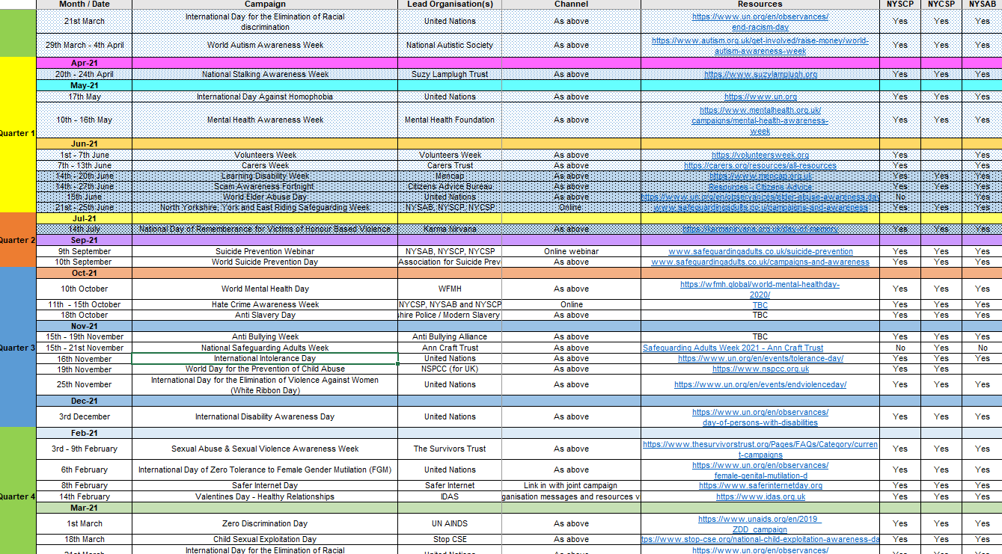
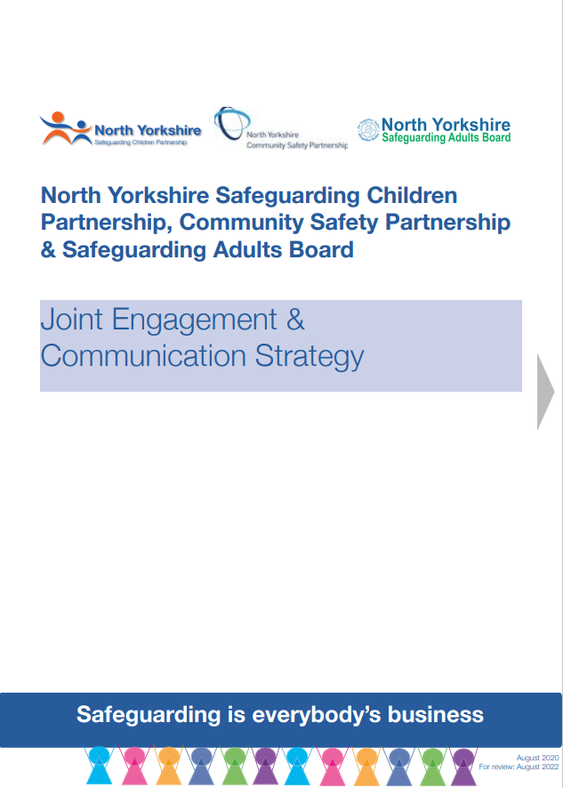
www.safeguardingadults.co.uk
www.safeguardingadults.co.uk
Follow us on Twitter: @NYSAB1
Follow us on Twitter: @NYSAB1
There is an expectation that the LSPs will undertake awareness raising and support the campaigns and activities set out in the Board and Partnerships Calendar of Activity. #SafeguardingIsEverybodysBusiness
This includes identifying, planning for and delivering local topics as part of the annual Safeguarding Week campaign.
The LSPs and their members are expected to deliver the Joint Engagement && Communications Strategy and adopt the principles of this within their localities and organisations
The LSPs will be supported by the engagement and communications leads for the Board and Partnerships for this work.
NYSAB Strategic Priorities for 2020-2023
Engagement and Communications
Joint Engagement & Communications Strategy
Calendar of Activity

Slide 8
www.safeguardingadults.co.uk
www.safeguardingadults.co.uk
Follow us on Twitter: @NYSAB1
Follow us on Twitter: @NYSAB1
We agreed to make use of the resources we already have i.e. NYSAB website, LSP reports etc. and also get more people from the VCSE involved, but for the right reasons.
More people from VCSE to attend LSPs: To have more local involvement and VCSE representation (“voice of the sector”) at the LSPs. This could be to highlight particular issues / concerns from their areas (i.e. cuckooing, financial abuse/door step scamming & crime)
Promote the LSPs within the sector: Add the dates of the LSP meetings into eBulletin / eNews and encourage people within the VCS to attend. Include link to the LSP webpage and share and promote via social media.
Use the LSP reports to update the sector: The updates from the VCS can be captured in the LSP reports from each of the four localities
Share information / actions from the LSP reports: Caroline to share the key points from the LSP reports and feed back into the 3 strategic meetings – having the LSP feedback as a standing agenda item
NYSAB Strategic Priorities for 2020-2023
VCSE and the LSPs

Slide 9
If you would like more information about the local safeguarding partnerships please see the contact details below for the Chair and Business Support of each LSP
Harrogate and Craven
Chair: Stephen.Thomas@northyorkshire.police.uk
Business Support: Harriet.Dewhirst@northyorks.gov.uk
Scarborough, Whitby and Ryedale
Chair: Sandra.Rees@scarborough.gov.uk
Business Support: Andrea.Hayes1@northyorks.gov.uk / Lauren.Young@northyorks.gov.uk
Hambleton & Richmondshire
Chair: Helen.Williams213@nhs.net
Business Support: Rachel.Bentley@northyorks.gov.uk
Selby
Chair: SSweeting@selby.gov.uk
Business Support: Susan.Watson@northyorks.gov.uk
You can also find more information about the LSPs, including the terms of reference and copies of these quarterly updates here: https://safeguardingadults.co.uk/about-us/lsps/
Contact the LSPs

Slide 10
www.safeguardingadults.co.uk
Follow us on Twitter: @NYSAB1
NYSAB strategic priorities– https://safeguardingadult.co.uk/strategic-priorities
NYSCP ‘Being Young in North Yorkshire’ strategy- https://www.safeguardingchildren.co.uk/about-us/who-we-are/
North Yorkshire Community Safety Partnership: https://nypartnerships.org.uk/nycsp
Joint Engagement & Communications Strategy: https://safeguardingadults.co.uk/engagement-and-communication/
Campaigns and Awareness: https://safeguardingadults.co.uk/campaigns-and-awareness/
Calendar of Activity: https://safeguardingadults.co.uk/calendar-of-activity/
For more information about this presentation or engagement and communications, please contact Laura.Watson@northyorks.gov.uk
Useful links & resources

Slide 11
www.safeguardingadults.co.uk
Follow us on Twitter: @NYSAB1
One Minute Guides – https://safeguardingadults.co.uk/working-with-adults/one-minute-guides-omg/
Keeping Safe Resources - https://safeguardingadults.co.uk/keeping-safe/easy-read-guides/
Training - https://safeguardingadults.co.uk/learning-research/training-courses/
NYSAB Procedures - https://safeguardingadults.co.uk/working-with-adults/nysab-procedures/
Resources
& Keeping up to date with the NYSAB
Twitter
Newsletter
Website
www.safeguardingadults.co.uk/nysab-newsletter
www.safeguardingadults.co.uk
www.twitter.com/nysab1

