Slide 1

Humber and North Yorkshire Digital Inclusion Group
c
North Yorkshire Equality and Inclusion Partnership Meeting
11 October 2023
Christian Turner

Slide 2
Background
Established over 4 years ago
Key purposes:
  Develop digital inclusion principles and strategy
  Promote digital inclusion in the HCV Digital Strategy and the HCV Operational Plan.
  Commission and share research and analysis
  Understand impact of digital tools on patient outcomes
  Promote non-digital options where appropriate
  To share and promote best practice
Wide membership
  Primary care
  Secondary care
  Community care
  Voluntary, community and social enterprise sector
  Local government
  Healthwatch

Slide 3
Our Strategy
Everyone can choose and use
digital services to improve their lives
Education
(Skills, awareness)
Access
(Devices and connectivity)
Co-production
(User experience)
Performance and Intelligence

Slide 4
Key pieces of work
Projects | Strategic Alignment
Digital Inclusion Networking pilot | All
Improving Digital Inclusion in General Practice - HNY | Education, Access
Sign-posting website | Education, Access
Village Halls Digital Hubs | Education, Access
East Riding/LGA Digital Inclusion Triage and Support Tool | Access
Digital Prescribers | Education, Access, Experience
Digital ‘Pod’ | Access
Shared Prosperity Fund - Scheme Development | TBC
Improving Digital Inclusion with NHS App | Education, Access
Must be scalable
Must be linked to health (primary care)

Slide 5
Supporting people to use the NHS App to help address Digital exclusion
Aim to work with cohorts of patients/people within areas of high risk of digital exclusion:
  Encourage downloading the NHS App (where not already done so)
  Be provided with the digital skills to use the App to book appointments, cancel appointments and order prescriptions.
  Provide further support within people’s communities to learn how to access and use other digital tools and the internet more broadly
  Demonstrate positive impact on health and wellbeing
Focus on Lower Super Output Areas at higher risk of digital exclusion
  Digital Exclusion Risk Index (DERI) to help identify geographical locations
  Further analysis on patient cohorts

Slide 6
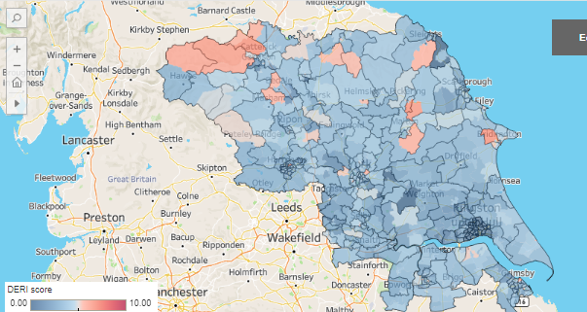
Supporting people to use the NHS App to help address Digital exclusion
Place | LSOA - Ward Name | DERI Score
North Yorkshire | Harrogate Bilton Woodfield | 6.589
North Yorkshire | Gilling West (Richmondshire) | 6.497
East Riding | Bridlington Central and Old Town | 6.405
North Yorkshire | Thornton Dale (Ryedale) | 6.185
North Yorkshire | Lower Swaledale and Arkengarthendale (Richmondshire) | 6.127

Slide 7
For discussion
How do we identify the people who are digitally excluded and need support or could benefit from support to be digitally enabled?
How do we evidence that we are 'digitally including' people and that they are benefiting from this?

Slide 8
Humber and North Yorkshire Digital Inclusion Principles
c
Appendix

Slide 9


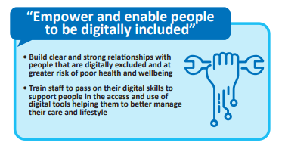
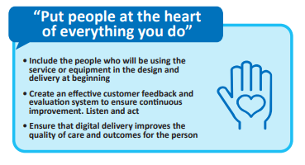
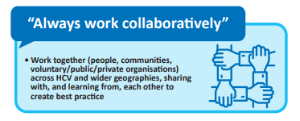
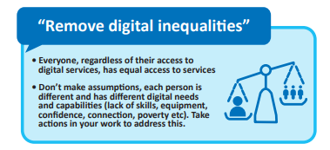
ICS Digital Inclusion Principles

Slide 10
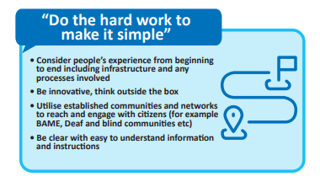
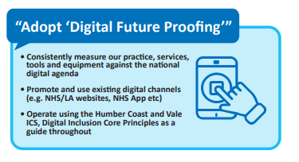
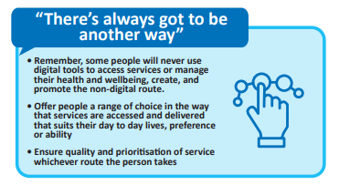
ICS Digital Inclusion Principles

