Slide 1
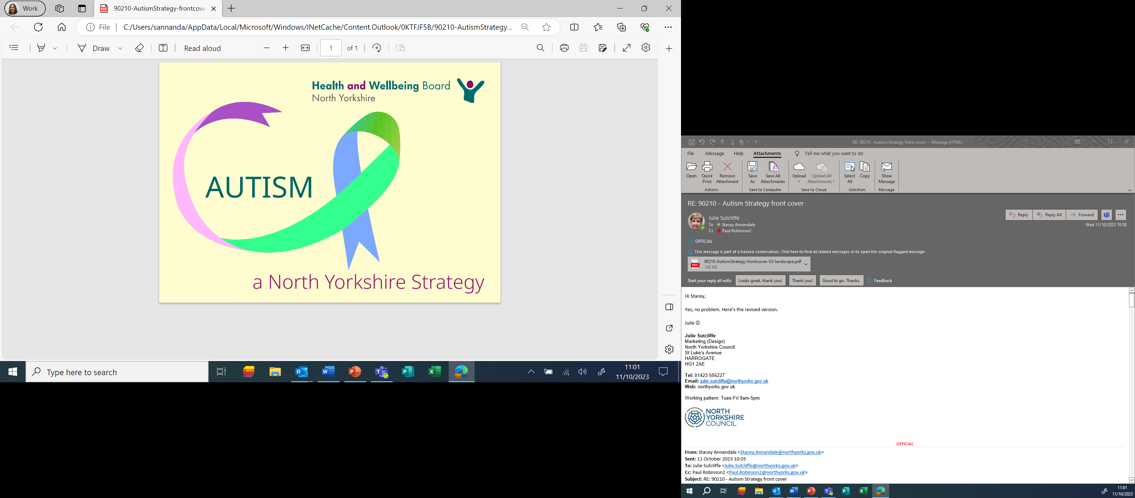
Version 0.6 – reflecting comments from Steering Group 9th October 2023

Slide 2













Working together to develop this strategy
Our strategy is led by the North Yorkshire Autism Group of partners - from carers and advocates to voluntary sector organisations, as well as agencies responsible for health, care, education and criminal justice. We are grateful to the wider Autism network of autistic people, carers, staff, partners and wider community services who have contributed to this strategy. Their experiences, views and ideas have been shared through events, workshops, surveys and conversations over the past 6 months:
April - May 2023
Autistic people & carers (72 attended)
July 2023
Practitioners from across partner organisations
Sept 2023
Autistic people, carers, practitioners and partners together
170 survey responses
7 events, 104 people
2 partnership meetings, 40 people
7 action-planning sessions with 77 people participating
8 events (local & virtual, 104 participants)
We have also looked at what local and national data and research tells us. We reviewed the progress made under our previous strategy, ‘Changing the landscape of Autism’ and have included some case studies in this document. We know that there is still a lot of work to do: our new strategy addresses the areas which are most important to people as well as being a local response to the national strategy.

Slide 3
What we want to achieve through our Joint all age Autism Strategy
Autistic children, young people and adults and their families
enjoy full, happy, and healthy lives.
To achieve this ambition, we will work together on the following key priorities…
Education & Preparing for Adulthood
Employment
Housing
Carers
Our priorities
Assessment,
Diagnosis &
Support
Health &
Care
Criminal &
youth justice
Inclusive
Communities
To help us to deliver our strategy, we will also focus on:
Delivering our strategy
Working together
Workforce
Data and research
Making best use of our resources

