Slide 1
Gypsy, Roma, Traveller and Show People – Health Needs Assessment
Eric Ayesu-Boapeah, Public Health Manager, Healthier Lives, Communities and Economies
Rachel Maw, Public Health Officer, Healthier Lives, Communities and Economies

Slide 2
Inclusion Health definition
“Inclusion health is a catch all term to describe people who are socially excluded and typically experience multiple overlapping risk factors for poor health which can include childhood trauma, poverty and violence”
Inclusion Health: Applying All Our Health

Slide 3
Inclusion Health Groups
Notes:
Belong to more than one group
List not exhaustive
Stigma, persecution
Not focus on specific diseases associated with specific group – as loose the multifaceted nature of socially excluded – Multiple morbidity and social issues
These groups wont be a surprise to you – GRT are explicitly included in the Council Plan in the Equality Objectives - work to eliminate discrimination, advance equality of opportunity and foster good relationships between different people when carrying out our activities Council Plan for North Yorkshire Council 2023 to 2024

Slide 4
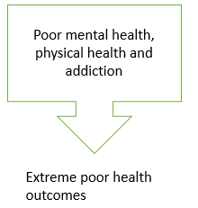
What is Inclusion Health – GRTS
Multiple risk factors for poor health
(poverty, violence, complex trauma)
Not consistently recorded in electronic systems
Stigma and discrimination
Social exclusion
Barriers in access to healthcare and other services
Insecure housing, communal accommodation, overcrowding
Notes:
Multifactorial - discuss
Shared risk factors – poverty and childhood trauma
Focus on IH – worse health outcomes, lower average of death
Barriers to accessing and engaging with NHS and other services

Slide 5
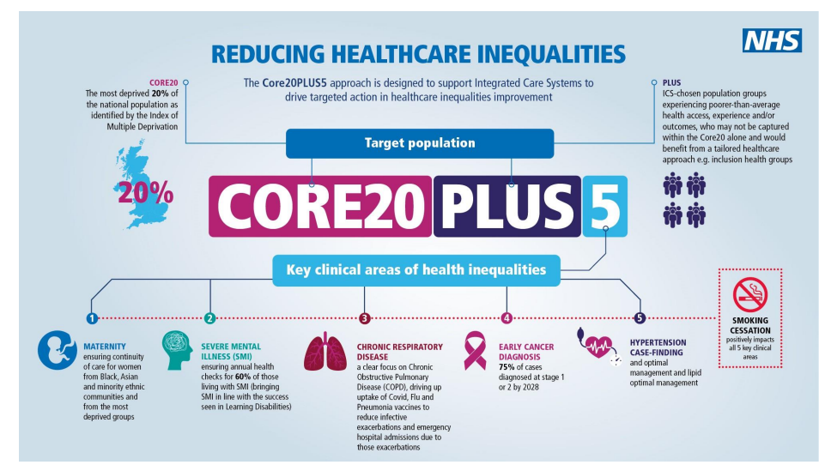
Core 20 PLUS 5
National approach to support the reduction of health inequalities at a national and system level
Notes:
There are also other tools which have recently been published see below to plan, develop and improve health services to meet the needs of people in inclusion health groups
NHSE Framework for action in Inclusion Health - NHS England » A national framework for NHS – action on inclusion health
Pathways Framework - Pockets of Excellence: Integrated Care Services for Inclusion Health - Pathway

Slide 6
Notes:
Chart refers to homeless, sex workers, substance misuse – NOT GRT, but is a good illustration of consequences of being in an excluded group.
Higher rates of disease, injury and premature mortality compared with the general population
Socially excluded groups have a mortality rate that is nearly eight times higher than the average for men and nearly 12 times higher for women
By contrast, individuals aged 15-64 years in the most deprived areas of England and Wales have a mortality rate that is 2.0 time higher in men and 2.1 times higher for women than individuals in the least deprived areas
Significant health inequalities exist between the Gypsy and Traveller population in England and their non-Gypsy counterparts, even when compared with other socially deprived or excluded groups, and with other ethnic minorities.

Slide 7
What is a Health Needs Assessment
Systematic approach to understanding the health needs of a population
Holistic assessment
Understand the community – needs and priorities
Builds recommendations to support policy, planning, commissioning and delivery of services to focus on those in greatest need
Part of a continual process – reviewing the issues in a population leading to agreed priorities to improve health and reduce inequalities
Notes:
What is a health needs assessment
Deep dive into a population – or a community
Gives a rounded picture – an explanation of the current position, comparison over time and with other geography (locally/nationally). Review the health of the population and highlights the health issues pertinent to the particular population in question. What is it about their live as a whole that impacts on their health resulting in poor outcomes?
Opportunity to review the wider determinants of health and their impact – social, environmental, economic, cultural and physical environmental factors that influence health, well-being and inequalities in health , - examples can include housing and education – no coincidence that these presentations follow on!
Driving forces – local plan, housing needs assessment, equality and diversity, local and national policies
Identification of assets/resources
Involve partners- many partners to gather the information, internal, external, community, voluntary……
Community voice – extremely important, own view of the issues, improve trust, target issues pertinent to the community – these can differ from our own, assumptions, improve success

Slide 8
GRTS Health Needs assessment
Outline what is know about the health needs of the GRTS communities in North Yorkshire, regionally and nationally
Identify health needs and gaps in service provision
Develop a great understanding across the NY system of the health issues
Identify key shared priorities

Slide 9
Population in North Yorkshire – Census data
Census 2011
Row Labels | White: Gypsy or Irish Traveller
Craven | 54
Hambleton | 132
Harrogate | 107
Richmondshire | 19
Ryedale | 81
Scarborough | 37
Selby | 158
Grand Total | 588
Census 2021
Row Labels | White: Gypsy or Irish Traveller | White: Roma | Grand Total
Craven | 49 | 12 | 61
Hambleton | 113 | 16 | 129
Harrogate | 83 | 109 | 192
Richmondshire | 33 | 12 | 45
Ryedale | 59 | 25 | 84
Scarborough | 60 | 134 | 194
Selby | 152 | 43 | 195
Grand Total | 549 | 351 | 900
Notes:
Census Data health warning! - only includes those who actually ticked the boxes! Could have completed the census but not ticked the identification. Use of the GRT term arguably fails to reflect the true diversity of the communities referenced.
Gypsy and travellers was only added to Census 2011, no specific option for White Roma, they were allocated to Other White, however this was added in 2021.
Show people not identified as a group in the census data – we have included them in our work, we have Show people, living, working and travelling through our county – need to include them. Could have different issues, more economically active in the area – links to other parts of the council – licensing, trading standards, public safety
Differences between Census 2011 and 2021 – White, Gypsy or Irish traveller – broadly the same – some fluctuation in the district and boroughs.

Slide 10
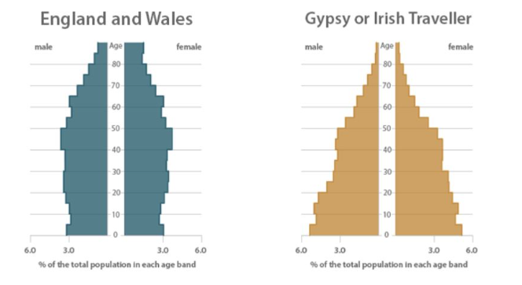
Population pyramids England and Wales, 2011
Notes:
Age demographic are very different for GT community – Census 2011 revealed a much younger population when compared to the England and Wales population – median age of 26 and nearly 40 % of the population being under 20 years old.
Estimated to have life expectancies between 10-25 years shorter than the general population

Slide 11
Smoking prevalence by ethnic group
Notes:
Explanation re smoking – higher disease, LTC, burden on the system
Gypsy and Travellers are significantly more likely to have long term illness, health problems or disability - 42% of Gypsy and Traveller people are affected by Long term health conditions as opposed to 18% of the general population Gypsy Roma and Traveller OHID resource June 2022.pdf
Infectious diseases – more vulnerable to infectious diseases due to poor access to sanitation amenities – Hepatitis A outbreak amon some Irish Traveller communities in England in 2021

Slide 12
Health and wider issues
42 per cent of English Gypsies are affected by a long-term condition, as opposed to 18 per cent of the general population
Delayed diagnosis
Higher rates of stillbirth, infant mortality and maternal death
Higher levels of stress, anxiety and depression
Poor dental health, low registration and high level of unmet need
GRT community has low Vaccination and Immunisation uptake
GRTs have the lowest rate of economic activity of any ethnic group, at 47 per cent, compared with 63 per cent for England and Wales overall.
More likely to live in poor housing condition.
Only 3-4% of GRT population access higher education (18-30yrs), compared to 43% of the general population (18-30yrs)
Notes:
Increased risk of suicide – however research has found that very few local suicide prevention plans specifically identify the GRT community – not widely discussed in the GRT community – difficulties in accessing mental healthcare
Oral health – GRT among the groups that had least success when booking an NHS dentist appointment
Gypsies’ and Travellers' lived experiences, health, England and Wales - Office for National Statistics (ons.gov.uk)
Health conditions – COPD, asthma, diabetes, bladder problems, cancer and mental health difficulties – perceived by the community to be caused by environmental factors – such as sites located in polluted areas with poor standards. Work related injuries and conditions.
Health outcomes significantly lower than those of the general population – issues regarding access to health care
Barriers to healthcare – difficulties registering with GP without fixed address, delayed diagnosis and treatment, uptake of screening and preventative health care, experiences of perceived discrimination and derogatory attitudes of healthcare providers, fears of facing negative judgment, apprehension about seeking help, feeling misunderstood. Embarrassment.
Positive experiences – feeling listened to, good relationships with health practitioners, respected by health practitioner
GRT response to ill health – belief by the community that speaking about ill health and getting help could worsen health conditions – with participants largely accessing healthcare only when very unwell – though not universal experience
Not receiving postal communication to site address – could be needed to remain registered and receive information
Literacy barriers to engaging with the health services, increased use of computers and limited access – online appointments etc Use of smartphones
Alternative provision of information – accessible formats for health information and appointment reminders, mobile out reach clinics on sites, people with lived experience from the community linking to health services.
Maternal Health
GRT mothers are 20 times more likely to have experienced the death of a child than mothers in the general population
one in five Gypsy or Traveller women experience more miscarriages than other women outside the communities
GRT communities have disproportionately high levels of infant mortality, child mortality and stillbirth
Vaccination and Immunisation – standard calls for immunisation and screening not received due to transient nature of the community, however long term residents do receive this information

Slide 13
Progress to date
Internal (NYC) Partners Workshop
Comprehensive GRTS HNA being written
Editorial group
Task and Finish groups – Data and Intelligence, Engagement, Wider Determinants
Literature Review

Slide 14
Whole System Approach- Practice
Create a plan for action
Learn and refine as we go
Understanding of the issue, context and wider system
Notes:
Collectively form an understanding of the issue, context and wider system.
Create a plan for action collaboratively with a wide set of stakeholders. Actions should be aligned and jointly prioritised.
Learn and refine as you go by involving stakeholders and embedding monitoring and evaluation. Considering the ‘so what?’ and ‘now what?’

