Slide 1
North Yorkshire Council Children and Families Overview and Scrutiny Committee
Children and Young People’s Mental Health
8th December 2023
Dr Gill Kelly, Consultant in Public Health
Emma Lonsdale, Head of Public Health Children & Families
Lorna Galdas, Interim Head of Children and Young Peoples Commissioning, North Yorkshire ICB
Zoe Davis, Service Manager, Compass Phoenix
Dianne Chew, Service Manager, Central & Emotional Health and Resilience, Harrogate and District NHS Foundation Trust
Simone Wilkinson, Group Manager – Early Help East, North Yorkshire Council

Slide 2
The ask
The impact of social isolation and disruption to education on children and young people’s mental health (particularly around the on-going legacy/effect of pandemic isolation and disruption)
The level of that impact – is it primarily low level anxiety, or more profound?
An update on demand pressures and unmet need

Slide 3
How to answer
The impact of disruption on mental health and level of that impact
Service pressures and unmet need
Whole system analysis
Multi-agency workshops in our priority development
Performance reviews of individual components
Growing Up in North Yorkshire survey
North Yorkshire Youth
Youth councils
Flying High
Healthy Schools events
Other engagement
National research

Slide 4
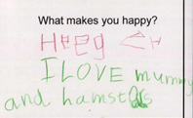
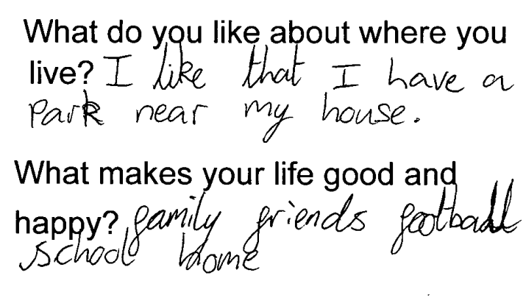
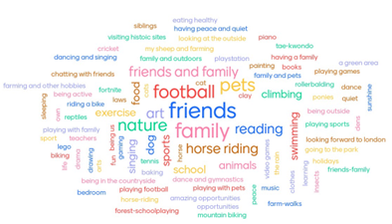
What makes children happy?
“It’s fun where I live as I have my best mate living next door to me”
“Overwhelmingly, what is making the children happy is being outside and being with their friends – these are children who would have been born around lockdown three years ago”
“I really do believe that in having greater community or our specific needs met in that way, that we are happier and maybe more able to make decisions that positively impact on our health in other ways too.”

Slide 5
But wellbeing and resilience has been deteriorating for longer…

Slide 6
Other reasons
"A lack of opportunities and activities for girls whose families have less money could drive them towards their phones and social media, creating even stronger unrealistic expectations in their heads." (Thomas, WHO)
"The pressures on young people start really early - to do well at school, to look good, have the right things etc. Sometimes it feels overwhelming." (Claudia, 14, WHO)
"The societal pressure (mainly coming from social media and the internet) for girls to fit a certain beauty standard is unlike most expectations that boys face when growing up." (Thomas, WHO))
62% of secondary school girls worry about their appearance vs 24% of boys (GUNY ‘22)
11% of secondary school pupils feel pressure from social media often or all of the time
From Year 6 onwards between 1 in 4 and 1 in 5 have been shown something online to upset them and 10% have been bullied online (GUNY ‘22)
“We are really worried about growing out of our school uniforms. We won’t be able to afford new stuff, they are so expensive. We will be getting second hand uniforms. Just feel really embarrassed in second hand stuff which then stresses me out.“
“One of my friends has got holes in her school shoes but she knows her mum hasn’t got any money so she’s not even telling her they are broken because she doesn’t want her to worry.”
17% of secondary school pupils worry about money often or all of the time(GUNY ‘22)

Slide 7
Children and young people not in school
Persistent absence levels (%) in secondary schools
The commonest reason for children being electively home educated is anxiety and stress, in both primary and secondary age groups
At the extreme end, over a third of the Year 8 (ages 12-13) pupils had deliberately harmed themselves or thought about taking their own lives in the year prior to the survey. Nearly half of them did not tell anyone.

Slide 8
Demand pressures and unmet need

Slide 9
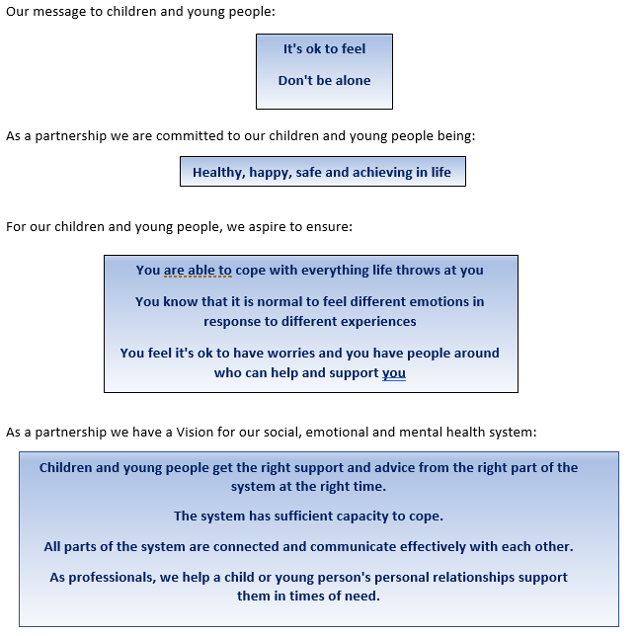
Understand the system: SEMH Group Vision and Priorities
To ensure a single, connected system at both strategic and provider levels
To use data, insight and knowledge to inform all parts of the system
To ensure there is focus on prevention, resilience building and advice
We will concentrate on identifiable, vulnerable groups of children and young people
We will identify and respond to the areas with greatest system pressures and/or need

Slide 10
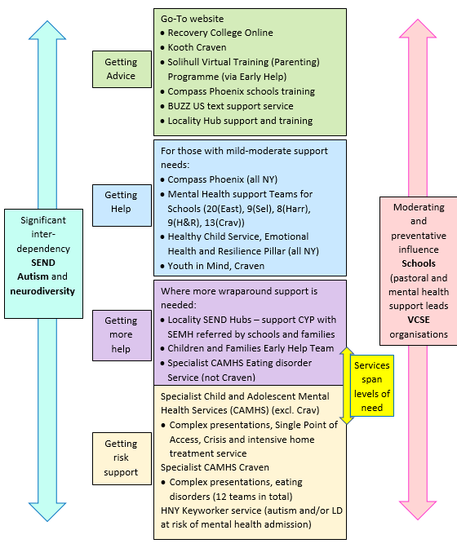
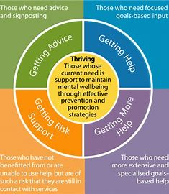
How the local system fits within the iThrive model

Slide 11
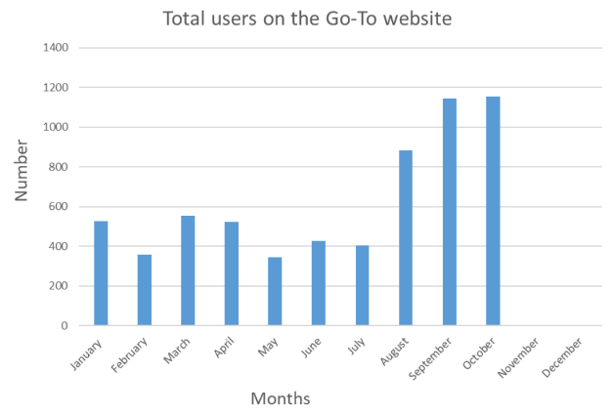
Getting Advice
The Go-To website
Large increase in numbers accessing the site in the last few months
Main pages accessed, other than homepage: feeling low or extremely sad
Kooth, Craven
Online wellbeing service for Bradford and Craven including councillors and wellbeing practitioners
New registrations reduced this year
Main reasons for accessing:
  Self-harm (32%)
  Anxiety/stress (29%)
  Friendships (26%)
  Suicidal thoughts (24%)
Progress tools show significant progress in users
Compass Phoenix
Offering consultation and training to schools
Schools’ feedback highlighted concerns around anxiety, stress and managing challenging behaviour
Developing a webinar around challenging behaviour

Slide 12
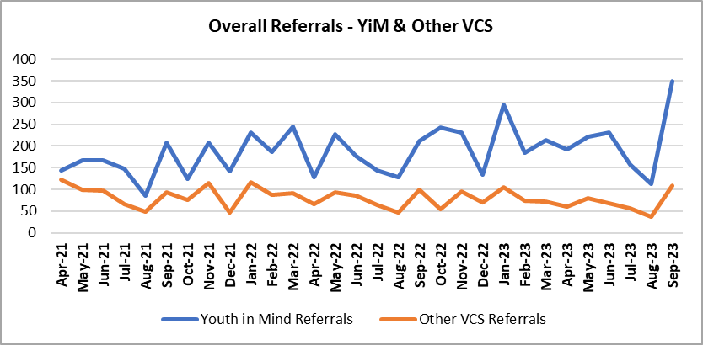
Getting help
Healthy Child Service: Emotional Health and Resilience Pillar
Mild to moderate needs
Q2: 178 referrals
Average age = 10.5
Screening within 5 days, but waits for intervention:
All young people’s validated scoring improved by the end of interventions
Youth in Mind, Craven
Mild to moderate needs
Overall increase in referrals, but significant increase since the pandemic
Main age group 11-15
Sept 23 wait just over a week for an initial assessment, then just under 5 weeks from referral to second contact
Compass Phoenix
Commonest reasons for intervention: anxiety (47%) and low mood (18%)
Main ages = 13/14, but increasing numbers in primary schools
Improvement in waiting times for all children, with lowest waits for group interventions and Lumi-Nova
85% rated the service as good or excellent
 | Q1 | Q2
Central | 15 wks | 13 wks
East | 17 wks | 17 wks
West | 17 wks | 14 wks

Slide 13
Getting help
Mental health support teams in NY schools excl. Craven
Mental health support teams in Bradford and Craven
5 teams, incl 2 in Scarborough
Cover 46 schools and colleges
Reasons for referral:
  Selby, Ham, Rich, Harr = 73-80% anxiety/panic
  Scarb, Rye = 52% anxiety, 28% low mood
1 team in Craven
Cover 12 schools and 1 college
October 2022 – September 2023: 171 children and young people treated for their mental health and wellbeing

Slide 14
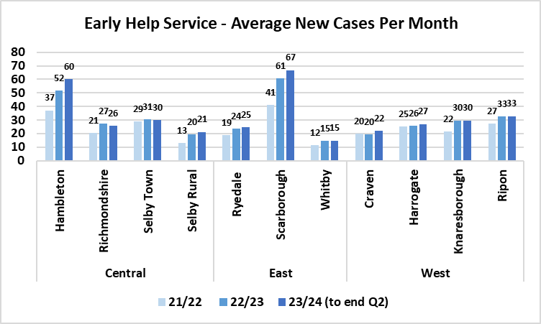
Locality Boards
5 Locality Boards serve all North Yorkshire schools, funding priorities according to local need e.g. Nurture
Getting more help
SEND Locality Hubs
Early Help
Range of specialist support from highly qualified staff who support families, schools and a range of organisations to help children with SEND
Each child has individual, clearly defined outcomes to be achieved as part of the specialist service caseload, which are shared with the child’s school and family
Q4 21/22 – Q4 22/23: 18% increase in referrals
1573 children supported across a range of specialist services
During Q4 22/23, 98% of outcomes partially or fully achieved
April-Sept 2023: 19% increase in new Early Help cases
Likely more than half cases have an element of SEMH, autism or ADHD
Social prescriber supports young people who are seen by Compass Phoenix and/or Specialist CAMHS

Slide 15
Getting more help
Getting risk support
Single Point of Access into Specialist CAMHS (TEWV) (Excl. Craven)
Eating Disorders Service, TEWV, excl. Craven
NB referral figures include City of York:
Crisis referrals are similar to last year
Community assessment waits (exl. ADHD):
  Northallerton, Harr = 2-3 weeks
  Scarb = 5-6 weeks
  Selby = 8-10 weeks
New intensive support team started Jan 23:
  50% reduction in critical admissions
  18.5% reduction in re-admissions in 6 months

Slide 16
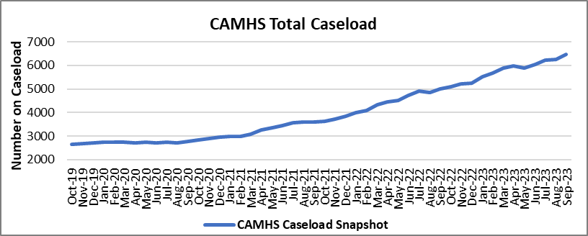
Getting more help
Getting risk support
Specialist CAMHS, Craven
Large caseload increase (incl. Bradford and eating disorders and neurodiversity)
Nearly 83% of children and young people were waiting less than 18 weeks from referral to starting treatment in September 2023
There is a directory of support services and “safe and well” checks whilst waiting

Slide 17
Autism
Craven
Provider BDCFT
Data includes all neurodiversity
Waiting list = 132 children (May 23)
A new child added to the waiting list from May 23 could wait around 38 months
Diagnosis made in over 80%
Scarborough/Whitby/ Ryedale
Provider ABL
Capacity 20 referrals/month
Demand 27 referrals/month
Waiting list = 114 children (Sept 23)
Average assessment wait = 44 weeks (Sept 23)
Autism diagnosis made in 71-81% (Jan-Sept 23)
Harrogate/Ham&Rich
Provider HDFT
Capacity 40 referrals/month
Demand 80 referrals/month
Waiting list = 1044 children (Sept 23)
Ave assessment wait = 58 wks
Autism diagnosis made in 92-100% (Jan-Sept 23)
New referral system with triage to offer support earlier
NB new all-age autism strategy consultation currently live

Slide 18
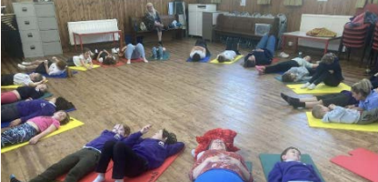
Schools
Multiple different programmes of work across our North Yorkshire schools, providing support and and promoting wellbeing. Most secondary schools have a Mental Health Lead and all education settings offer pastoral support.
Healthy Schools Awards Programme
My Happy Mind
Over 80% of primary schools signed up and working towards awards
Online event, March had 2,000 pupils
RHS Harlow Carr in June
East Barnby Outdoor Learning Centre November 27th
“Make sure everyone has someone to play with - if we see someone on their own, we ask them to join in”
“Teachers take time to talk to you when you're sad."
"We have well-being brain breaks."
Currently in 12 primary schools in Scarborough (+ 4 pending)
80% of staff are now having 1-3 conversations about children’s wellbeing each week
93% of teachers said that Happy Breathing benefited their class:

Slide 19
Final points
Further work within our priorities
What more would make a difference?
Single connected system
  Mental health transformation project
Data, insight and knowledge
  SEND data dashboard
Focus on prevention and resilience
  Thriving mapping group in Selby
Concentrate on vulnerable groups
  Emotionally based school avoidance
  Transitions to adult services
Identify and respond to system pressures
  Attachment and trauma awareness in schools
  Emerging eating disorders
  Anglo-American project for wellbeing
Increased capacity in all parts of the system
More wellbeing programmes in schools and communities
Support for staff in non-clinical organisations

Slide 20
Conclusion
Children are amazing!
Our whole population has shifted to be less resilient, with poorer wellbeing – how big a shift is open for debate…
Our job, therefore, is to focus on prevention, resilience, wellbeing, providing extra support as needed
Workforce are amazing! Dedicated and professional, going above and beyond

