Slide 1
North Yorkshire Safeguarding Children Partnership
February 2024 Update
Kathryn.Morrison@northyorks.gov.uk
Notes:
Welcome to the North Yorkshire Safeguarding Children Partnership LSP update for February 2024. My name is Kathryn Morrison and I am a policy and development officer in the partnership business unit, I will be doing the report for Haydn who is currently off work. I've added my email – so please do get in touch if there is something that you would usually contact Haydn with.

Slide 2
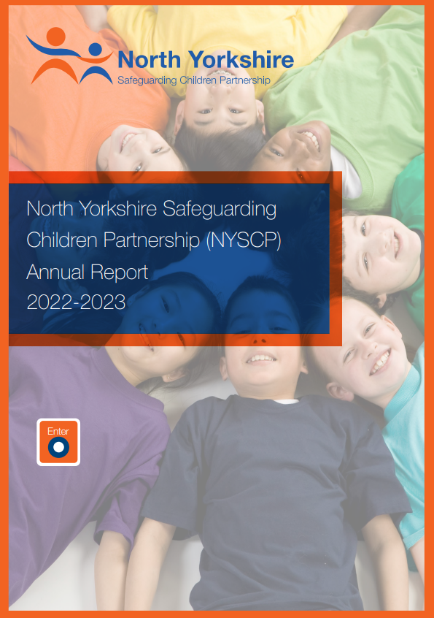
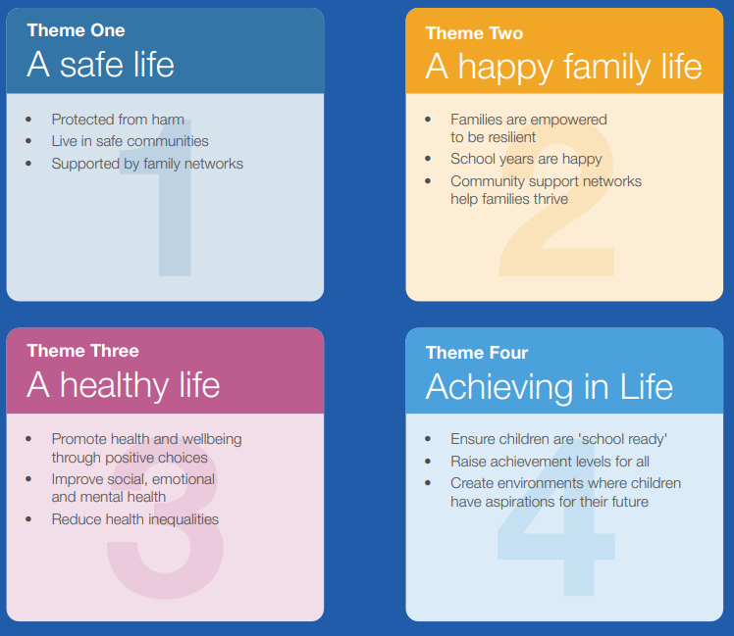
NYSCP Annual Report
Being Young in North Yorkshire (BYiNY) achievements
Partnership awards
Subgroup work
Audits
Multi Agency Learning and Training
Voice of the child
Financial Position
Priorities for 2023-2024
Notes:
Starting with some key documents for you:
The North Yorkshire Children’s Safeguarding Partnership Board Annual Report 2022-2023 was released in November 2023. This report is a testament to our unwavering commitment to ensuring the safety and well-being of our children and young people in North Yorkshire.
In a world where our children face evolving challenges and uncertainties, our role as the safeguarding partnership is more crucial than ever.
This report is more than a compilation of statistics and achievements; it is a reflection of our collective determination and the incredible work carried out by the board, its partners, and the communities we serve. It offers a comprehensive overview of
our activities, successes, and the challenges we’ve encountered, as well as our plans for the future.
Throughout this report, you will find insights into the collaborative efforts that have enabled us to create a safer and more nurturing environment for children and young people in our county.
The report included information on partnership achievements linked to the Being Young in North Yorkshire Strategy, the partnership awards that were presented over the year. Updates on subgroup work as well as audits and training. The is information about how the partnership listens to the voice of the child and use this voice to seek assurance that what we are doing remains child focused. The financial position of the partnership is also shared as well as the priorities for the coming year.
These are:
Strengthen the role of education in the partnership
Children and Young People’s emotional and Mental Health and Promoting positives of online engagement while minimising the risk children and young people face online.

Slide 3
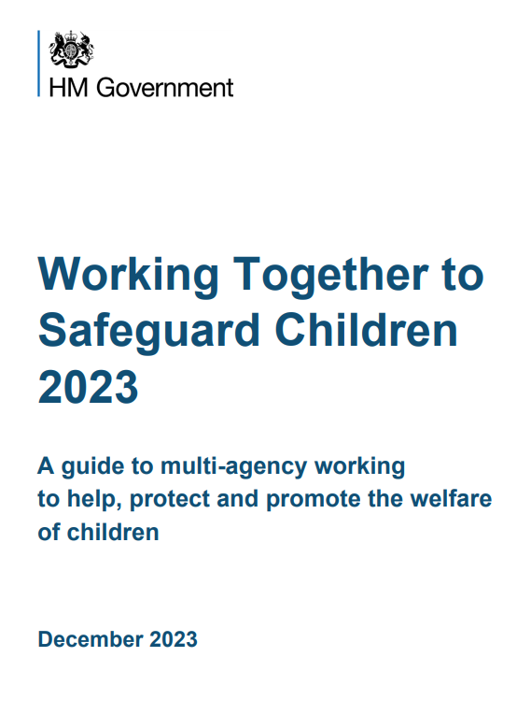
Working together to Safeguard Children 2023
A shared responsibility.
Working with parents and carers
Multi Agency Safeguarding arrangements
  Schools Colleges and education providers
  Voluntary Sector
Providing help, support and protection
  Early Help
  Safeguarding and promoting the welfare of children
  Child Protection
Notes:
A new and updated version of Working together to Safeguard Children was released in December 2023. This statutory guidance from the Department for Education sets out what organisations and agencies who have functions relating to children must and should do to help, protect and promote the welfare of all children and young people under the age of 18 in England. The 2023 edition replaces Working together to safeguard children 2018, which underwent a limited factual update in 2020. This new edition of Working together is central to delivering on the strategy set out in Stable homes, built on love (2023), which outlines the Government’s commitment to support every child to grow up in a safe, stable and loving home.
A summary of some of the key additions to the guidance:
A new chapter “ a shared responsibility” highlights how positive outcomes for children depend on strong multi-agency working. It introduces a set of multi-agency expectations for all practitioners involved in safeguarding and child protection. These expectations aim to ensure that practitioners: • share the same goals • learn with and from each other • have what they need to help families • acknowledge and appreciate difference • challenge each other.
The updated guidance sets out four principles that professionals should follow when working with parents and carers: • effective partnership and the importance of building strong, positive, trusting and co-operative relationships • respectful, non-blaming, clear and inclusive verbal and non-verbal communication that is adapted to the needs of parents and carers • empowering parents and carers to participate in decision making by equipping them with information, keeping them updated and directing them to further resources • involving parents and carers in the design of processes and services that affect them.
Multi Agency safeguarding arrangements: The updated guidance outlines new roles and responsibilities relating to the three safeguarding partners (the local authority, the police and the health service). The head of each statutory safeguarding partner will be referred to as the ‘lead safeguarding partner’ (LSP), who will in turn appoint a ‘delegated safeguarding partner’ (DSP)
It is expected that all local education and childcare providers working with children up to the age of 18 will be included in local arrangements. • partners should consider including voluntary, charity, social enterprise (VCSE) organisations, childcare settings, and sports clubs in their arrangements. The document references the crucial role that VCSE organisations play in safeguarding and promoting the welfare of children – part of this references the importance of information sharing.
Providing Help Support and Protection – This section is split into 3 sections – Early Help, Safeguarding and promoting the welfare of children and Child protection.
For Early Help – there is call to consider family needs in the context of early help and work closely with education and childcare settings.
For Safeguarding and promoting the welfare of children: Social care assessments should consider parent capacity of both resident and non resident parents as well as other adults responsible for this child's needs. Including the wider network and community and environment. Clarity of the role of Lead partitioner is also shared. It also references supporting disabled children and their carers and the issue of harm outside them home.
For child protection: the guidance sets out a series of national multi agency practice standards for all practitioners.
As a partnership we are continue to look in more depth at the changes to working together and what impact it will have on practice in North Yorkshire – we will continue to share updates with partners.

Slide 4
Harmful Sexual Behaviour Audit
Sexual behaviours expressed by children and young people under the age of 18 years old that are developmentally inappropriate, may be harmful towards self or others and/or be abusive towards another child, young person or adult (derived from Hackett, 2014).
Hackett’s continuum tool
Multi agency audit for better understanding in North Yorkshire.
Launch event – 17th January (recording available via YouTube @nyscp)
Dissemination event – 20th March
Notes:
I think Haydn mention this at your last meeting by I just wanted to give you an update on the Harmful Sexual Behaviour Audit that is currently in process.
To clarify –there is no universally agreed definition of what HSB is, which can make recognising and responding to HSB a challenge and can also impact on agency ability to develop and agree on shared language to describe behaviours. As a partnership we use the work and definitions of Professor Hackett and use the Hacketts continuum tool.
The NYSCP has a strategic priority to tackle child abuse in all its forms – and we have identified that we need a better understanding of Harmful Sexual Behaviour (experienced by and displayed by children across North Yorkshire)
To help inform this understanding we are conducting a multi-agency audit that will seek to identify current practitioner awareness of HSB and the pathways of support for children and young people displaying such behaviours.
The aim of the audit is to get a clear, honest picture of our current position and highlight any actions that may be required to improve the provision of response and services for children and young people to support the development of a HSB Strategy.
We need your help to ensure all organisation are engaged in the audit which is being undertaken by the NSPCC as this is key to developing an informed approach.
A launch event was shared with partners on 17th January where colleagues form NSPCC who are conducting the audit talked partners through the process and we will the hold a similar event in March 20th to disseminate learning. The sessions are available on our YouTube channel.

Slide 5
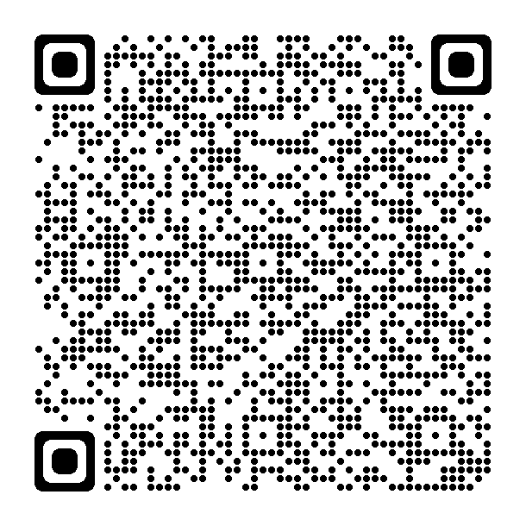
VCSE group
VCSE partnership work
Communications work
  Wider partnership day event
  Safeguarding Key messages
  Social medial campaign
  June 2024
VCSE and LADO referrals
LADO Practice Guidance
Notes:
Dave filled you in last meeting in regarding an assurance report that was shared at the Partnership executive board and some of the areas to focus on as a result of that report.
One of which was in relation to improving communication between the VCSE community and the partnership – focusing on the two way channels of comminution. i.e. the partnership sharing key messages with VCSE groups, and VCSE sharing key safeguarding information back to the partnership.
As a result of this a small task and finish group was established to look at the scope of the communication work. scoping exercises and mapping we completed and We also attended the Wider partnership day last Autumn and used this an opportunity to speak with VCSE members about the messages they were receiving – how they disseminated them and what gaps they could identify.
The group had already established that there was a wealth of safeguarding information already there (i.e. on NYSCP website) – and it was not for VCSE members to ‘know it all’ – but to know the key messages and know how to access the information if and when they every needed it. For the wider partnership day I produced a crib sheet/guide with key messages/QR codes and partners responded really well to this – so as a group we decided that this was useful way to progress – we are in the process of working with a design team to produce a much more visually appealing guide/poster alongside a series of social medial assets that partners can continually share with key safeguarding messages. The hope is that we launch this in June 2024 to link with volunteers week – and we plan to run a masterclass that week to highlight the campaign and key safeguarding conversations for VCSE groups.
I know Dave also mentioned thematically that in terms of LADO referrals (i.e allegations against those working with young people) there was a lack in confidence and referrals coming from VCSE sector – I just wanted to point you in the direction of guidance we have for partners on this.

Slide 6


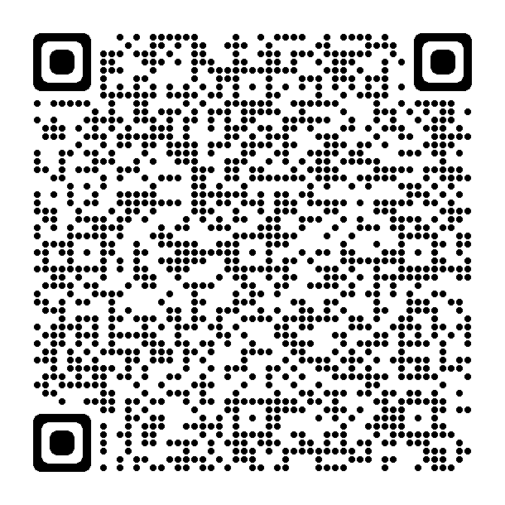

Community Partnership Intelligence
The online Community Partnership Intelligence Form gives professionals a safe and direct way to share information with North Yorkshire Police. Information shared may include:
Information about a concerning incident
Suspicious activity
An unusual exchange between two or more people
Something that makes a professional uncomfortable
Police Partner services portal: Partner services | North Yorkshire Police
Notes:
KEY UPDATE: in relation to the sharing on intelligence – such an important tool in the disruption of abuse and exploitation against young people across the county. It is a key and safe way for professionals and voluntters to share information e.g. concerning incident or suspicious activity, unusual exchange. Something that makes you feel uncomfortable.
gives all professionals a safe a direct way to share information with NYP
Doesn’t supersede safeguarding referrals – and concerns about a child you would follow your usual safeguarding procedures – online form shares additional parts of info you see or hear that make you feel uncomfortable - particularly suspicious activity – conversations that have been picked up in the community or through conversations – often the vital piece of a jigsaw for partners. E.g. online use/communication, car details, times dates etc.
Key update is the change to a new online form for professionals – rather than the previous downloaded form – much quicker and easier. I've included a QR code with takes you straight to the police portal. We also have updated guidance documents on our website.
Part of larger partner services portal – services for agencies and partners of the police (not for public uses) i.e request a welfare check, report a missing person or add information to a missing person report

Slide 7
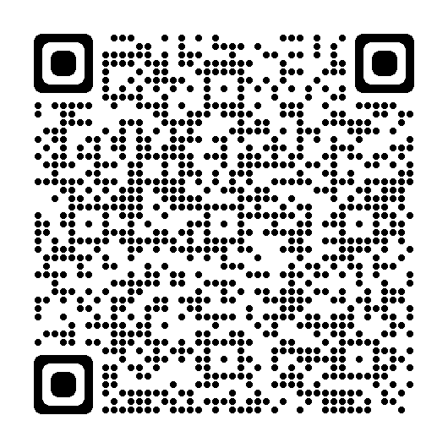
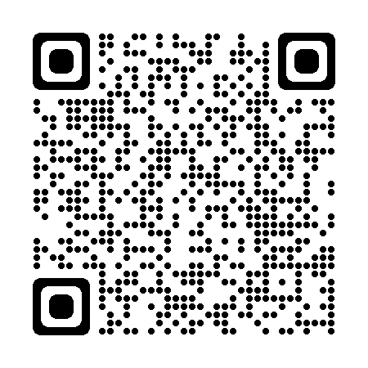
Training and Learning
Upcoming Masterclasses
7th February 2024 (12-1) | Learning from LADO cases
20th March 2024 (12-1) | Launch of MACE Strategy
17th April 2024 (12-1) | #AskMe campaign
1st May 2024 (12-1) | Counter Terrorism Police Update
5th June 2024 (12-1) | VCSE
Procedures, practice guidance and OMGs.
Training Page:
(2) NYSCP - YouTube
Notes:
A reminder to partners that you can access all of our procedures, practice guidance and one minute guides on our website and I've added the QR for you to scan for convenience. We know it can be hard to hold all the safeguarding information, but its key to remember that if you do want to find out more about a particular topic or theme the relevant and up to date e guidance will be available to you here.
Similarly I've added a link to our Training page where you can access information about all upcoming training courses available to partners. We have a masterclass coming up in February (next week) with learning from LADO cases and our March Masterclass will be focused on the launch of the new Multi Agency Child exploitation and contextual safeguarding strategy which launches to coincide with Child Exploitation Awareness day on 18th March. Please keep a look out as in March as we will be holding a series of events to support the day – with additional free masterclasses from partners looking at issues such as financial exploitation and the issue criminal exploitation and female victims. We will also be sharing dates for some upcoming MACE face to face development sessions in June.
April will see the launch of a new campaign called #Ask me – have the conversation – looking at collation of resources for all partners to continue to have safe sleep conversations with new and expectant parents.
May will see an update from North Yorkshire Police looking at counter terrorism
June we hope to hold a masterclass for VCSE partners to coincide with volunteer week – looking at sharing key safeguarding messages.
A reminder that all the masterclasses are also recorded and available on our YouTube channel for you to watch back.
We are in the process of planning our schedule of masterclasses for the rest of 2024 so if partners have anything they would like to see please get in touch.

Slide 8
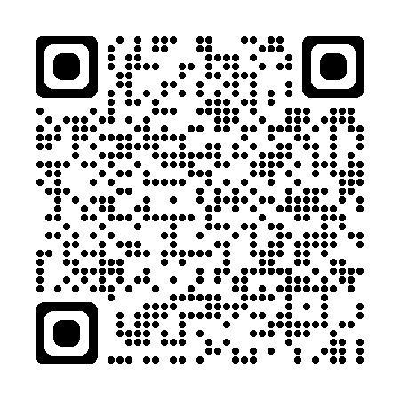






Key Links
Subscribe to our e-bulletin:
NYSCP Website: www.safeguardingchildren.co.uk
NYSCP X (Twitter): twitter.com/NYSCP1
NYSCP Facebook: facebook.com/nyscp1
NYSCP YouTube: youtube.com/@nyscp
Podcast: podcasters.spotify.com/pod/show/north-yorkshire-safeguarding-children-partnership
Linkedin: https://www.linkedin.com/company/nyscp
NYSCP Business Unit: 01609 535123 nyscp@northyorks.gov.uk
Notes:
A reminder to partners of all our key links including our social media channels, YouTube page and how you can access podcasts. Ive also included a QR code to scan to sign up to our monthly e-bulletin where we share key safeguarding updates with partners. For example in January we focused on online safety and shared key ways for partners to support children to stay safe online – especially as a lot of young people may have received new devices over the Christmas period.
Please as always continue to share key information across your teams and networks and get in touch with us if there is any further information we can provide you with.

