Slide 1
EDI data and protected characteristics
Equality and Inclusion Partnership
10 April 2024
Colin Bainbridge
Public Health Intelligence team

Slide 2
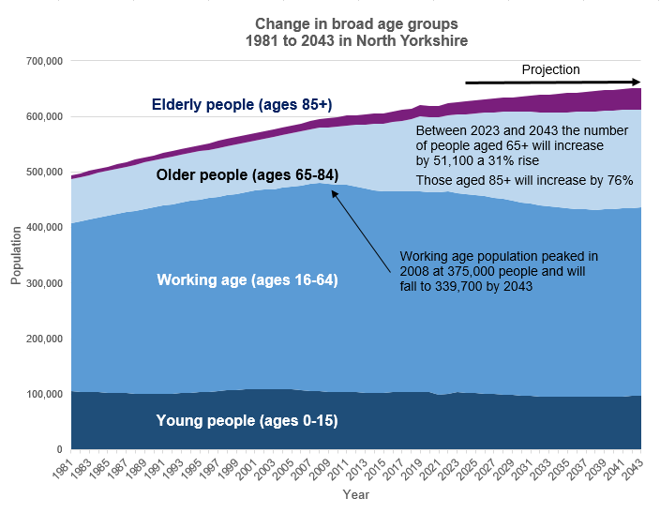
Age
Sources: 1981 & 1991 Census; Mid-year population estimates;
and 2018-based sub national population projections, ONS

Slide 3
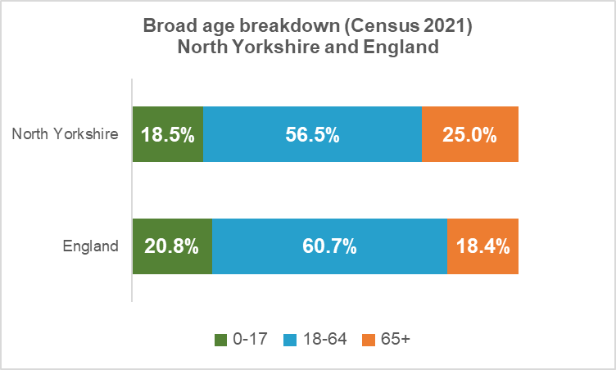
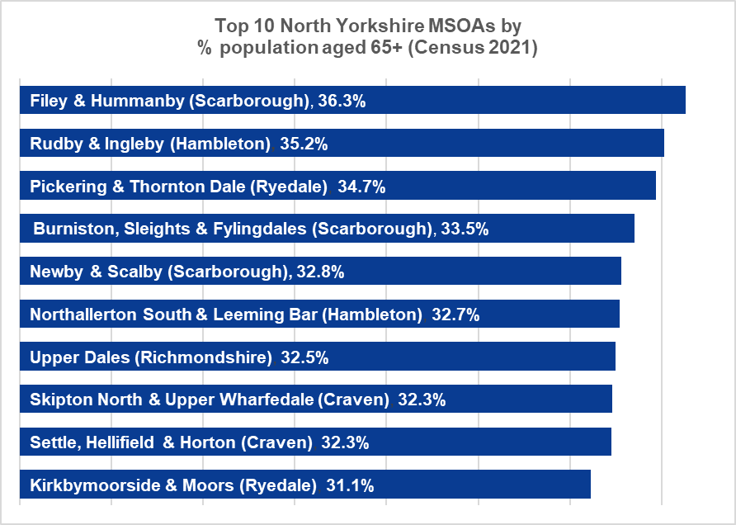
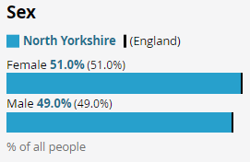
Age and sex
North Yorkshire has a lower proportion of young and working age people than the national average but a higher proportion of older people.
The Filey & Hunmanby MSOA has the highest proportion of people aged 65 and over (36.3%)
Across North Yorkshire as a whole the proportion of males and females is broadly equal.

Slide 4
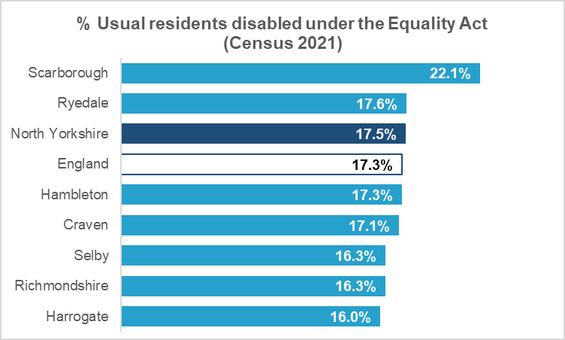
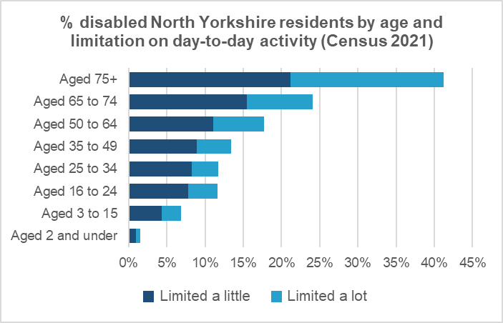
Disability
108,000 North Yorkshire residents identified as being disabled under the Equality Act in Census 2021
This equates to 17.5% of the population – close to the national average of 17.5%
Scarborough Borough had the highest proportion of disabled residents at 22.1%
The proportion of disabled people increases with age, rising from 1.5% at age 2 and under to 41.2% at ages 75+
At ages 75+ around 21% of people have their activity limited a little while a further 20% have their day-to-day activity limited a lot by disability

Slide 5
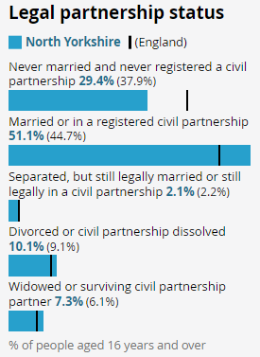
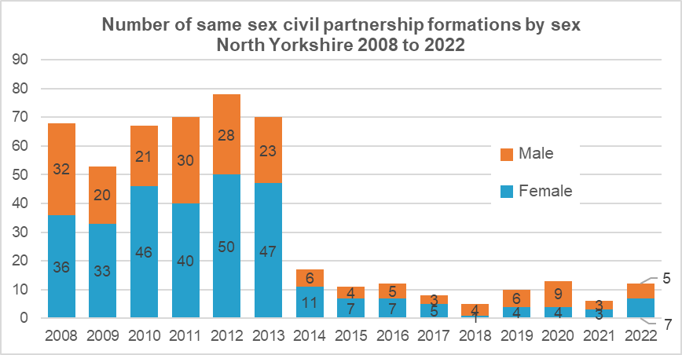
Marriage and civil partnership
Married or in a registered civil partnership made up 29.4% of the population of North Yorkshire aged 16 and above.
This was the largest legal partnership status and a larger proportion than the national average (44.7%).
The number of same sex civil partnerships have reduced from 32 male and 36 female in 2008 to 5 male and 7 female in 2022.
Source: Civil partnerships, ONS

Slide 6
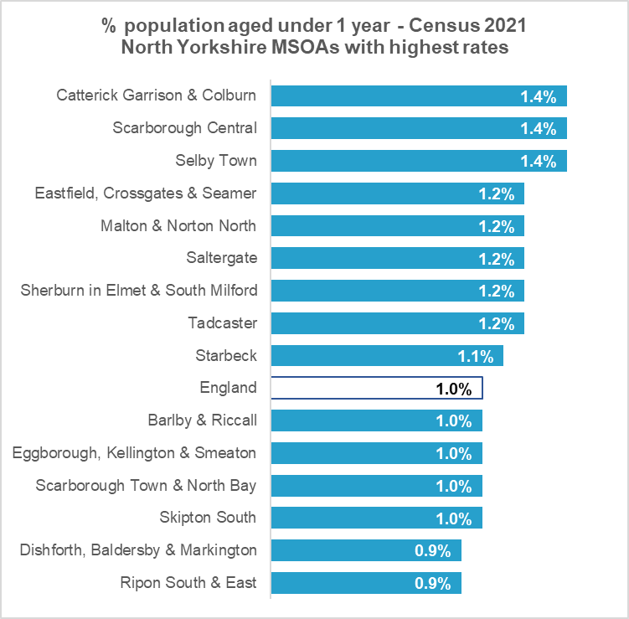
Pregnancy and maternity
No information available directly from the Census
Children aged under 1 year make up 0.8% of the North Yorkshire population – lower than the England average of 1.0%
The highest rates (of 1.4%) are in urban Middle Super Output Areas (MSOAs) in Catterick Garrisons, Scarborough and Selby towns.
Pateley Bridge & Nidd Valley has the lowest rate (0.4%)

Slide 7
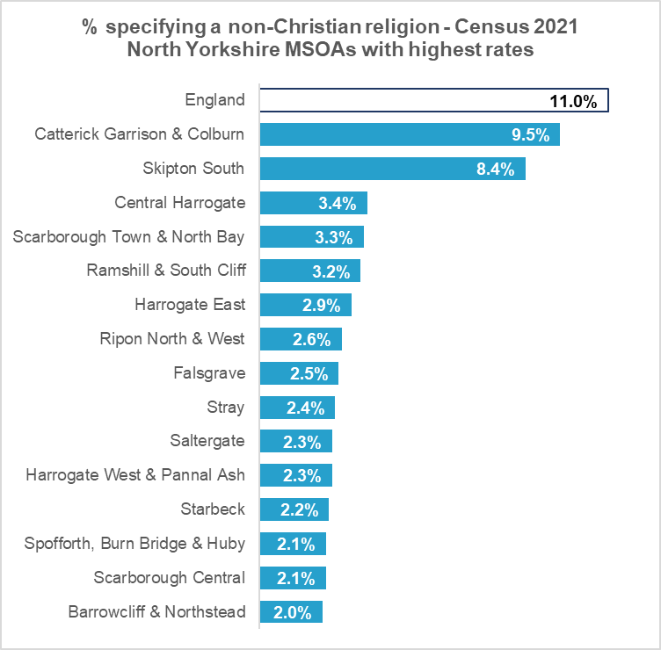
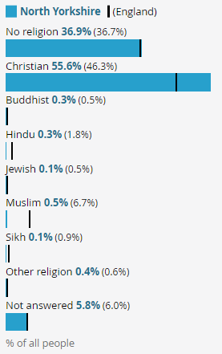
Religion and belief
55.6% of the North Yorkshire population are Christian – higher than the national average of 46.3%.
Catterick Garrison & Colburn has the highest proportion of people specifying a non-Christian religious belief (9.5%) but figures for all areas of the County are below the national average (11.0%).

Slide 8
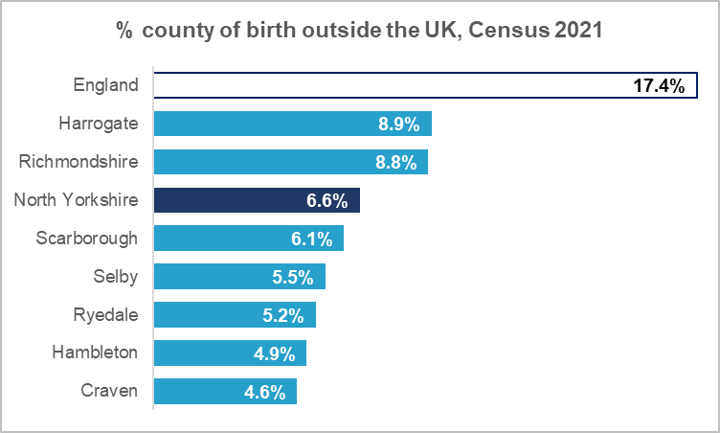
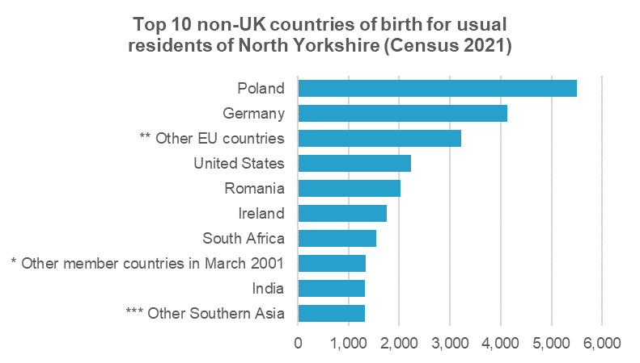
Country of birth
6.6% of the North Yorkshire population were born outside the UK – a much smaller proportion than the national average of 17.4%.
The highest rate is in Harrogate Borough, at 8.9%.
Around 5,500 North Yorkshire residents were born in Poland - the most common non-UK country of birth.
In total around 40,550 North Yorkshire residents were born outside the UK.
* 'Other member countries in March 2001' exclude Ireland, France, Germany, Italy, Portugal and Spain
** 'Other EU countries' exclude Lithuania, Poland, Romania, Croatia and other member countries in March 2001
*** 'Other Southern Asia' excludes Afghanistan, India, Pakistan, Bangladesh and Sri Lanka

Slide 9
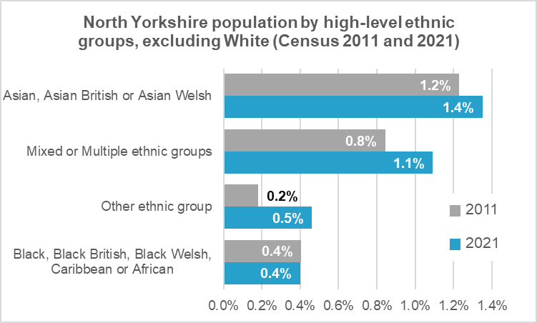
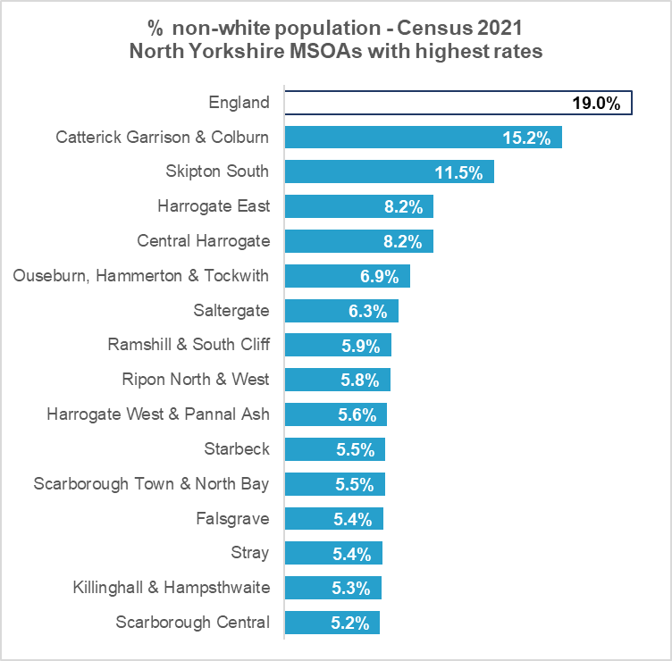
Ethnic group
Asian, Asian British or Asian Welsh make up the largest non-white ethnic group in North Yorkshire (1.4% of the population).
Catterick Garrison & Colburn MSOA has the highest proportion of non-white residents in North Yorkshire (15.2% of residents) but is well below the England average (19.0%).

Slide 10
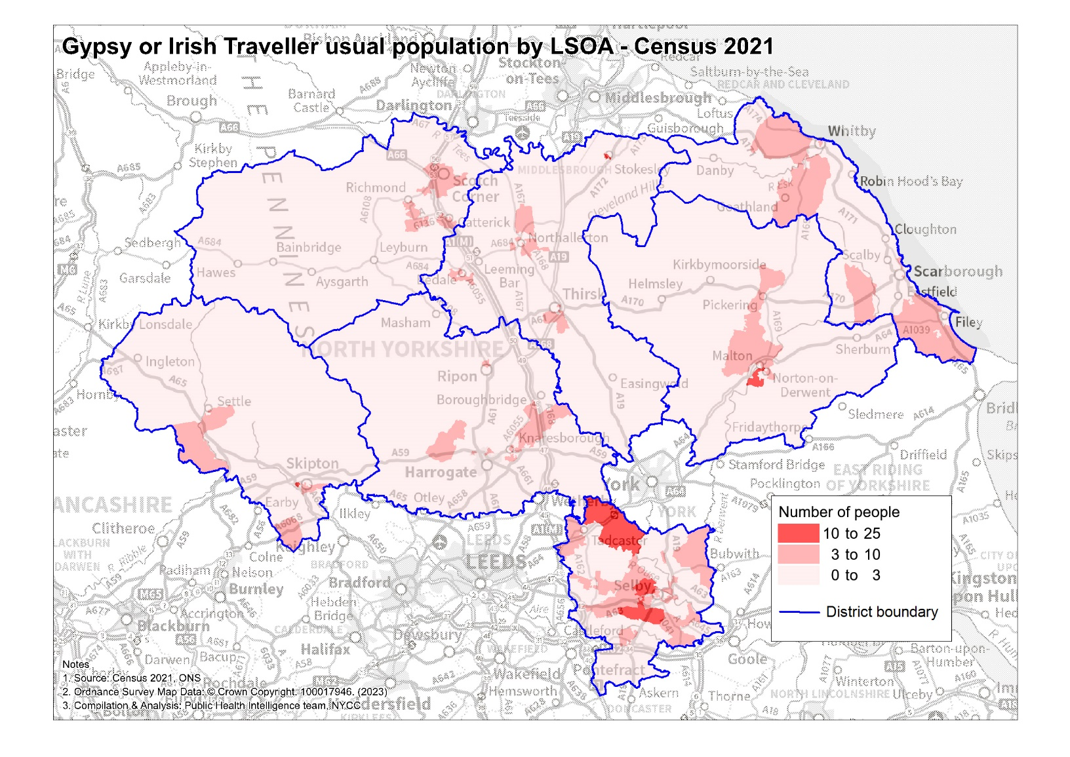
Gypsy or Irish Traveller
Note: ONS may have applied statistical disclosure control to the data, to preserve confidentiality

Slide 11
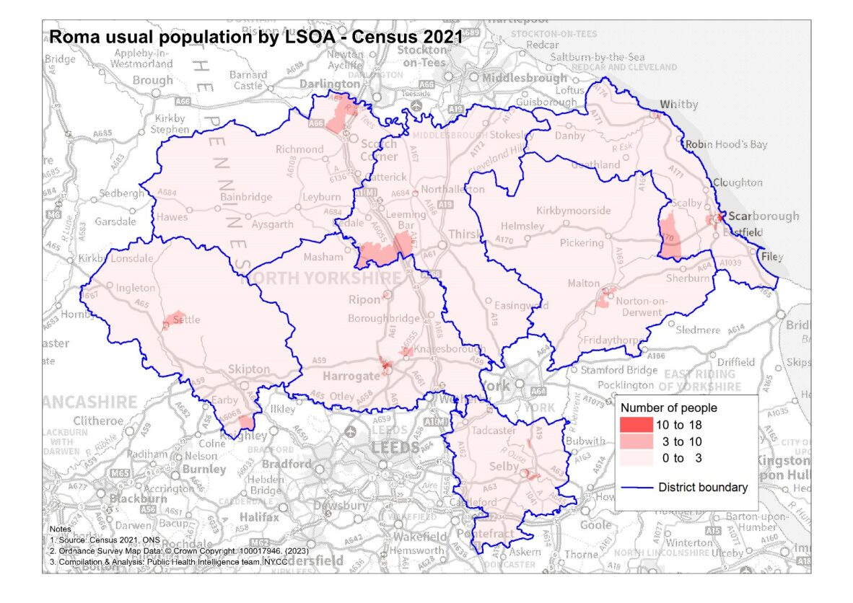
Roma population
Note: ONS may have applied statistical disclosure control to the data, to preserve confidentiality

Slide 12
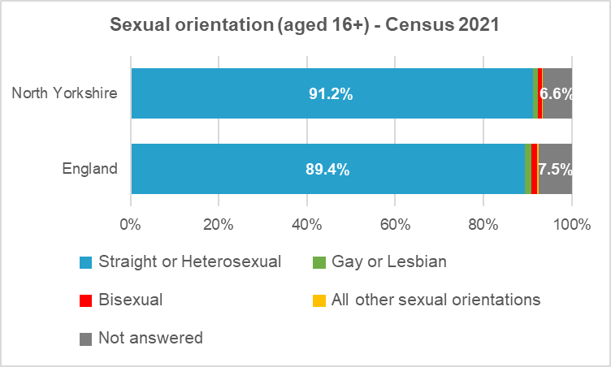
Sexual orientation
2021 was the first time that the Census had asked about sexual orientation. It was only asked of those aged 16 years and over.
6.6% of people in North Yorkshire did not answer the question (7.5% nationally).
91.2% of people in North Yorkshire answered that they were straight or heterosexual - a larger proportion than nationally (89.4%).
2.2% of people in North Yorkshire (11,290 people) identified with an LGB+ orientation compared with 3.1% nationally.

Slide 13
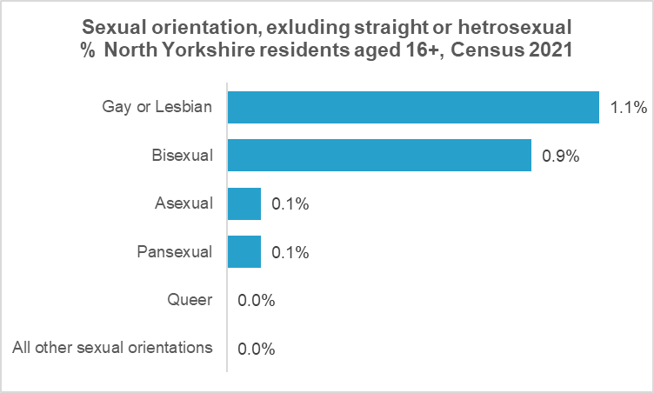
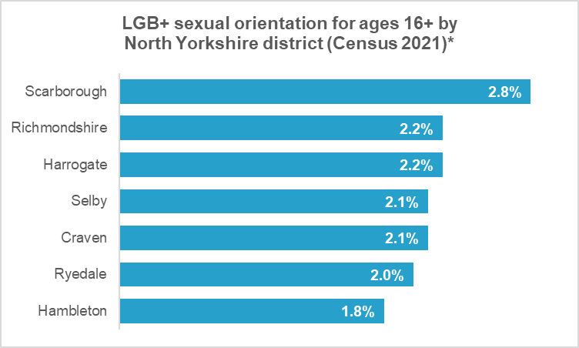
Sexual orientation
The largest LGB+ orientation in North Yorkshire was ‘gay or lesbian’ (1.1%), as it was nationally (1.5%). ‘Bisexual’ was the second largest orientation, at 0.9%, compared with 1.3% nationally.
Scarborough district had the largest proportion of people in North Yorkshire who identified with an LGB+ orientation (2.8%).
* Because the question was voluntary, there were differences in response rates between areas, so caution should be used when comparing figures for different areas.

Slide 14
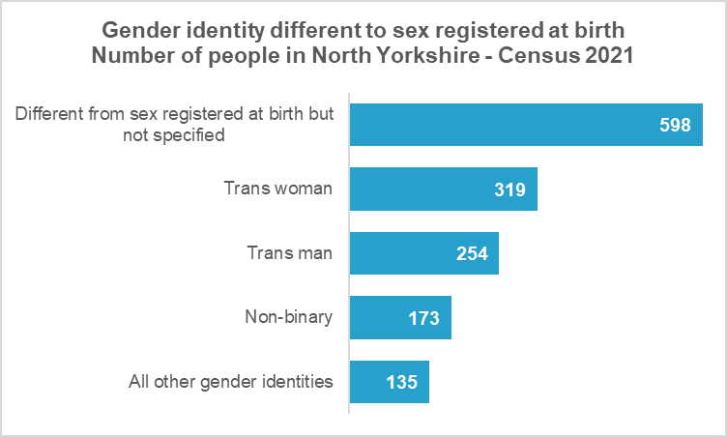
Gender identity
2021 was the first time that the Census had asked about gender identity. It was only asked of those aged 16 years and over and was a voluntary question.
5.2% of usual North Yorkshire residents aged 16 and over answered that they had a different gender identity to the sex that was registered at birth (6.5% nationally).
This equated to almost 1,500 people across North Yorkshire.
Those with a different sex but no gender identity specified made up the largest group (598 people).
Note: ONS may have applied statistical disclosure control to the data, to preserve confidentiality

Slide 15
Provision of unpaid care
Census 2021 deep dive

Slide 16
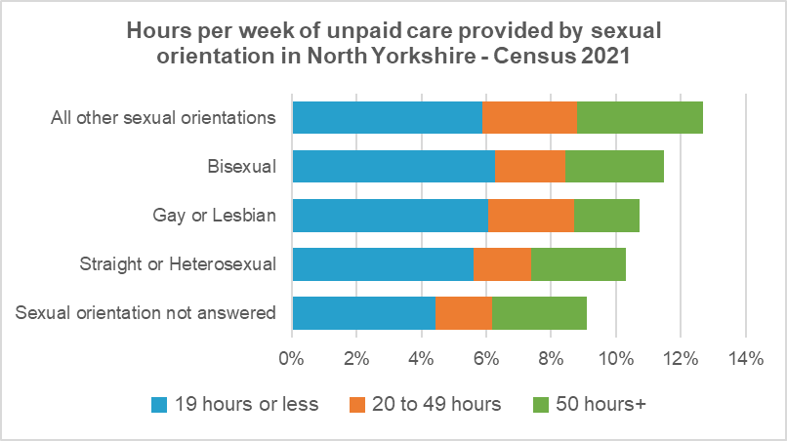
Provision of unpaid care by sexual orientation
Around 53,700 people in North Yorkshire said that they provided unpaid care in 2021 – 8.6% of the population aged 5 and over.
Data on unpaid carers by sexual orientation is only available for ages 16+ but figures for LGB+ groups are higher than for the ‘straight or heterosexual’ group.
The bisexual group provide the largest proportion of care for 19 hours or less per week (6.3% compared with 5.6% of the overall population).
Those of ‘other sexual orientations’ provide the largest proportion of care for 20 to 29 hours and 50 hours or more per week, with around 12.7% of people in this group providing some hours of unpaid care.
Note: percentages are based on small numbers in some categories and should be used with caution

Slide 17
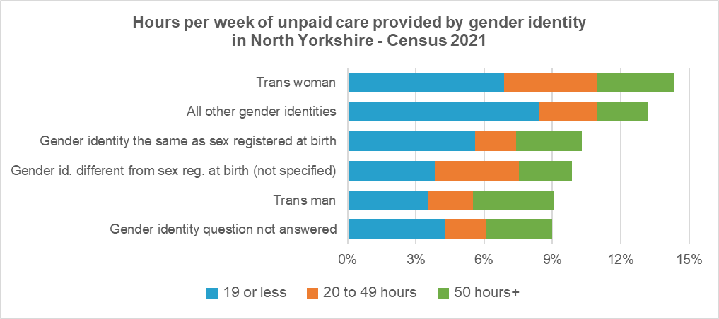
Provision of unpaid care by gender identity
The proportion of trans women providing unpaid care was the highest across all gender identities (14.4% compared with 10.2% across all gender identities).
Trans men provided the largest proportion of care for 50 hours or more per week (3.5%) – slightly higher than trans women (3.4%) and higher than across all gender identities (2.9%).
Note: percentages are based on small numbers in some categories and should be used with caution

Slide 18
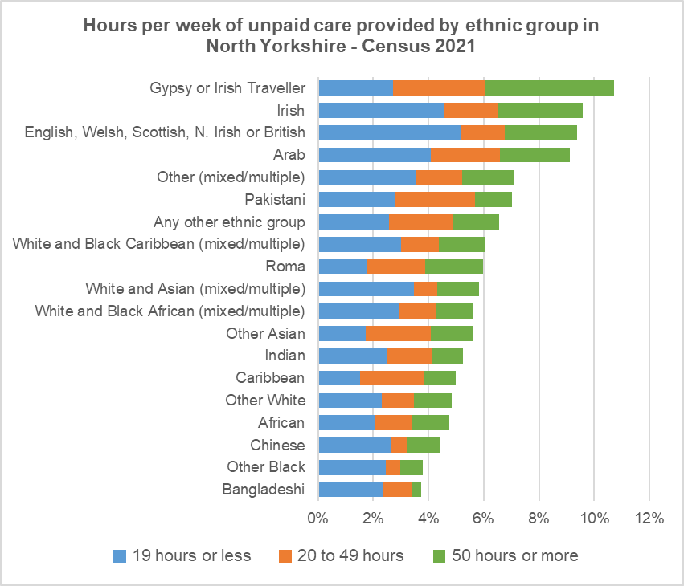
Provision of unpaid care by ethnic group
10.7% of those in the Gypsy or Irish Traveller ethnic group provide unpaid care – the largest proportion of all ethnic groups. This compared with 9.1% across all groups.
The Gypsy or Irish Traveller ethnic group also provide the largest proportion of care for 50 hours or more per week – 4.7% compared with 2.6% across all groups.
Note: percentages are based on small numbers in some categories and should be used with caution

