Slide 1




Just ‘B’
Emma Parker
Just ‘B’ Project Manager
eparker@justb.org.uk

Slide 2
About Just ‘B’
Just ‘B’ is part of an independent charity, North Yorkshire Hospice Care, a family of services which also includes Herriot Hospice Homecare and Saint Michael’s Hospice.
Just ‘B’ is a specialist bereavement support and emotional wellbeing service helping children, young people and adults across the communities of North Yorkshire, as well as offering specialist support regionally and nationally.

Slide 3
Just ‘B’ Services outside of CYP Team
Adults Service
Hear to Help
Professional support and training

Slide 4


Just ‘B’ Children and Young People Services
Bereavement Service
Schools Service
Respond Service
Our CYP Team
Safeguarding Team

Slide 5

Bereavement Service
Offering free one-to-one support sessions for young people experiencing any type of bereavement, including suicide, road traffic accident or terminal illness.
We offer an opportunity for children and young people to explore their emotions and process their grief through activity-based support and talking therapy with our trained bereavement support workers and volunteers.

Slide 6
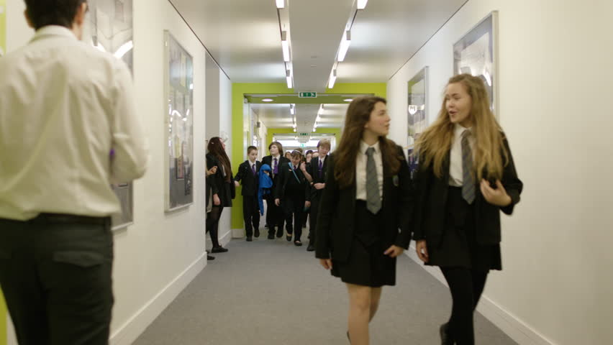
Schools Service
Offering children and young people a space to share, explore and develop an understanding of their lives and emotional responses.
Support is flexible, holistic, and integrated with other services, based on the child or young person’s needs.

Slide 7

Respond Service
Offering an immediate response to support school communities and families following the sudden death of a teacher, student or person in the community.

Slide 8
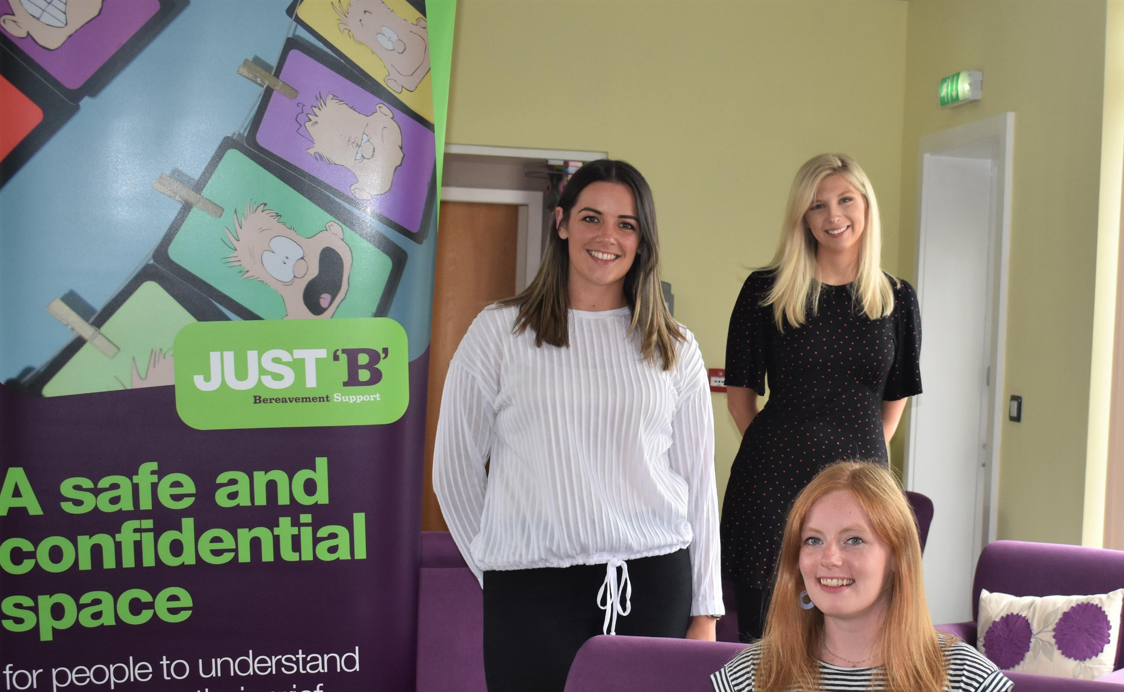
Our CYP Team
Multi-Disciplinary
Remote workers
Collaborative Working
Training Developments
Our Systems
Supervision/contact meetings

Slide 9
Safeguarding
Our Team
Pathway
Policies and Procedures
Governance

Slide 10
Any Questions
Emma Parker
Just ‘B’ Project Manager
eparker@justb.org.uk

