Slide 1
North Yorkshire Safeguarding Children Partnership
April 2024 update
Kathryn.Morrison@northyorks.gov.uk
Notes:
Welcome to the North Yorkshire Safeguarding Children Partnership LSP update for April 2024. My name is Kathryn Morrison and I am a policy and development officer in the partnership business unit.

Slide 2
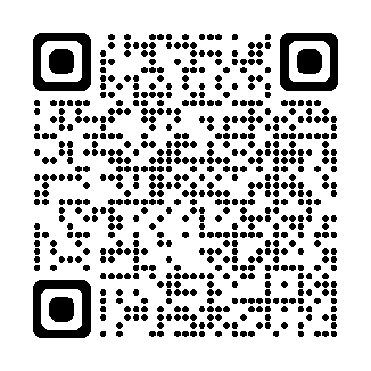
Headline updates:
Harmful Sexual Behaviour
Harmful Sexual Behaviour Audit
Multi Agency Audit – children who have been suspended or excluded from school
School safeguarding audit
Policy and OMG updates:
  Domestic abuse, Professional Curiosity, CAPVA, Snapchat, HEAT tool
7PB – Child R 91316-Child-R-7-Point-Briefing-FINAL-1.pdf (safeguardingchildren.co.uk)
Notes:
Just to give you some updates on what has been happening in the partnership over the last quarter.
Work has been ongoing in relation to a partnership audit of Harmful sexual behaviour –a launch event was held in January which explained to partners the aim of the audit – to gain a fuller understanding of the prevalence of harmful sexual behaviour in North Yorkshire in order to develop a multi agency strategy for identifying and responding to it. Audits have been sent to, and completed by partners – with the finding analysed by the NSPCC. These were shared to partners via a dissemination event on 22nd April – this session was recorded and will added to the YouTube channel for partners to access at a later date. The learning from this audit will be taken to a task and finish group who are working on the development of a new HSB strategy.
Ive added a QR code that will take you to the Be Aware page on the NYSCP website which will give you more information about harmful sexual behaviour.
A recent partnership agency audit has focused on multi agency responses to children and young people who have been suspended or excluded from school. The report is currently waiting for final publication following subgroup approval but highlighted key themes around good practice, including recognising neurodiversity, using relational based practice and strength based working as well as positive information sharing. The report recognised areas for development including considering alternative hypothesis for the behaviour of children and exploring the impact of trauma on behaviour. There was also some recommendations based on strengthening multi agency working. The report highlights in each of the 4 cases that were audited; the good practice identified by education professionals and this has been formally recognised through the NYSCP partnership awards. The full report will be available on the NYSCP website later in the spring and will be shared with partners.
The biennial mandatory NYSCP schools safeguarding audit has been complete for 2022/23 and a report has gone through the subgroup for final approval. This time the online audit completed with schools was supported by a series of face to face discussion panels with a sample of those who completed the audit to give them an opportunity to discuss their audit with panel members and provide evidence of their self assessment scores. The published full report will be available later in the spring.
There have been numerous documents reviewed by partners this quarter. Practice guidance around domestic abuse and professional curiosity (joined with adults) has been reviewed. There have also been updates to OMGs looking at CAPVA (or child adolescent to parent violence and abuse) and abuse, a snapchat professionals guide and an update to the HEAT toolkit – HEAT being home environment assessment toolkit – a tool used by practitioners to identify those families where here may be early signs of neglect so that prompt actions can be taken to address and support families to improve home conditions and safety for their children. Ive added a QR in a later slide that will take you to all the NYSCP practice guidance and OMGs.
Finally we have a new 7 PB added to the website looking at Child R and the importance of follow up when parents of young babies request advice about potential injuries. This follows the sad case of child who presented at ED with multiple limb fractures as a result of non accidental injuries – a week prior the mother had contact the midwifery helpline with concerns of a swollen limb of her baby and she advice to go to the GP or ED department but there was no evidence of mum following this advice (until a week later) – had the call been followed up help could have been sought much sooner.

Slide 3
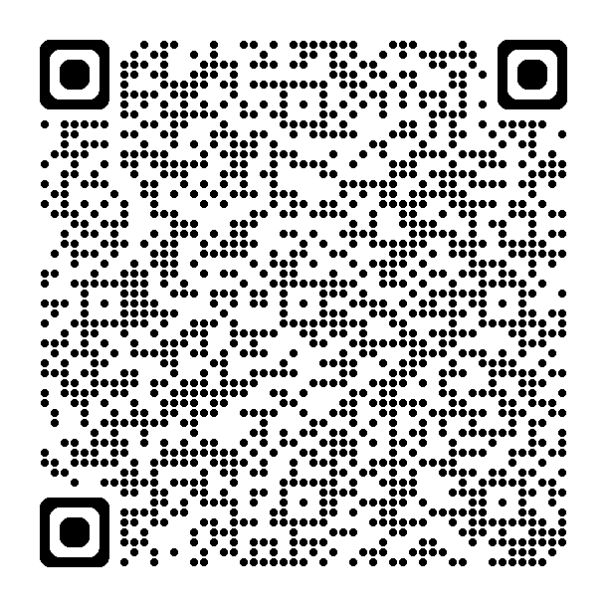

Professional Curiosity
Regular learning theme in reviews completed by partnership.
New practice guidance – produced by NYSCP, NYSAB and NYCSP
  What is professional curiosity
  Barriers to professional curiosity
  Developing skills
  Supporting professional curious practice
  Additional resources
Notes:
Professional curiosity is a regular learning point that arises from both Safeguarding Adult Reviews (SARS), Child Safeguarding Practice Reviews (CSPR) and Domestic Homicide Review (DHRs). Several recent Safeguarding Practice Reviews undertaken by the NYSCP have found that developing a deeper understanding of family dynamics by asking professionally curious questions may have led to improved outcomes for children and their families.
Professional curiosity is a practice mindset and communication skill that involves exploring and understanding what is happening by asking questions and maintaining an open mind. It is about understanding one’s own responsibility in managing risk and safety and knowing when to act, rather than making assumptions and taking things at face value.
This guidance may be used to help anyone to gain an understanding of professional curiosity, what it means in practice, and how is can be used to develop deeper and more meaningful relationships with people and develop professional practice. We have broken it down into helpful segments such as ….
Such an important learning tool – please promote among teams.

Slide 4
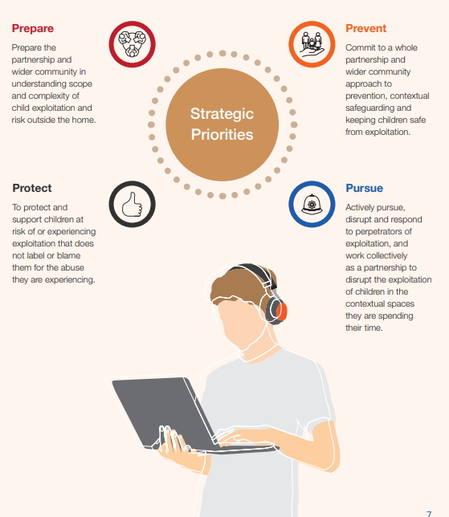
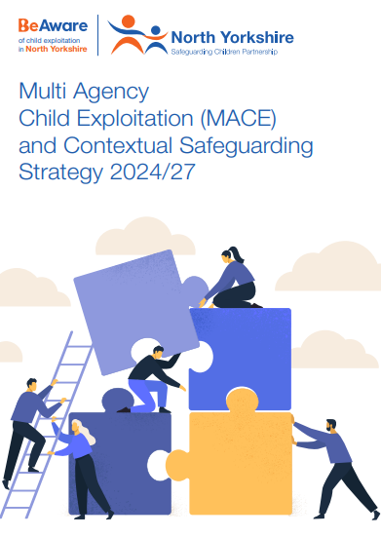
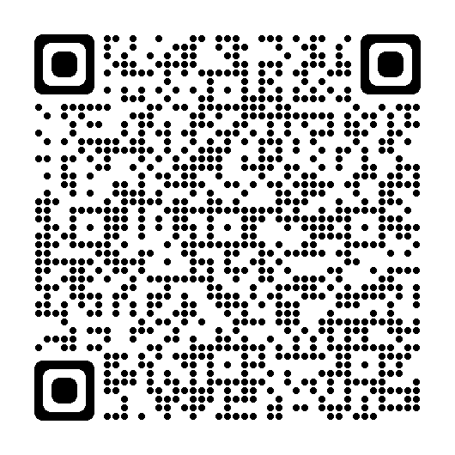
MACE Strategy
Notes:
March 2024 saw the launch of the Multi Agency and Child Exploitation and Contextual Safeguarding Strategy – the previous strategy has been reviewed by frontline and strategic partners as part of a series of consultation events and this review was used to formulate the new strategic priorities for the next 3 years –based around a 4 P plan of Prepare, Prevent, protect and Pursue
Prepare: Prepare the partnership and wider community in understanding the scope and complexity of child exploitation and risk outside the home
Prevent: Commit to a whole partnership approach to prevention, contextual safeguarding and keeping children safe from exploitation
Protect: To protect and support children at risk of or experiencing exploitation that does not label or blame them for what they are experiencing
Pursue: Actively pursue, disrupt and respond to perpetrators of exploitation and work collectively as a partnership to disrupt the exploitation of children in the places and spaces they are spending their time.
I've added the QR which will take you straight to the strategy where you will see the priorities – each supported by a series of multi agency commitments and outcomes.

Slide 5
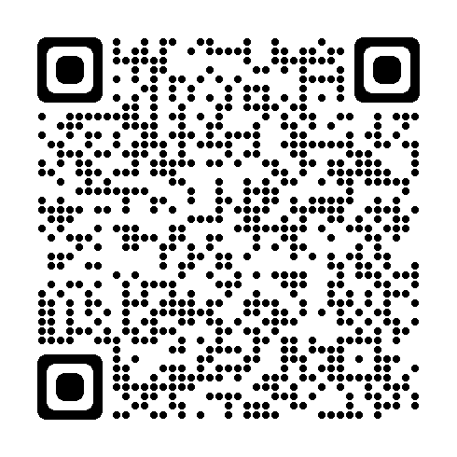
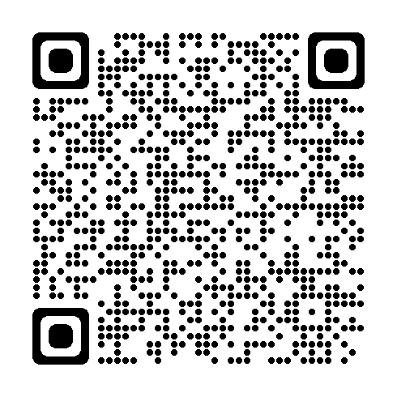

MACE updates
Child Exploitation Awareness day 2024
  Programme of online learning
  10 free online sessions
  300 attendees
  Social media campaign
Be Aware resources:
  Sexually coerced extortion
  Financial
  exploitation
Face to face
development
sessions
– June 2024
Notes:
To support National Child Exploitation Awareness Day (18th March) and the launch of the new Multi-Agency and Child Exploitation and contextual Safeguarding Strategy, MACE partners were approached to develop a programme of online learning do be delivered to partners throughout the week.
There was a positive partnership response that enabled 10 sessions to be added to the programme which were offered free to partners online across the week. Sessions included looking at criminal exploitation and girls in gangs, the work of the Ivison trust (formerly PACE) partnership disruption of exploitation, sexually coerced extortion, financial exploitation and many more.
We had an incredible 350 attendees across the week with amazing feedback of the impact and usefulness of the sessions.
We also promoted key messages through social media with 2500 people accessing posts over the week
The sessions were recorded (or in some cases where recording was not possible the slides have been saved) so you can continue to access these resources: See the QR for more details
We’ve also updated some resources on the BeAware website: firstly we have guidance and resources on sexually coerced exploitation: a serious form of blackmail that involves the exploitation of nude, explicit or sensitive images or videos to coerce victims into unwanted actions such as sharing further explicit imagery or paying to prevent further sharing.
Alongside this we have added resources on financial exploitation : a new and evolving form of exploitation, it involves criminals approaching children and young people online through gaming and social media platforms, and in places like shops and cashpoints with offers of quick cash and fake job opportunities, only to use and control their bank accounts to commit fraud and launder money from organised crime.
Check out the pages for more information.
Don’t forget we have some face to face MACE development sessions across the county in June 2024 – a fantastic opportunity to meet with partners in locality areas face to face to develop professional relationships and focus thinking on locality tackling of exploitation – please contact me for more details.

Slide 6



#AskMe…Have the conversation
Masterclass 17th April 2024 – Available via the NYSCP YouTube Channel
Campaign aimed at professionals across North Yorkshire
Encouraging conversations with new and expectant parents
Collation of key resources and information alongside conversation starters.
  Safe sleep
  Icon
  Mental health
  Information for dads
Notes:
Leads us onto the #AskMe Have the conversation campaign This is a campaign aimed at professionals across North Yorkshire to encourage them to have conversations with new and expectant parents about how they are feeling about a number of aspects of having and caring for a baby. The key messages are derived from a series of common things that are often a concern to new parents and have been developed in conjunction with the learning identified from our recently commissioned thematic review identifying learning from three similar cases of non-accidental injury to non-mobile infants.
The campaign is not designed to replace any of the work already undertaken through NYSCP including the work around SUDI, ICON or the resources accessible through the Lullaby Trust. It aims to raise awareness with frontline practitioners of the need to ask parents how they are feeling around aspects of caring for their baby in those crucial first few months of life. The campaign recognises that the arrival of a new baby is a big life changing event, and it can be hard for new parents to share with professionals that they are struggling. It is therefore crucial that frontline practitioners have the confidence to explore with new and expectant parents how they are feeling and how they are coping with these changes.
The campaign was launched with a social media presence throughout that week and a masterclass delivered by the 2 designated safeguarding nurses highlighting learning from recent thematic reviews that have lead to the production of the campaign. For those who miss/unable to attend the masterclass it will be available on the YouTube channel. We encourage the promotion of the social media resources and use of the website – follow the QR
– professional based campaign encouraging conversation – not just about delivering the message. Giving parents an opportunity to talk about their worries and professionals being curious about the lives of the people they are supporting
Collation of key resources – safe sleep (e.g. linked to the Day or Night Sleep right campaign) and national resources e.g lullaby trust and the ICON work
Masterclass on Wednesday – nearly 100 attended – very good feedback – focus group to measure impact in 3 months

Slide 7
VCSE – Key Safeguarding Messages
'Safeguarding Key Messages' campaign was proposed to include:​
Posters​
Information leaflets​
Social media assets to be ‘evergreen’​
These resources would be consolidated on one page on the NYSCP website for easy access​
The campaign is designed for professional and volunteer information and is not a public facing campaign​
Masterclass
7th June 12:00
Notes:
To make you aware of an additional campaign launching in June for volunteers week. A task and finish group was established with VCSE partners to establish communication links between the VCSE and the wider partnership with regards to safeguarding messages
Consultation with VCSE partners – key feedback – ensure there is an understanding of how VCSE partners interact with and receive safeguarding information. Importance of regular and concise information (not overwhelming). Acknowledgement that it is not about making everyone experts but making people aware of key things and where to access further information.
Campaign has been developed…
Masterclass 7th June - Launch of the safeguarding key messages campaign produced by the voluntary, community and social enterprise sector. The session will be delivered by VCSE partners and will be an overview and understanding of safeguarding the VCSE community and how they can work in partnership with other.

Slide 8
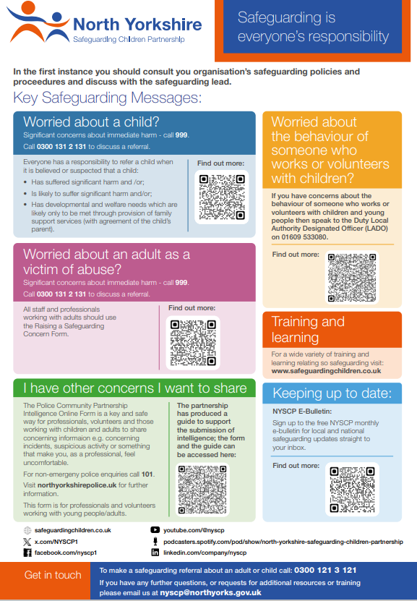
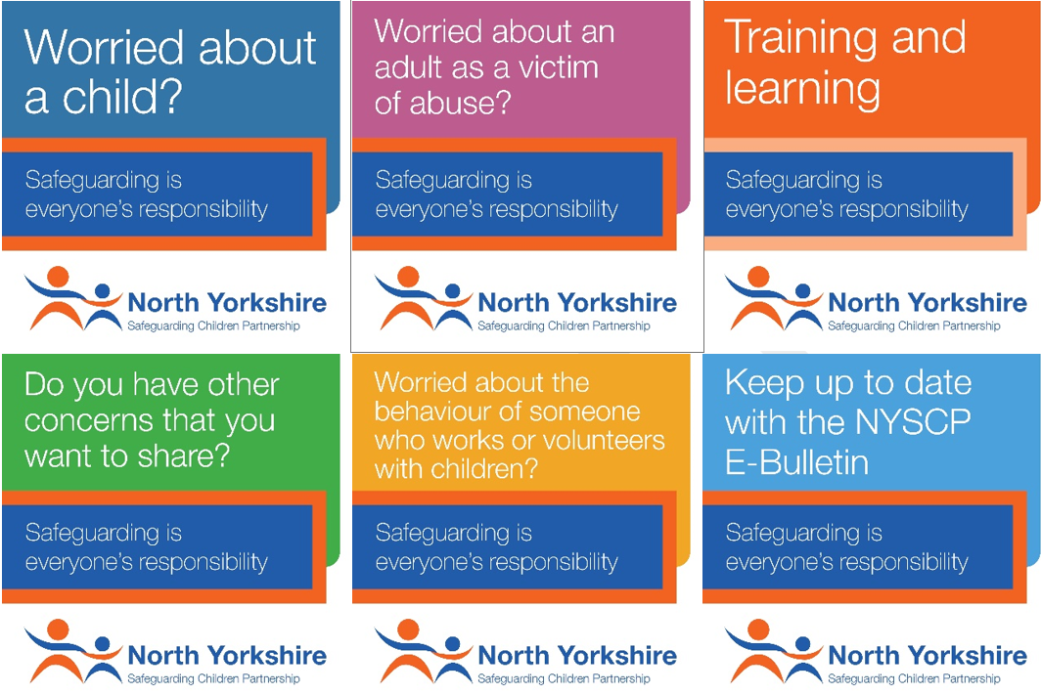
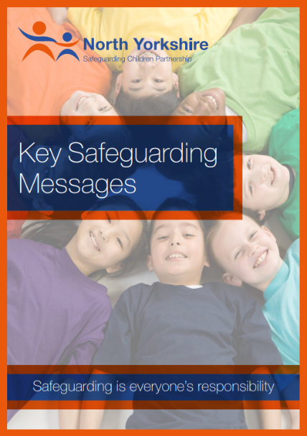
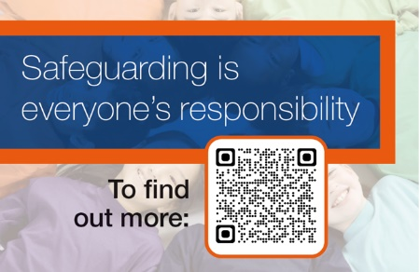
Resources
Poster
Social Media
Booklet
Lanyard/Business Card

Slide 9
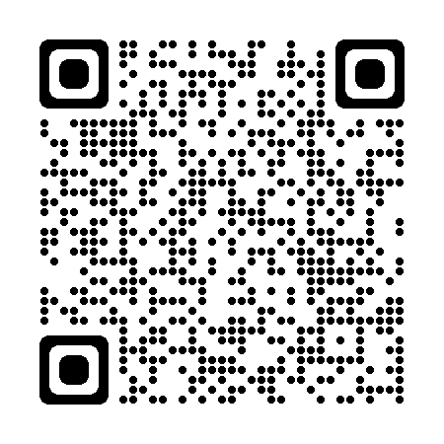
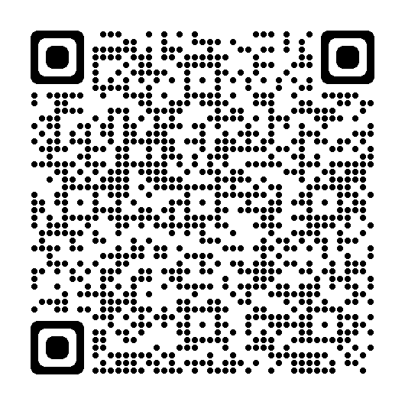
Training and Learning
Procedures, practice guidance and OMGs.
Training Page:
Notes:
A reminder to partners that you can access all of our procedures, practice guidance and one minute guides on our website and I've added the QR for you to scan for convenience. We know it can be hard to hold all the safeguarding information, but its key to remember that if you do want to find out more about a particular topic or theme the relevant and up to date e guidance will be available to you here.
Similarly I've added a link to our Training page where you can access information about all upcoming training courses available to partners.
Upcoming masterclasses –Our next masterclass will now be in June and will be the Launch of the safeguarding key messages campaign produced by the voluntary, community and social enterprise sector. The session will be delivered by VCSE partners and will be an overview and understanding of safeguarding the VCSE community and how they can work in partnership with other.
Later in the year we will look to hold sessions exploring learning from partnership case reviews and audits, the Home Environment Assessment Tool, and professional curiosity. As always please do get in touch if there are any further topics you would like us to consider.

Slide 10
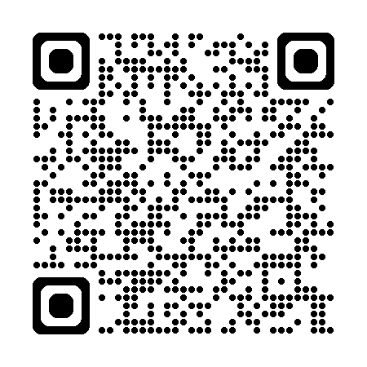

Safeguarding week
Notes:
A reminder to partners that Safeguarding week is in June (17th 21st) with a focus on safeguarding being everyone's responsibility.
A task and finish group is currently putting an agenda of safeguarding training and activities in place for the week. If there are any ideas you would like to be covered as part of the programme please get in touch.
The QR takes you to the North Yorkshire adult safeguarding board page – where the programme will be released in due course.

Slide 11
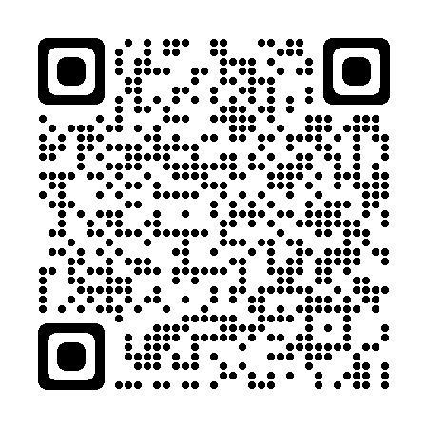






Key Links
Subscribe to our e-bulletin:
NYSCP Website: www.safeguardingchildren.co.uk
NYSCP X (Twitter): twitter.com/NYSCP1
NYSCP Facebook: facebook.com/nyscp1
NYSCP YouTube: youtube.com/@nyscp
Podcast: podcasters.spotify.com/pod/show/north-yorkshire-safeguarding-children-partnership
Linkedin: https://www.linkedin.com/company/nyscp
NYSCP Business Unit: 01609 535123 nyscp@northyorks.gov.uk
Notes:
A reminder to partners of all our key links including our social media channels, YouTube page and how you can access podcasts. Ive also included a QR code to scan to sign up to our monthly e-bulletin where we share key safeguarding updates with partners. For example in January we focused on online safety and shared key ways for partners to support children to stay safe online – especially as a lot of young people may have received new devices over the Christmas period.
Please as always continue to share key information across your teams and networks and get in touch with us if there is any further information we can provide you with.

