Slide 1
North Yorkshire Safeguarding Children Partnership
September 2024
Kathryn.Morrison@northyorks.gov.uk
Notes:
Welcome to the North Yorkshire Safeguarding Children Partnership LSP update for February 2024. My name is Kathryn Morrison and I am a policy and development officer in the partnership business unit.

Slide 2
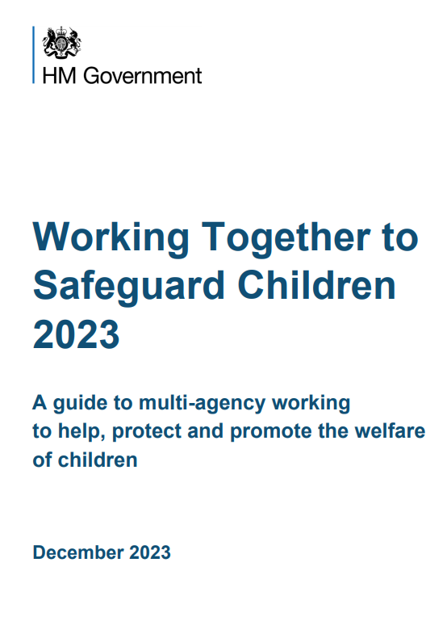
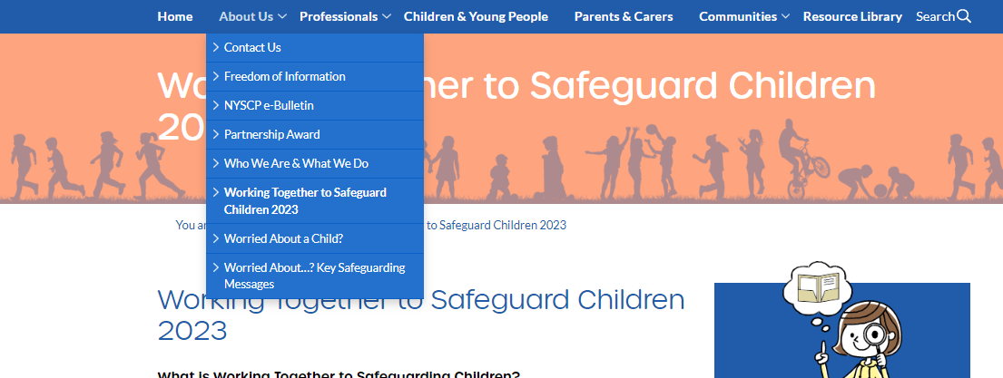
Working Together to Safeguard Children
Headlines
Working Together to Safeguard Children
  Monthly Operational T&F group
  Webpage
  Documents review
  OMG for professionals and Parent/carers
  Learning event – 4th December 2024
Notes:
There continues to be monthly meetings with operational partners to look at the implementation of changes to the Working Together Document. A reminder that these need to be reported on nationally to the DFE alongside a copy of the updated Multi agency safeguarding arrangements in December 2024.
All the information in relation to the changes has been collated on the NYSCP webpage (easily accessible in the ‘about us’ drop down – to share with teams and wider workforce – this includes what WT is, why it's important in all our roles, a summary of the changes and what the changes mean in North Yorkshire and for individual practice. There are OMGs accessible for professionals and parents and carers as well as a recorded briefing of the changes. A reminder that this will all be presented in a learning event (alongside partner updates) on 4th December.
The business unit are currently working through all the NYSCP documents (OMGs and Practice guidance) to ensure it is in line with the WT changes – at the bottom of every page now we have included the date it is reviewed so you if you have the most up to date version – a reminder to encourage partners to access the documents via the weblink rather than saving a document to their own files which could become outdated.

Slide 3
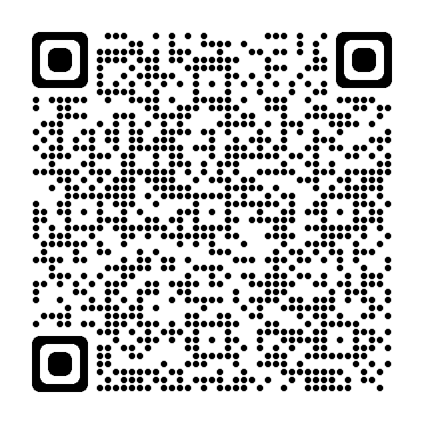
Document Reviews
For Awareness
Professional Curiosity
Managing Different Professional Perspectives
Multi Agency Deep Dive Audit One Minute Guide
Stalking Protection Orders One Minute Guide
County Lines, Cross Border Gangs and Cuckooing One Minute Guide
Dangerous Dogs One Minute Guide
Stronger Relationships , Practice Guidance
Reducing Parental Conflict – A guide for professionals
Reducing Parental Conflict – A guide for parents
LADO, Managing Allegations One Minute Guide , Whistleblowing Practice Guidance
**TriX**
Notes:
As already mentioned, the BY have been working through the review of all documents in light of the changes to WT – there are some where minimal changes have been made e.g. changes to reference documents, terminology ect. But there are some where more significant reviews/changes have been made. Linked above.
TriX: Partner are reminded that alongside the North Yorkshire centric practice guidance, the partnership also work with Tri X who provide national practice guidance that is relevant to North Yorkshire Practice. All of this is clearly marked on the NYSCP professionals page NYSCP (safeguardingchildren.co.uk), but can also be accessed via Tri X:

Slide 4
Strategy Updates
Harmful Sexual Behaviour
Early Help & Being Young in North Yorkshire (BYinNY) Consultation Events
Consultation events – around 100 attendees' partnership wide
Partner contributions to both strategies
Identification of good practice and family perspectives to feed into inform the new strategies
Findings being collated and trends identified by the NYSCP Business Unit
Presentation to Executive Board - BYinNY – January 2025 and Early Help March 2025
NSPCC Audit Completed
Audit findings disseminated to partners; findings have shaped the HSB strategy
Monthly T&F groups ongoing
Emphasis on partners understanding what HSB is / isn’t and responding to developmentally appropriate and HSB’s
A shared approach and language to HSB
Recognition of on and offline behaviours
CYPS Senior Leadership ongoing discussions with Professor Hackett as a critical friend
Notes:
EH & BYinNY
Attendees showed an appetite in wanting to be involved in the consultation process, with strong attendance from colleagues across the three separate consultation events. There was attendance from all three statutory partners, from senior leadership to frontline practitioners as well as representatives from the education sector (early years to FE), and VCSE organisations. Events were planned at different times of the day to ensure that partners had the opportunity to attend – questions were circulated in advance of the sessions and discussions facilitated in break out groups. The events provided insight into current use of the strategies and how they are understood by practitioners as well as how they impact families.
From partner feedback clear themes have emerged and the strategies for both BYinNY and EH are ongoing with the understanding that they will be underpinned by the feedback received and a vision to develop a trauma informed approach and way of working. The strategies will provide a framework in which practitioners can support children ,young people, and their families. Both and all future strategies will share the same consistent language and approaches, however each with their own strategic areas of focus.
HSB
The partnership executive has made it a strategic priority to better understand the issues surrounding Harmful Sexual Behaviour (HSB) among children and young people in North Yorkshire. An audit commissioned by the NSPCC and funded by the Community Fund from the OPFCC has been completed. The findings from this audit have been disseminated among partners and are informing the development of the strategy.
The strategy is built upon the foundations of the Being Young in North Yorkshire Strategy and follows the principals of using the same consistent language (as mentioned previously) with a focus on a partnership approach to understand sexualised behaviour in children and young people, what is developmentally appropriate and what is deemed as harmful. Documentation and support materials will be clear in their message that all sexualised activity requires a response; however, it needs to be understood that behaviours are part of a continuum, and the appropriate actions are required. Support information will help practitioners with usable information and support.
We are currently developing new materials for a dedicated and soon-to-be-updated specialist section of the NYSCP website, which will include a One Minute Guide linking to a support toolkit for practitioners. There is a recognition that there are increasing worries about online sexualised behaviours and how virtual and real lives can overlap becoming undisguisable for some young people. The strategy considers this as will the actions arising from it.
Discussions with the steering group lead and CYPS leadership are ongoing in respect of endorsement and involvement from prof S Hackett as a critical friend and partner. With the opportunity of CFS becoming involved in a pilot scheme for a new HSB continuum. These discussions are ongoing with the CFS strategic lead (SW), CYPS leadership (MH) and Prof Hackett.
The strategy is due for presentation at the Executive board in early 2025.

Slide 5
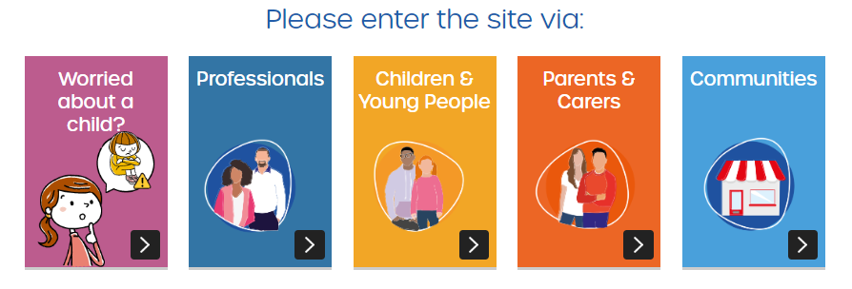
Website update:
Notes:
Website updates: Link to walk through of website
Over the summer period the business unit have taken time to review the content and structure of the NYSCP website and have made changes to improve accessibility and navigation across the site.
Homepage:
The homepage has been simplified with clear entry links for professionals, children and young people, parents and carers and community members. Quick links to useful forms have also been added to the homepage for ease.
An additional page has been added with information for Schools and Early Years Professionals NYSCP (safeguardingchildren.co.uk).
A consolidation of all LADO resources has also been added to the drop-down menu for ease of access. NYSCP (safeguardingchildren.co.uk)
The Strength in Relationships Practice Model page has all been reviewed. NYSCP (safeguardingchildren.co.uk)
Children & Young People Page:
The information has been consolidated to one, easy access, page for children and young people with clear topics and links to keeping safe.
This page will be reviewed by the OPFCC Youth Forum in September 2024
Parents and Carers Page:
All information has been consolidated onto one page with clear links to further support or information around key safeguarding areas.
This page will be reviewed by the CFS parents with lived experience group in September 2024.
Communities Page:
This is a new page with key information for communities in relation to safeguarding children.
Welcome feedback – any further information e.g. links to communities pages.

Slide 6




Who’s in Charge
Notes:
York and North Yorkshire’s safeguarding partnerships are raising awareness of who’s in charge when you’ve had drink or drugs?
In 2020, 80 pedestrians were killed or seriously injured by drink drivers. 20 children (0-15) were killed or seriously injured by drink drivers that year.
The campaign also highlights safe sleeping and the affects that alcohol and drugs have on your body and how drinking alcohol and drug use may make you less aware of your child’s needs.
Below are images and text that can be shared via social media platforms:

Slide 7
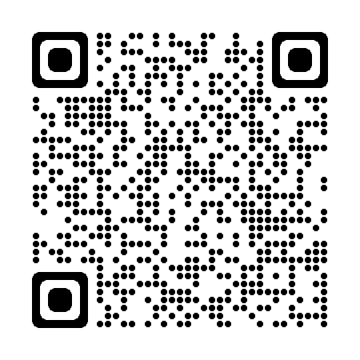
Training and Learning
Upcoming Learning Session
11th September (12-1) | Business Unit Updates
2nd October (12-1) | Young People and Vaping
6th November (12-1) | Professional Curiosity and Managing Different Professional Perspectives
4th December (12-2) | Working Together 2023; Partnership Updates
Procedures, practice guidance and OMGs.
Training Page:
(2) NYSCP - YouTube
Notes:
A reminder to partners that you can access all of our procedures, practice guidance and one minute guides on our website and I've added the QR for you to scan for convenience. We know it can be hard to hold all the safeguarding information, but its key to remember that if you do want to find out more about a particular topic or theme the relevant and up to date e guidance will be available to you here.
Similarly, I've added a link to our Training page where you can access information about all upcoming training courses available to partners.
A reminder that all the masterclasses are also recorded and available on our YouTube channel for you to watch back.
We are in the process of planning our schedule of masterclasses for the rest of 2025 so if partners have anything they would like to see please get in touch.
* Just a note – are moving away from calling the sessions “masterclasses” so if you are struggling to find the course vis NYES – search for NYSCP and they all come up.

Slide 8
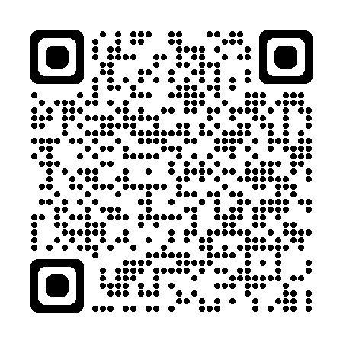






Key Links
Subscribe to our e-bulletin:
NYSCP Website: www.safeguardingchildren.co.uk
NYSCP X (Twitter): twitter.com/NYSCP1
NYSCP Facebook: facebook.com/nyscp1
NYSCP YouTube: youtube.com/@nyscp
Podcast: podcasters.spotify.com/pod/show/north-yorkshire-safeguarding-children-partnership
Linkedin: https://www.linkedin.com/company/nyscp
NYSCP Business Unit: 01609 535123 nyscp@northyorks.gov.uk
Notes:
A reminder to partners of all our key links including our social media channels, YouTube page and how you can access podcasts. Ive also included a QR code to scan to sign up to our monthly e-bulletin where we share key safeguarding updates with partners. For example in January we focused on online safety and shared key ways for partners to support children to stay safe online – especially as a lot of young people may have received new devices over the Christmas period.
Please as always continue to share key information across your teams and networks and get in touch with us if there is any further information we can provide you with.

