Slide 1
North Yorkshire Children and Young People’s Partnership meeting
September 2023
Shona Goudie

Slide 2

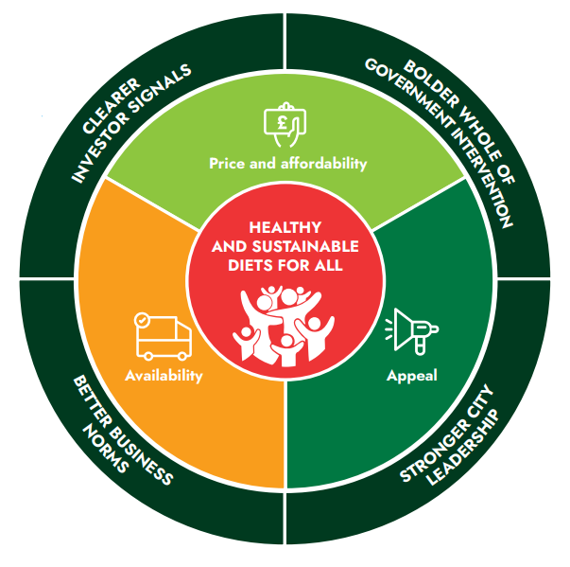
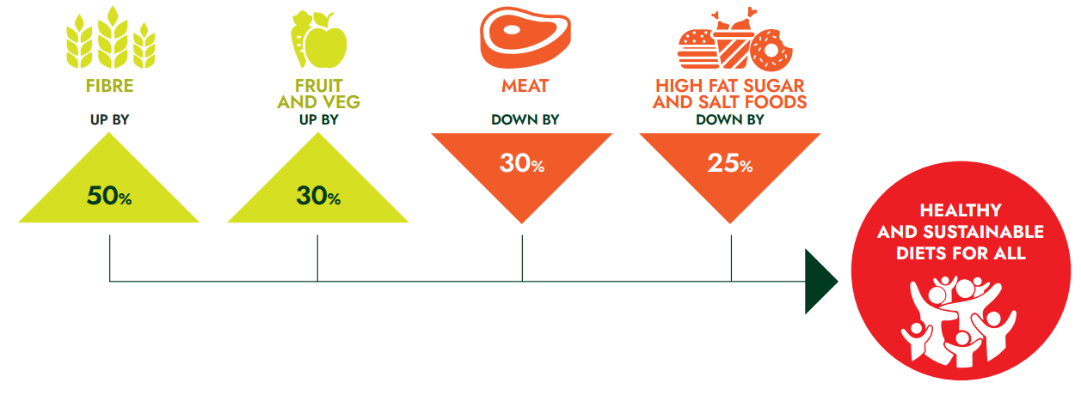
The Food Foundation

Slide 3


Slide 4
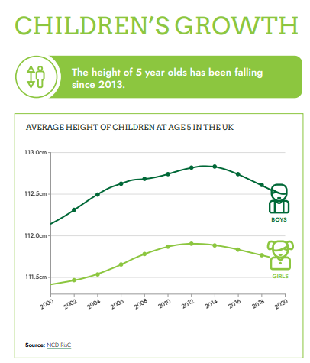
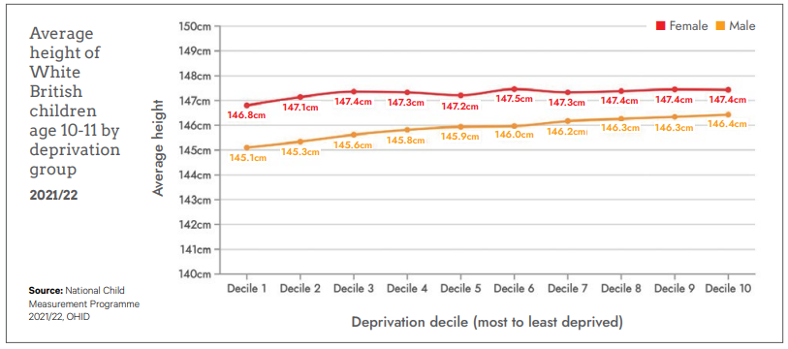

Slide 5
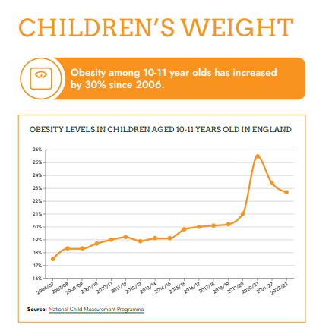
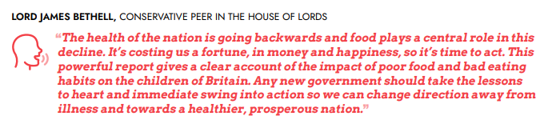
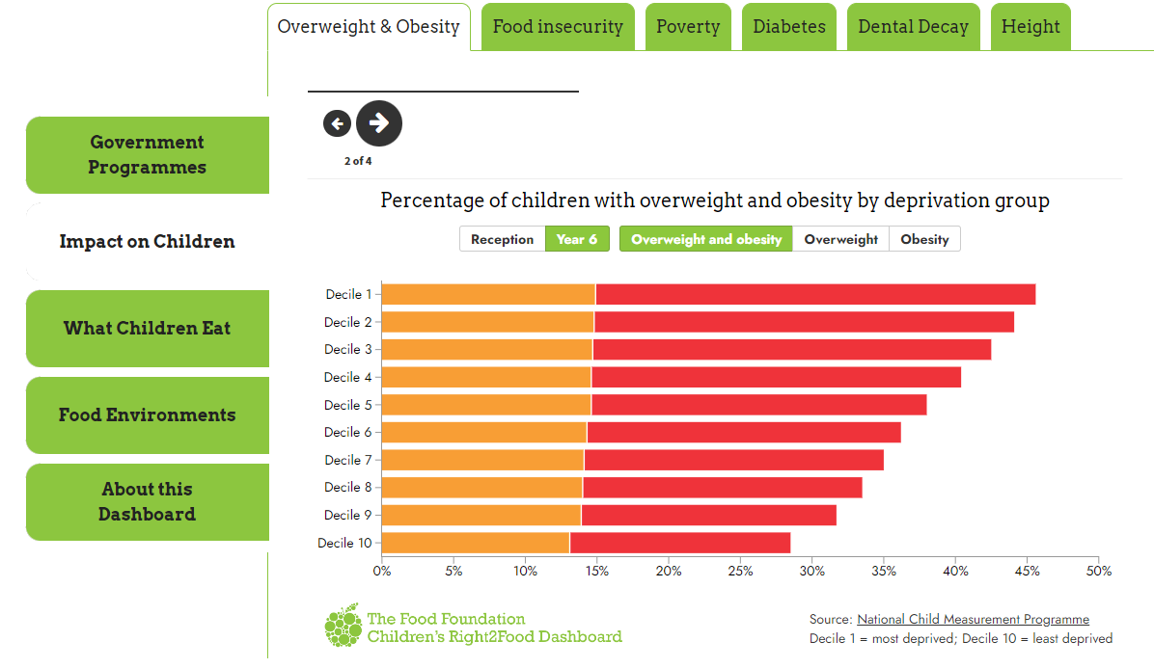

Slide 6

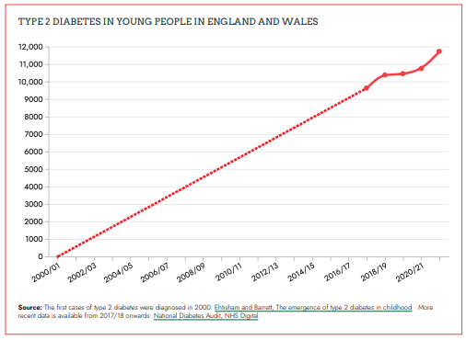

Slide 7

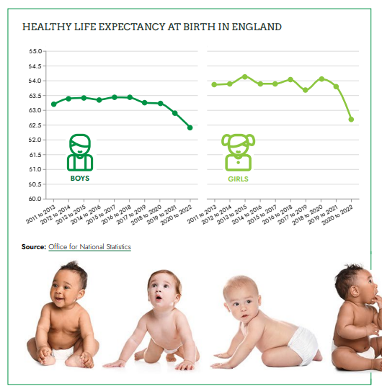
GORDON BROWN, FORMER PRIME MINISTER “When the height of 5 year olds has been falling since 2013, and we’re learning babies born today will enjoy a year less good health than babies born a decade ago, every mother and father in the land will be concerned and shocked at what is happening to children through lack of nutrition living through the hungry 2020s in food bank Britain.”

Slide 8
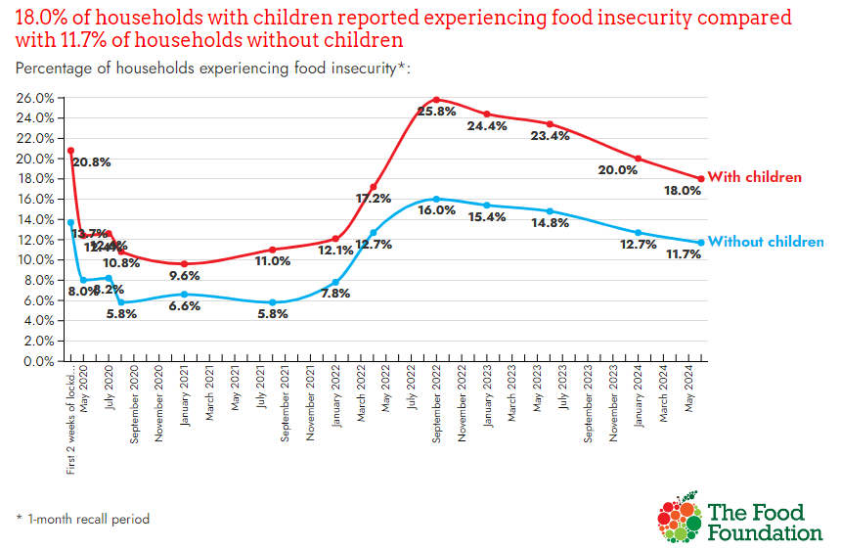

Slide 9
https://foodfoundation.org.uk/publication/broken-plate-2022

Slide 10



Slide 11
shona.goudie@foodfoundation.org.uk

