Slide 1
NYC and VCSE -Working together to improve mental health and wellbeing in NY for our working age population, now and in the future

Slide 2
Why:
To improve and protect the mental health and wellbeing of North Yorkshire’s working age population so that they thrive within their communities
Explore what North Yorkshire Council and the VCSE are doing to support mental health and wellbeing in North Yorkshire communities
Explore opportunities as to how and where we can work better together

Slide 3
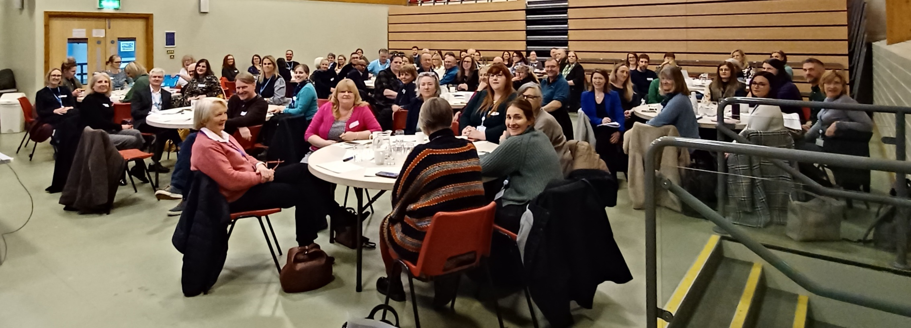
What has happened to date:
Initial NYC/VCSE ‘coming together’ workshop event – March 2024
Worked together to learn from each other and discuss the strengths, gaps and opportunities within our sectors

Slide 4
Healthwatch reminded us who we were there for and why
Person centred approach
Stigma
Crisis support
Accessible information
Consistent
support
Family, friends
& carers
Early intervention
Notes:
Ashley
Then hand over to Richard

Slide 5
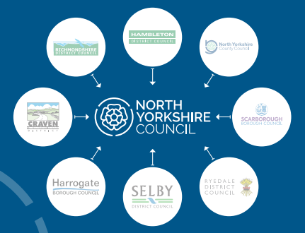
Creating the new Council for North Yorkshire
Getting to day 1 of the new Council
The first 100 and 1000 days
3, 5, 10 year transformation
1st April 2024: Happy 1st Birthday, NYC!
Notes:
Getting to day 1:
New Council created 1st April 2023 from 7 former DCs/BCs and NYCC
Serves the whole of North Yorkshire (615,000 residents and nearly 33,000 businesses) providing diverse local government services
Key Central Government requirement from to pave the way for new North Yorkshire & York Mayoral Combined Authority
First 100 / 1000 days
Nearly 1 year old! Focus in year 1 on service convergence and getting single teams in place
5 – 10 year transformation journey
Key opportunities relating to MH – housing, leisure review, locality working/community anchors as well as continuing transformation/improvement of PH and ASC services

Slide 6
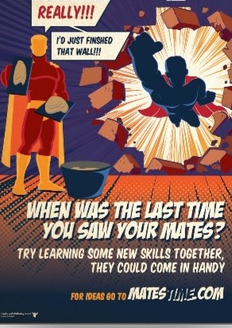
What is the Council doing to support people?
Public Health / Population Health
Tackling stigma and raising awareness
Co-production
Suicide prevention
Stronger Communities investment and support
Across the new Council
Housing
Supported Employment
REACH
Living Well
Leisure and Culture
Community Safety
Children and Young People’s Services

Slide 7
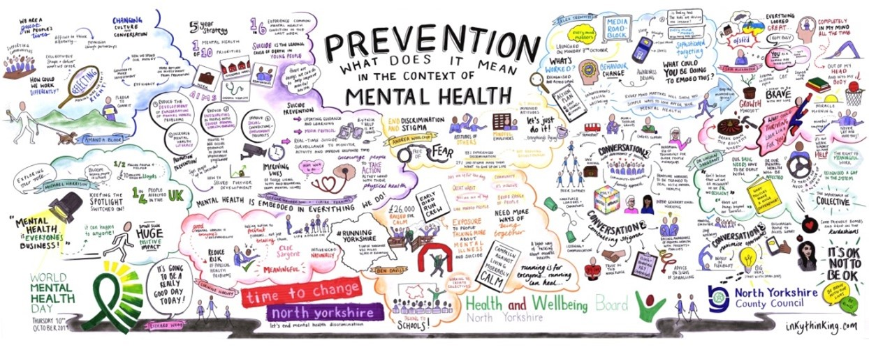
What is the Council doing to support people?
Adult Social Care Mental Health Service
Prevention, crisis intervention and recovery
Social Work/Social Care teams in local areas
Approved Mental Health Professionals
Support, Time and Recovery (STR) workers
Commissioned Services
Mental Health Prevention Services
Carers’ Services
Other adult social care services
Preparing for adulthood
Multiple needs – substance use, autism

Slide 8
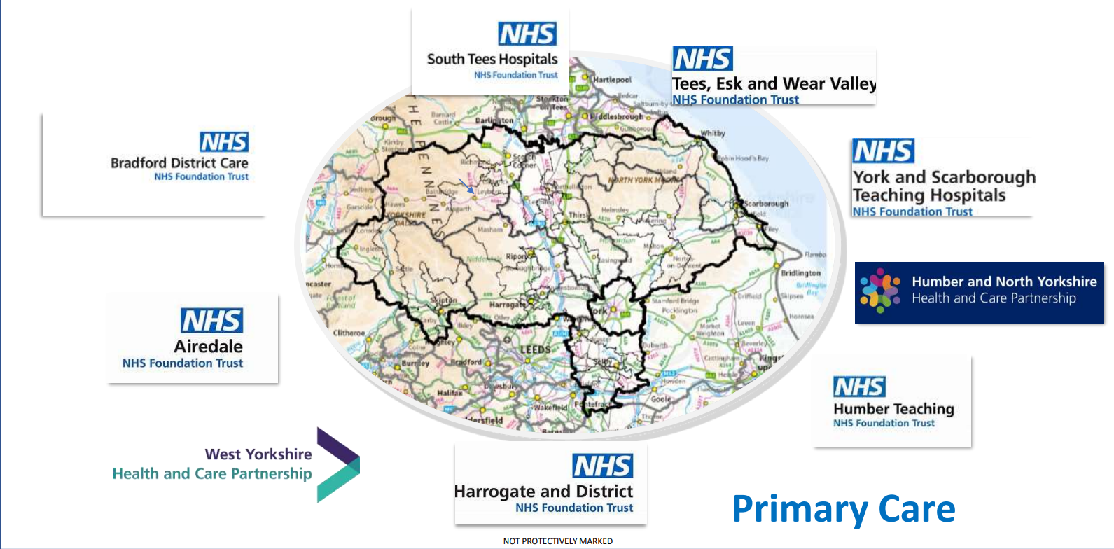
How does the Council work with the NHS?
It varies….
Joint strategy (up for renewal)
Joint commissioning of some voluntary sector
services and care packages
Some teams work from the same office base
Regular multi-disciplinary team meetings
in most places
Approved Mental Health Practitioner triage hubs
linked to some NHS acute mental health services
Specialist joint team: REACH in Scarborough

Slide 9
A local perspective
Personal Community
Community based specialist services (VCSE & NYC)
Person
Community
Acute Mental Health Care
Notes:
Person
Personal Community – Family/Friends , Neighbours, Work Colleagues, Online/social media communities
Community – Parks/outdoor spaces, Café’s /Restaurants, Shopping Centres, Local events/festivals, Leisure Centres, Art /Music venues, Educational settings, Community Centres/Hubs, Places of Worship/Faith groups, Bars/pubs, Interest/activity based groups, Sports venues, Libraries/museums
Community Based Specialist services (VCSE & NYC) – Includes mental health, physical health, VCSE, employment support, Housing support, Health & Social Care support
Acute Mental health care.

Slide 10
Workshop 1: Discuss
45 min
What strengths and assets can your organisation / service contribute to improving mental health and wellbeing?
What is working well which we can share across localities and build on?
What are the gaps?
What would support you to make partnership working between the Council and VCS more effective?
What is your table’s magic wand wish?
Feedback from each table after the break:
One thing that stood out
Your magic wand wish
Notes:
Naomi and Dena
Naomi to introduce herself
Dena – magic wand wish: we know funding is an issue but let’s consider how we can maximise income/sustainability together, and look beyond that to the outcomes/difference we want to make

Slide 11
Workshop 2: Reflect
25 min
Reflecting on what you heard from other tables…
How consistent was their feedback with your group’s conversation?
What intrigued or inspired you?
What did you learn?
What might you do differently or explore further?
Notes:
Leon and Liz

Slide 12
What has happened since:
Reflections from the workshops event fed back to NYC/VCSE at an online event in July 2024
Discussed ‘What are the actions or ideas, within our influence, we could begin to take forward?’
Ideas/thoughts/challenges contributed through Jamboard exercises
DD/LM collated and synthesised all responses
Steering group brought together to drive forward
In-person partner event planned for in April 2025 to review distance travelled

Slide 13
Themes pulled out from Jamboard that it’s felt would contribute to improving how the VCSE & NYC work together to improve Mental Health & Wellbeing support across NY
(A)Building awareness and understanding (better working together)
(B)What’s important in planning our work together (How we do it)
(C)Other partners we need to involve
(D)Strategic development
(E)Messages to convey
(F)Areas of need
(G)Future events/opportunities
(H)Improving understanding of impact
(I)Appreciation of the sector
(J)Other generalised thoughts

Slide 14
Need for increased support highlighted
For Autistic Adults with mental health needs (F)
Parental Mental Health – recognition this impacts the whole family (F)

Slide 15
Proposed themed actions identified from the information gathered on the Jamboard
Reponses identified for strategic consideration
Responses identified for potential immediate action
Responses suggesting the approach that should be adopted by all participants
Suggestions for others who should be connected into the conversations.
Need for increased support highlighted

Slide 16
Reponses identified for strategic consideration
Shared Strategic Vision (D)
Data sharing agreements in place between VCSE & NYC (A)
Place-based multi-agency pathway planning for key cohorts (A)
Implementation of ‘I Thrive’ (A)
Collective pooling of known /predicted resources across sectors(A)
Ensure preventative provision doesn’t become a holding space for tertiary statutory services through regular dialogue in place-based partnerships.(B)
Clear Outcome measurement tools , that support grassroots organisations to understand the impact they are having. (H)

Slide 17
Reponses identified for strategic consideration
Review of Community Mental Health Commissioning – is it still fit for purpose? (J)
Appointment of keyworkers/PA’s who build trusted relationships offering person-centred support and introductions to specialist services (J)
Promote the use of personal budgets to open up the opportunity of more personalised support (J)
Recording of safeguarding issues – sometimes there is a need for new safeguarding record rather tham amending original. (J)
Continuation of Community Mental Health Transformation (J)
Develop peer mentoring opportunities (A)

Slide 18
Reponses identified for strategic consideration
Assessment of population needs for mental health which can lead which informs strategy.(D)
Implement evidence-based interventions , understand which make the most difference (E)
Develop strategy with clear links to housing and education support services.(D)
Develop a collaborative mental health VCSE group that feeds into NYC, ICB and TEWV (G)
Develop community based accessible services.(G)
More opportunities for those living with a mental illness, peer support, mentoring and apprenticeships.

Slide 19
Responses suggesting the approach that should be adopted by all participants
Recognise solutions may vary across North Yorkshire (B)
Can do ‘ open door approach’ (B)
Understanding and mutual respect should be given across system (I)
VCSE and NYC both incur costs for the services they provide, nothing is free (I)
Recognising that the person needs a trusted ‘support person’ that may be someone within a VCSE organisation or statutory both are to be valued (I)

Slide 20
Responses identified for potential immediate action
share what each organisation offers, how its accessed, criteria for participation and how it fits into existing pathways. (upload this onto existing directory of services)(A)
Greater clarity and understanding of roles and functions in NYC with regard to wellbeing support shared within NYC and with VCSE (A)
Provide opportunities for VCSE orgs to meet in place with mental health practitioners to support understanding of each other and provide access to individual support for VCSE if needed . (A)
Develop a common understanding of language and terms (e.g. prevention, early intervention) (A)
Arrange visits across organisations between NYC staff & VCSE – opportunities to shadow each other for the day/half day (A)

Slide 21
Responses identified for potential immediate action
Create opportunities for shared work force development (A)
Identify case studies that demonstrate positive partnership working (H)
Future network events to include the NHS Primary Care /TEWV/Lived Experience (G)
Place based engagement event, for example ‘speed dating’ model with opportunity to meet everyone and understand more what each organisation can offer (G)
Existing pathways info graphic shared (A)

Slide 22
Suggestions for others who should be connected into the conversations
The Mayor – has opportunity to influence agenda on economy & skills from a mental health angle.(C)
Developing Community Anchor Organisations (C)
Local Care Partnerships (c)
NYC – Housing, benefits, leisure (support holistic approach)(C)
TEWV (C)
Involve those with lived experience – consider the support needs of facilitating this in a meaningful way. (A)

