Slide 1
Sensory Loss - Isolation & Inequality For NY Equality & Inclusion Partners – January 2025
“Individuals who are socially isolated are between two and five times more likely than those who have strong social ties to die prematurely. Social networks have a larger impact on the risk of mortality than on the risk of developing disease, that is, it is not so much that social networks stop you from getting ill, but that they help you to recover when you do get ill.”
Marmot (2010) Fair Society Healthy Lives Final Report.

Slide 2
Who we Are - The NYC Adults Countywide Sensory Team:
Sensory Social Workers who work with people who are Deaf, deafened, deafblind or people who have vision loss. They provide an assessment and professional support service primarily for people using British Sign Language (BSL). (1.4FTE qualified & 2 ASW)
Rehabilitation officers for people with a visual impairment - who provide vision rehabilitation to enable a person who is sight impaired learn new skills to live with their sight loss. (4.5FTE) They offer:
Orientation and mobility training indoors and outside
Independent Living Skills training to enable independence and safety, including food preparation and personal care.
Communication skills to enable access to information, bills, finances and more. This can include use of technology
Low vision therapy to maximise visual skills
Awareness training to benefit the person where required, and offer support and advice to family members and carers
Communicator Guides for People with Dual Sensory Loss (2.8FTE) support Deafblind people to support their access to communication, information and mobility. They can provide awareness training to benefit the person and offer support and advice to professionals, family members and carers.
Sensory Officers work in the Prevention and Access Team but have a strong link with the Sensory Team. They screen referrals for people with a sensory impairment. They also assess and offer advice, information and support regarding equipment for people with hearing impairments. (2FTE)
Tips for social workers on implementing the Care Act for deafblind people | Deafblind UK

Slide 3
3 May 2011
Chris Farrow, who has Usher syndrome, talks about how support from Nicola, his communicator guide, has helped reduce his isolation, and about how vital social care is for deafblind people.The transcript is available on the Sense website: http://www.sense.org.uk/sites/default
Notes:
4.16

Slide 4
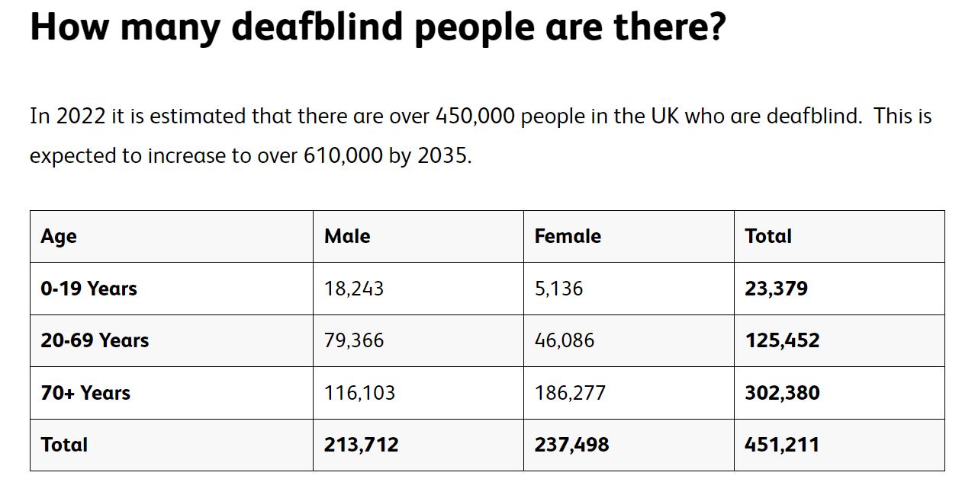
Someone is deafblind if they have both a hearing and sight impairment.
Together this can impact on how the person accesses information, communicates and navigates around the physical environment.
Some people are born deafblind (congenital) or it can happen later in life (acquired).
Deafblindness statistics in the UK - Sense

Slide 5
The impact of deafblindness
Difficulties in communication, mobility and access to information that result from an impairment of sight or hearing can have a profound negative impact.
Often, they result in a decline in the person’s functional and ability to carry out the tasks of everyday life successfully.
There may also be psychological consequences. First, the reduction in sensory stimulation may itself cause deterioration in cognitive functioning
Secondly, the functional impairments and increased dependence on others that result may give rise to feelings of sadness, helplessness, anxiety, depression and withdrawal.
Indeed, as might be expected, people with either visual or hearing impairments are at increased risk of mental health problems, compared to their peers in the general population.
(Department of Health, 2002; Fellinger et al., 2007; Kvam and Loeb, 2007; Varma et al., 2006).

Slide 6
A diagnosis of a sight loss condition is a life-changing event, and for people who are born with visual impairment there can be a range of emotional impacts as they face barriers and stigma which still exist in our society.
In 2020 Royal Blind and Scottish War Blinded published a policy report “Social Connections and Sight Loss.” This report studied the links between loneliness and sight loss; the research findings suggested that around two thirds of blind and partially sighted people have experienced loneliness because of their sight loss.
The report highlighted many experiences of challenges to mental wellbeing and episodes of emotional trauma as a result of visual impairment.
This ranged from blind and partially sighted pupils struggling to make friendships, young people accessing counselling to help them manage anxiety linked to their visual impairment and veterans with sight loss experiencing chronic mental health challenges.
Around 2 million people in the UK are living with some form of sight loss, with this expected to rise to 2.7 million by 2030. Maintaining good eye health is central to maintaining good mental, social and physical health. Vision loss is associated with a reduction in overall quality of life, mental health, independence, mobility, educational attainment, and employment.
Emotional support for sight loss | Mental Health Foundation
Vision | Fingertips | Department of Health and Social Care (phe.org.uk)

Slide 7
Many studies show that the combined loss of vision and hearing has a greater impact than that of either impairment alone, since the person affected cannot use one or other sense to compensate for the loss. People who have adjusted to hearing impairment, for example, may lose the ability to lipread as their sight fails, and individuals with visual impairment may lose the ability to hear clearly.
In both cases, there is likely to be increased isolation arising from the loss of not only essential information and interactive routes like conversation, but also more solitary leisure activities such as reading, listening to the radio or watching television. The influence of a combined dual sensory impairment on sight and hearing may also make the person more physically vulnerable.
The domestic environment may present physical obstacles or difficulties and require changes to make it safer or easier. While it is important to obtain appropriate diagnosis and treatment for conditions giving rise to sensory loss, the social aspects are often masked by a focus on the medical aspects of impairment and are separated from associated outcomes, such as falls. Falls are a recognised source of anxiety in older people and are also a potential trigger for isolation as reduced mobility often follows, all factors which are recognised by health and social care professionals.
Dual sensory loss (DSL) is recognised by deaf blind specialists as a clear underlying cause of falls in older people and a greater awareness among non-specialists would act as a preventive measure. The potential for isolation increases as their impairment becomes more severe. Visits outside the home or from family and friends may become increasingly difficult when ease of travel and communication are lost, for example.

Slide 8
General communication tips For those who are deaf/hard of hearing
Where lip-reading is possible for in-person meetings:
· Make sure there is adequate lighting.
· Face the person you are speaking to.
· Get the person’s attention before speaking.
· Use normal lip movements, facial expression and gestures.
The following tips are particularly important when the person using your service cannot use visual cues, for example when you’re on the telephone or wearing PPE:
· Speak clearly – avoid shouting or speaking unnecessarily slowly.
· Say things differently if people ask you to repeat what you’ve said or do not understand.
· Check understanding by asking the person to repeat information back.
· Use plain language and be straight to the point.
· Reduce background noise as much as possible.
· Where possible, also provide written information.
· speak to a relative or friend (only if requested).

Slide 9
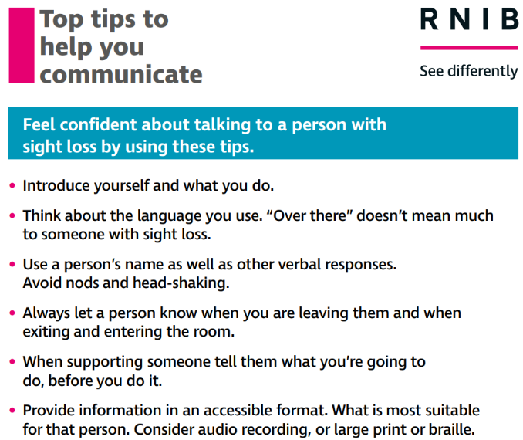
Consider Environment
Contrast – handrail/ banisters will stand out more if you paint it in a contrasting colour or tone from the stairs and the wall.
To make the edge of each step stand out more, mark each one with white paint, or fix a contrasting white plastic or metal strip on the edge of each step.
Things stand out better on plain or subtly patterned surfaces or backgrounds, avoid shine/glossy finish.
Lighting - Dark colours absorb the light, light colours reflect it – consider changing adding contrast for distinction.
Marking tape around switches and plug sockets
Bump-on stickers
Vertical blinds – easier to adjust
Practical adaptations for people with visual impairments | RNIB | RNIB

Slide 10
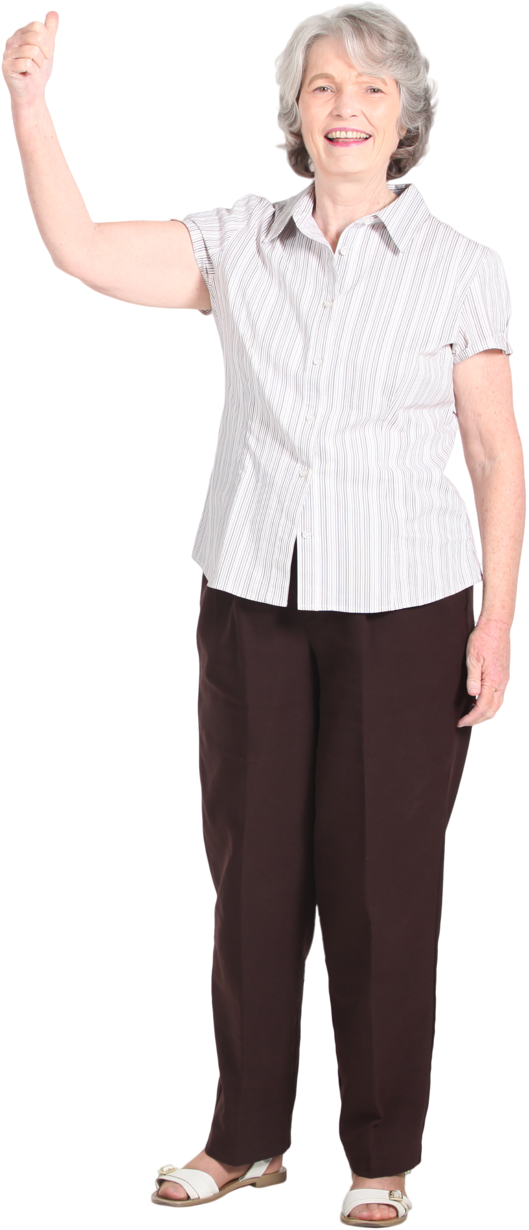
What can we be thinking about to make our services more accessible to people with sensory loss, and how can the Sensory team help?
Use the top tips for sight and hearing loss
Encourage people to go to GP, Audiologist and/or Optician Opthamologist.
Consider your environment from a DSL perspective & make changes.
Invite us to a meeting, we can visit and give advice.
Use community grants to upskill in BSL – Teachers
Advise people about our service - print out leaflets, or share the link - Hearing and vision impairment | North Yorkshire Council
Explore local groups & signpost people to them
ENQUIRE via the NYC contact centre – they will direct you to us
Keep on learning about sensory loss!
Make Referrals & inform people they have a right to support as per the Care Act Tips for social workers on implementing the Care Act for deafblind people | Deafblind UK
Notes:
Leanne in Scarborough – Coastline Sight & Hearing using Inspire funding to ‘grow’ skills in community (Tony may be attending).

Slide 11
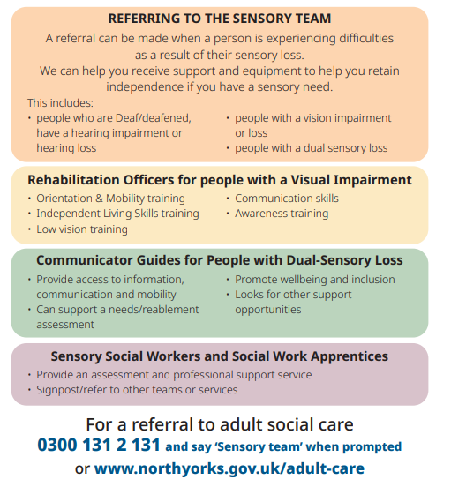
Help someone make their own communications card (our Apprentice Social Worker did this for a few people one day at Scarborough Deaf club)….
Create a personalised digital communication card - RNID

Slide 12
Resources
Vision Support, Harrogate and District -23 East Parade, Harrogate, HG1 5LF. Telephone: 01423 565915
Yorkshire Coast Sight Support - 183 Dean Road Scarborough YO12 7JH. Telephone: 01723 354417
Selby District Vision - Prospect Centre, Prospect Way, Selby YO8 8BD. Telephone: 01757 709800
Sight Support Ryedale - Norton Hive Community Library, Commercial Street, Norton, North Yorkshire YO17 9ES. Telephone: 01653 698860
Sight Airedale - 31 Scott Street, Keighley, West Yorkshire, BD21 2JH. Telephone: 01535 602354
Mysight York - 4 Merchant Place, Merchantgate, York, YO1 9TU. Telephone: 01904 636269
Teesside and District Society for the Blind - Stockton Road, Middlesbrough, TS5 4AH. Telephone: 01642 247518
Galloways Society for the Blind - Howick House, Howick Park Avenue, Penwortham, Preston PR1 0LS. Telephone: 01772 744148
Coastline Sight and Hearing - Unit 1 The Street, 12 Lower Clark Street, Scarborough, YO12 7PW. Telephone: 07751 428131
Sight Advice South Lakes - The Bradbury Centre, 116 Highgate, Kendal, Cumbria LA9 4HE. Telephone: 01539 769055
Harrogate Deaf Society - Community House, 46-50 East Parade, Harrogate, HG1 5RR. Telephone: 01423 503700

Slide 13
Events
Harrogate Deaf Café
When: Every second Thursday of every month between 1pm and 3pm.
Where: Harrogate Library.
Mowbray Community Church - Signed services for Deaf people
When: Come and enjoy lunch at 1pm every 2nd Sunday of the month in the Side Hall followed by a church service from 2pm until 3pm.
Where: Mowbray Community Church, Westmoreland Street, Harrogate, North Yorkshire, HG1 5AT
Easingwold Macular Group meeting
When: Second Monday of every month from 10.30am until midday
Where: The New Inn 60-62 Long Street, Easingwold, YO61 3HT
Richmond Macular Group meeting
When: First Monday of every month from 1.30pm until 3pm
Where: Methodist Church, entry on Dundas St, Richmond DL10 4AE
Selby Macular Society Support Group
When: Fourth Tuesday of every month from 11am until 12.30 pm
Where: Selby Abbey Coffee Shop, The Crescent, Selby YO8 4PU
Harrogate and Ripon Centre for Voluntary Services
When: Every Wednesday between 2pm and 4pm.
Where: Harrogate and Ripon Centre for Voluntary Services, 46-50 East Parade, Harrogate, HG1 5RR.
Scarborough Deaf Club
When: Every first Monday of every month between 10am and 1pm
Where: Westborough Methodist Church, Westborough, Scarborough, YO11 1TS
Some community run groups are Subject to change – please call in advance of attending

