Slide 1
Business Model Canvas
A Plan You Will Use

Slide 2









Welcome and Introductions
Things to consider before we begin
Notes:
We will be recording the meeting
Make yourself comfortable, anything you need, we will keep to time, take a break if you need. Open space to chat, contribute, network. Will send follow up notes et

Slide 3
What we will achieve!
Methods
Analyse Your Venture
Practical Planning
One for the shelf?
Large Undertaking
Costly
Notes:
Social ventures take many forms. They may be a charity, a social business or a community group. The common feature is that their main objective is to tackle an issue of social importance rather than to generate profits for an owner or shareholders.

Slide 4
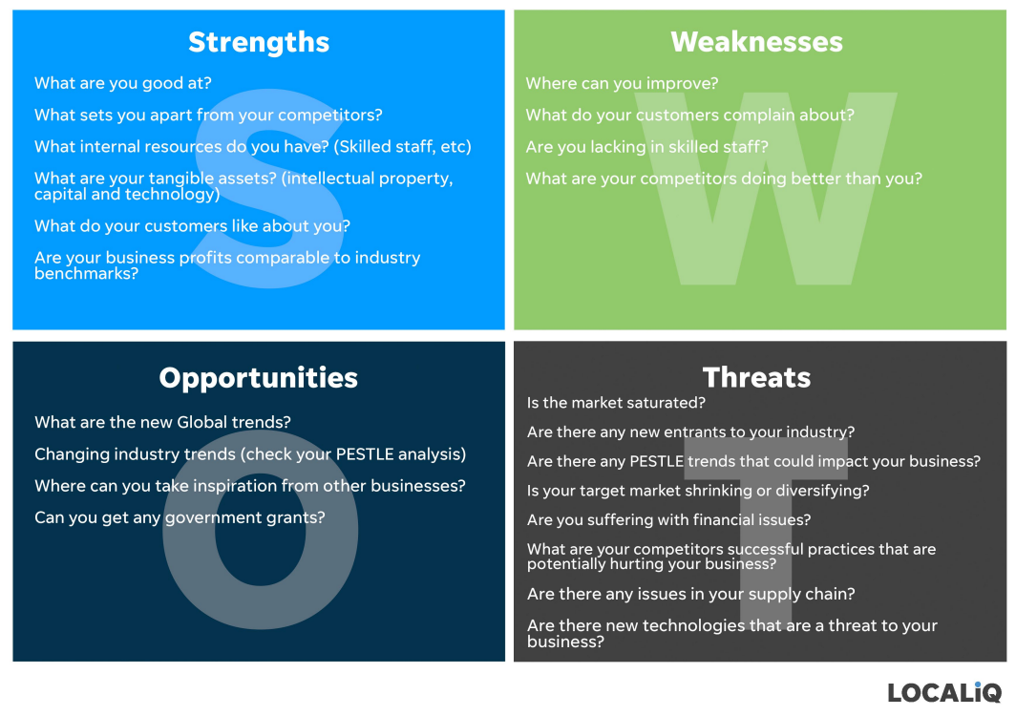
SWOT Analysis
Start with the basics…
Notes:
Activity – 5 mins to chat about who your customers might be and what model you are considering?

Slide 5
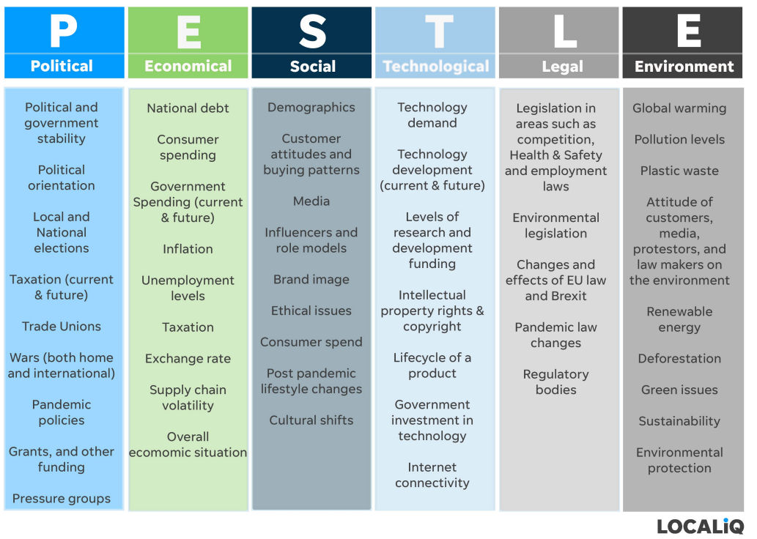
Pestle Analysis
A more in depth look at the impact of external influences on your business

Slide 6
What’s the best type of business plan?
There may come a time when someone wants a big business plan from you.
This will more than likely be a sign of success.
In the meantime…
One that you use!!!
A4
Several paragraphs
Some stats

Slide 7
Keeping it short…
What is the problem?
Who has the problem?
How will you solve it?
Why should someone buy from you?
How will you reach your customer?
Cost?
Profitability
Timeline
Measuring Success
Actions
Notes:
Who has the problem – target market
How will you solve it – Your product
Whysomeone should buy from you? - USP, Cost, Skills, IP
How you will reah your s=customer – marketing, advertising, cahnnels etc.
Cost – capital operations distribution
Profitability – margins, revenue streams, value of different customers
Timeline – when things will happen
Measuring – SMART Targets / impact
Actions – to do list, with timeline

Slide 8
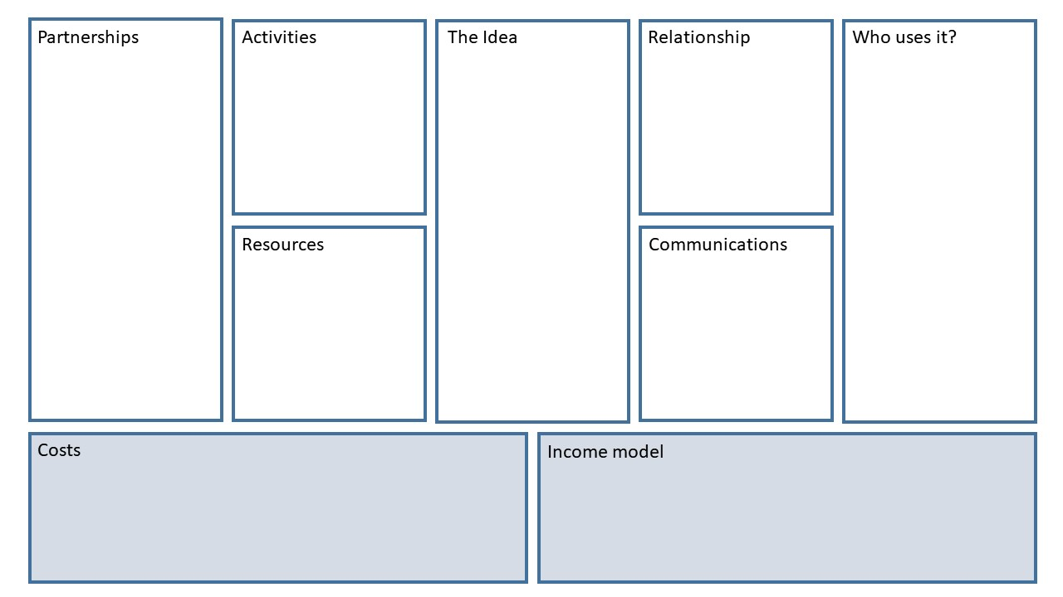
Social Model Business Canvas

Slide 9
In summary…
Think about who you are writing it for
Write something you will use
Forecasting is difficult, but it gets easier

Slide 10



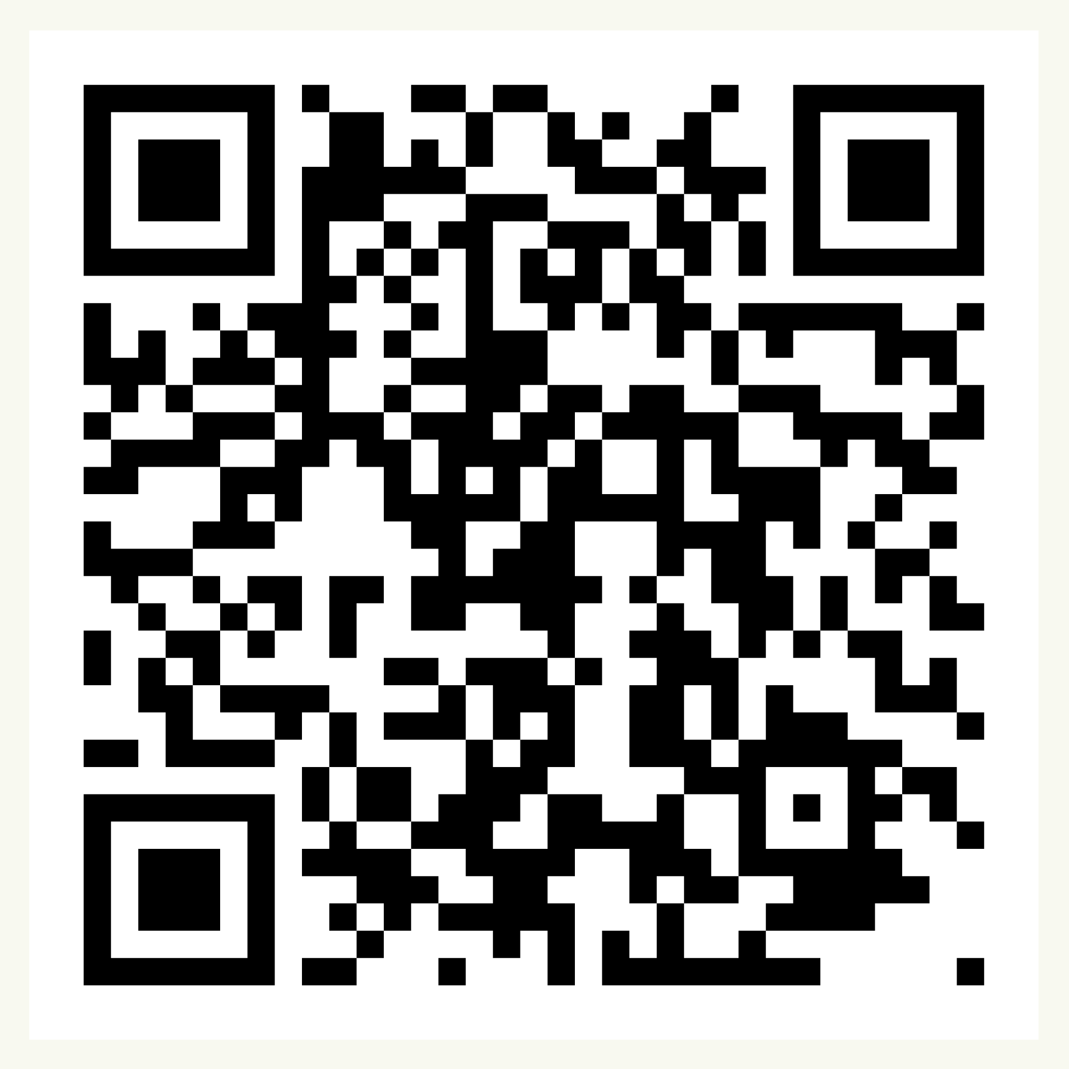
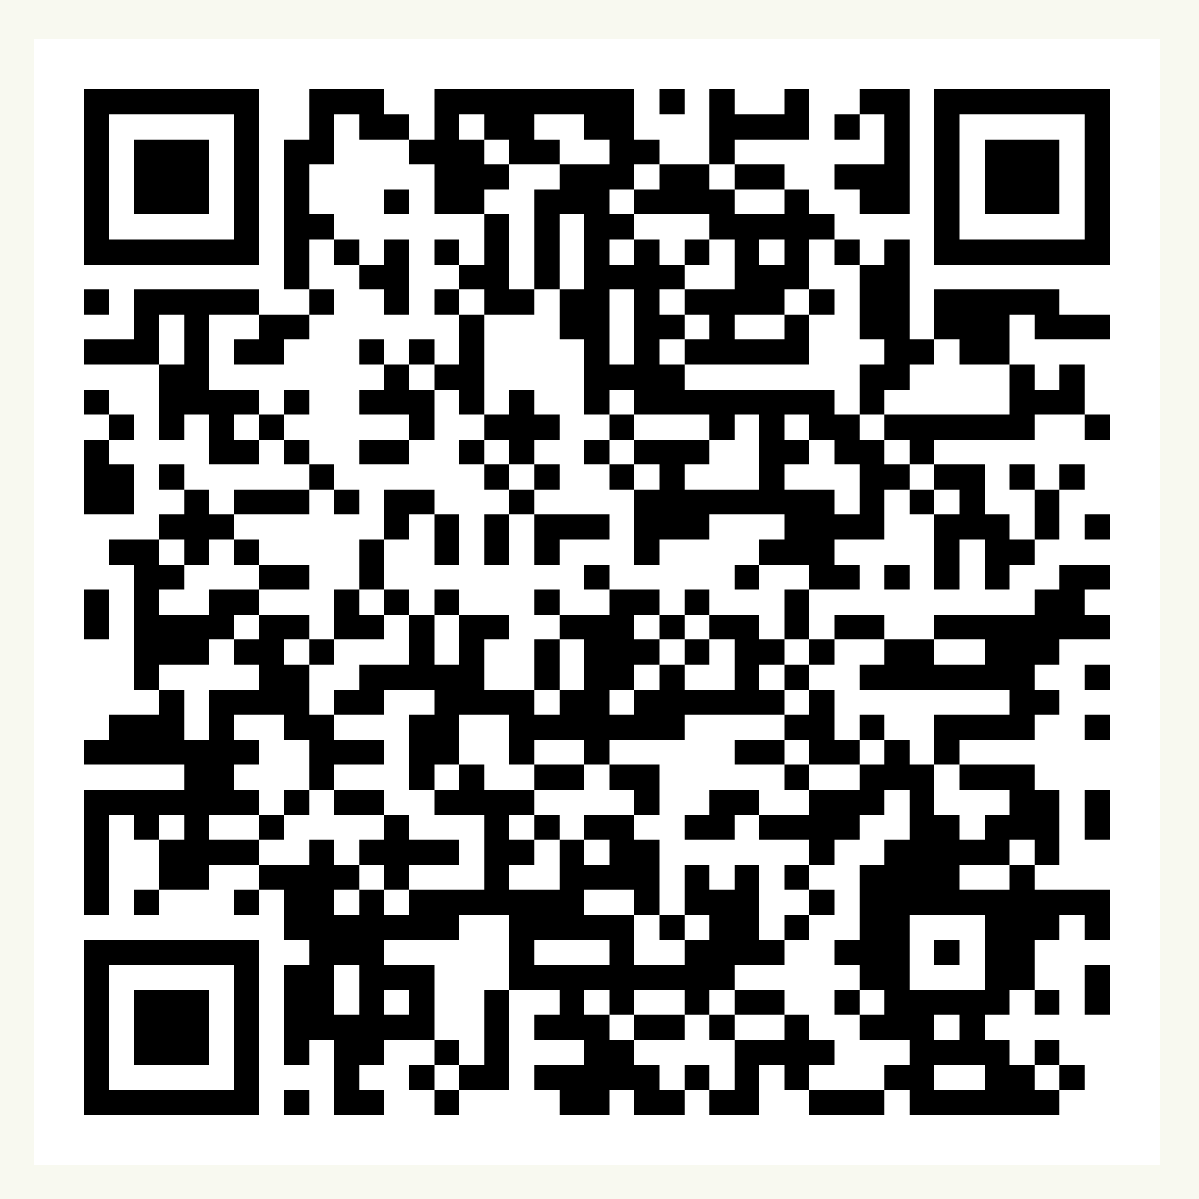
Over to you!
Soc Ent Support
Contact us at:
communitysupport@communityfirstyorkshire.org.uk
Sign up for our funding portal here:
Sign up to receive our newsletters here:
Notes:
https://forms.gle/jmTCRdr79QhnK4cb7
Link in the chat to what you can access and we will email out
We hope that has given you a flavour of our work and a clear picture of how and why we do what we do.
We are open to questions!

Slide 11
See you next time 😀
Paul Kilgallon
paul@participateprojects.org.uk

