Slide 1



West Yorkshire Community Accounting Service
WYCAS
@_WYCAS_
www.wycas.org.uk

Slide 2
Rhys North
Finance for new Social Enterprises
@_WYCAS_
www.wycas.org.uk

Slide 3
Housekeeping
Course timings:
Finance: 11am – 12.00noon
Funding: 12noon – 12.30pm
Confidentiality
@_WYCAS_
www.wycas.org.uk

Slide 4
Who are WYCAS?
WYCAS is a charity which helps organisations to manage their finances effectively and efficiently
We work with over 600 organisations throughout Bradford, Calderdale, Kirklees, Leeds and Wakefield
@_WYCAS_
www.wycas.org.uk

Slide 5
Services WYCAS can offer:
Annual Accounts
One to One Support
Training Courses
Finance Tools
Finance Forums
Financial Health Checks
@_WYCAS_
www.wycas.org.uk

Slide 6
Introductions
Who you are?
What do you want from today’s session?
@_WYCAS_
www.wycas.org.uk
Notes:
Check permission to share this info. 10.15 start on this slide.

Slide 7
Aims of this training
To cover the four financial foundations:
Plan your money – budgeting
Record your money – bookkeeping
Control your money – financial procedures
Report your money – Management Accounts and Annual Accounts
@_WYCAS_
www.wycas.org.uk

Slide 8
Planning your money
Budgeting
@_WYCAS_
www.wycas.org.uk

Slide 9
What is a budget?
A budget is a financial plan for an organisation, prepared in advance.
@_WYCAS_
www.wycas.org.uk

Slide 10
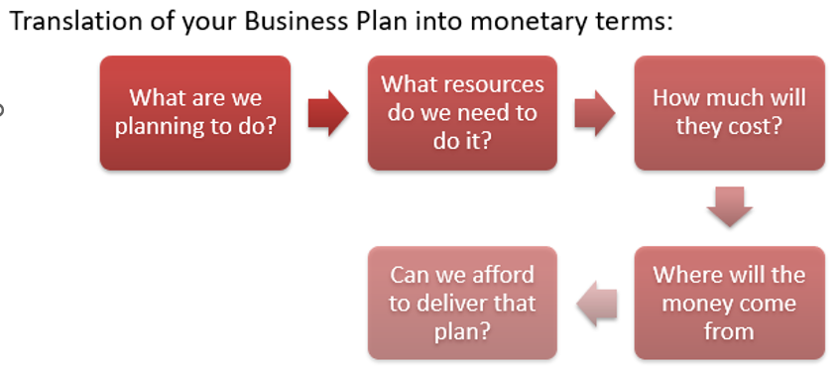
@_WYCAS_
www.wycas.org.uk

Slide 11
Why budget?
An organisation that budgets is an organisation that plans
Enables decisions to be made
Helps communicate the organisation’s plans to its stakeholders
Provides confidence to funders and potential funders
Enables the organisation to monitor its performance and take corrective action
@_WYCAS_
www.wycas.org.uk

Slide 12
How to prepare a budget?
Understand what the organisation is planning to do.
Cost the plan
Work out your income
Compare planned income and expenditure
Monitor the plan
@_WYCAS_
www.wycas.org.uk
Notes:
Importance of minutes

Slide 13
Tips when preparing a budget
Involve the right people
Allow enough time
Last year can be a useful predictor for next year but be careful when doing this
Keep notes on how you have prepared the budget
Be prepared to challenge the budget assumptions
Be realistic!
Ensure it is formally approved by the directors
@_WYCAS_
www.wycas.org.uk
Notes:
Importance of minutes

Slide 14
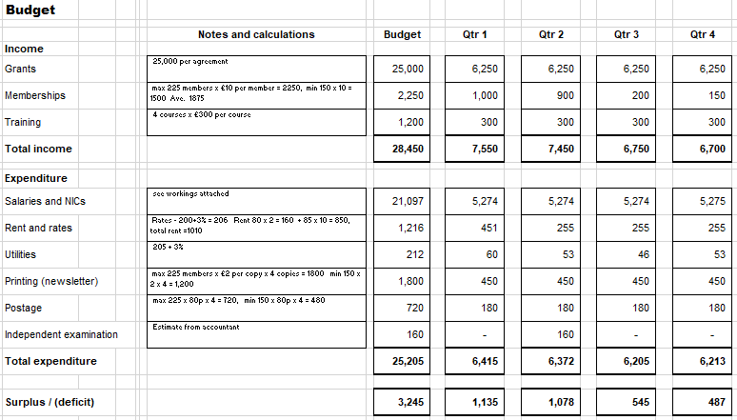
Possible Budget Format
@_WYCAS_
www.wycas.org.uk
Notes:
Handout as per Excel file . 10.50 start. Feedback – one comment per pair

Slide 15
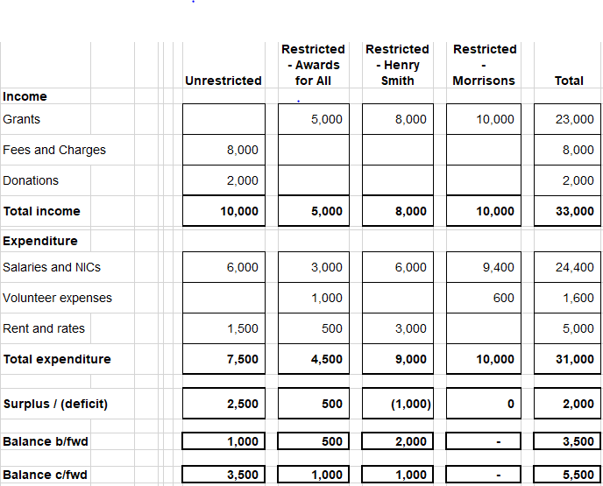
Possible Budget Format
@_WYCAS_
www.wycas.org.uk
Notes:
Handout as per Excel file . 10.50 start. Feedback – one comment per pair

Slide 16
Recording your money
Bookkeeping
@_WYCAS_
www.wycas.org.uk

Slide 17
Financial Records
You need to keep:
Bank statements
Invoices and receipts for income and expenditure
File in date order and reference to your accounting system
Petty cash vouchers
Contract and grant documentation
Keep financial records for six years.
@_WYCAS_
www.wycas.org.uk

Slide 18
Recording transactions
Spreadsheet
Commercial accounting system
@_WYCAS_
www.wycas.org.uk
Notes:
Importance of minutes

Slide 19
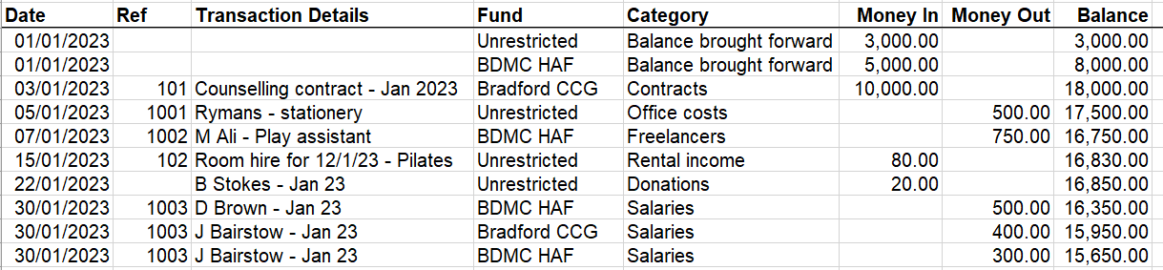
Recording transactions
@_WYCAS_
www.wycas.org.uk
Notes:
Importance of minutes

Slide 20
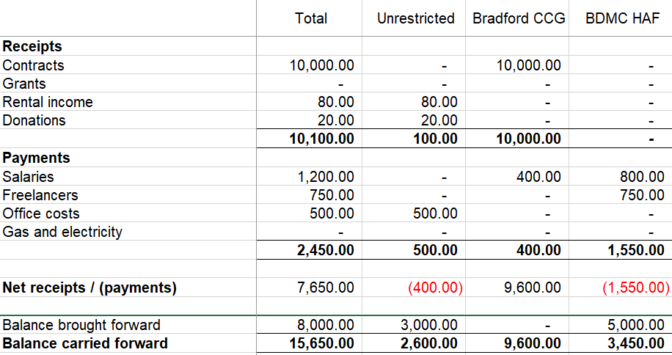
Recording transactions
@_WYCAS_
www.wycas.org.uk
Notes:
Importance of minutes

Slide 21
Petty Cash
Recommend firstly that you minimise the use of petty cash
If using petty cash then use an imprest system where you top up your petty cash to a target float level eg £50
Always have receipts to support any petty cash payments
Recommend that any petty cash received is banked instead of adding it to your petty cash
@_WYCAS_
www.wycas.org.uk

Slide 22
Controlling your money
Financial Procedures
@_WYCAS_
www.wycas.org.uk

Slide 23
Key Financial Controls
Keep your financial records up to date
Perform a monthly bank reconciliation
Review data quality and coding consistency
Monitor amounts owed to you and owed by you
Regularly review and report on your finances – compare actual income and expenditure against your budget
Prepare cash flow forecasts
@_WYCAS_
www.wycas.org.uk

Slide 24
Why are Cash Flow Forecasts important?
Most organisations fail because they run out of money.
A cash flow forecast predicts how much money will be in the bank account.
Preparing a forecast will allow the organisation to take action in advance.
@_WYCAS_
www.wycas.org.uk
Notes:
Importance of minutes

Slide 25
Key Financial Procedures
  No one person, if possible, should make a complete financial transaction - separate authorisation and payment.
  Two people to sign off expenditure.
  Set authorisation limits for individuals.
  Set procedures for how quotes will be sought.
  Clear recruitment and payment processes for staff.
  Keep all money and assets securely.
  Use expense claim forms for volunteers and staff.
  Post opening and cash counting systems.
  Regular banking of monies received.
  Approve financial procedures and review regularly.
@_WYCAS_
www.wycas.org.uk

Slide 26
Reporting your money
Management Accounts and Annual Accounts
@_WYCAS_
www.wycas.org.uk

Slide 27
Management Accounts
  Reports on actual income and expenditure
  Compares actual against budget
  Allows income and expenditure to be monitored and for remedial action to be taken
  Can be used to forecast financial performance
  Can also be used to report on assets and liabilities
@_WYCAS_
www.wycas.org.uk

Slide 28
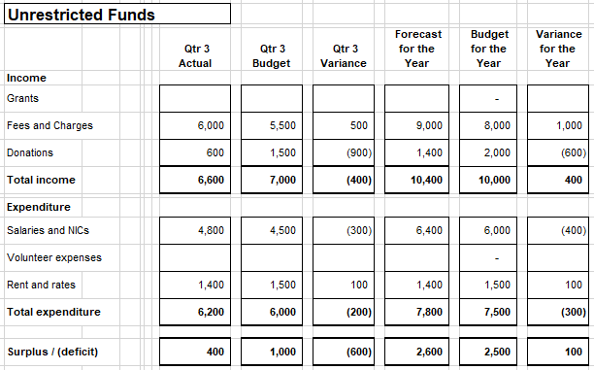
Management Accounts Example
@_WYCAS_
www.wycas.org.uk
Notes:
Importance of minutes

Slide 29
Annual Accounts
  Statutory filing requirement at Companies House for CICs, Charities – deadline 9 months after year end
  Tax return to be filed – deadline 12 months after year end but any tax payable within 9 months of year end
  Provides an opportunity to publicise your organisation – use your annual report.
  Annual Accounts may need external checking
@_WYCAS_
www.wycas.org.uk

Slide 30
For any further information or advice do contact:
Rhys North, Senior Community Accountant rhys.north@wycas.org.uk
Mobile: 07891 333030
You may also want to visit our website www.wycas.org.uk
@_WYCAS_
www.wycas.org.uk

