Slide 1
Legal Structures
The wonderful world of…

Slide 2









Welcome and Introductions
Things to consider before we begin
Notes:
We will be recording the meeting
Make yourself comfortable, anything you need, we will keep to time, take a break if you need. Open space to chat, contribute, network. Will send follow up notes et

Slide 3
Where to begin…
What is the purpose of the organisation?
Do I need to be paid or employed?
Do I need to employ staff or take on contracts?
Will the idea require grant funding?
Will the organisation require investment?

Slide 4
Directors / Trustees / Committee Members
Funding
Trust
Skills
Time
Understanding / Lived Experience
JD’s
Skills Mapping
DBS Checks

Slide 5
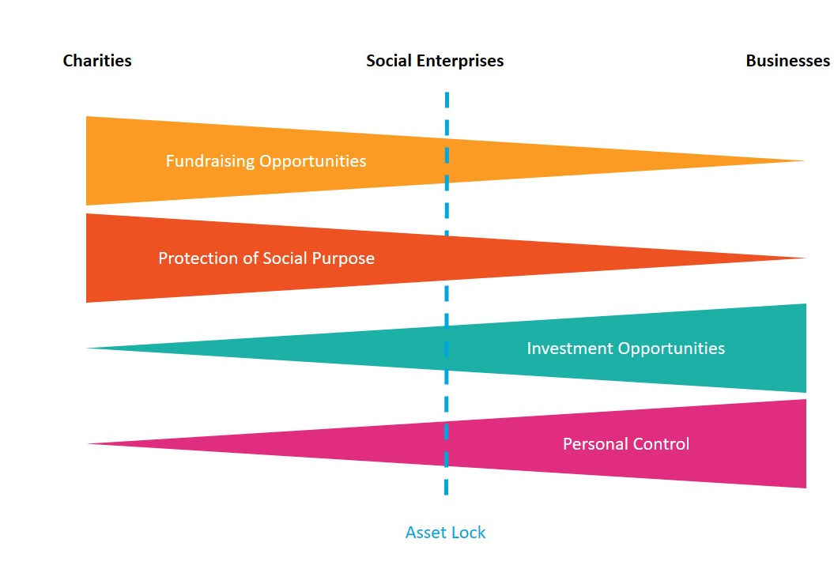
Social to Private

Slide 6
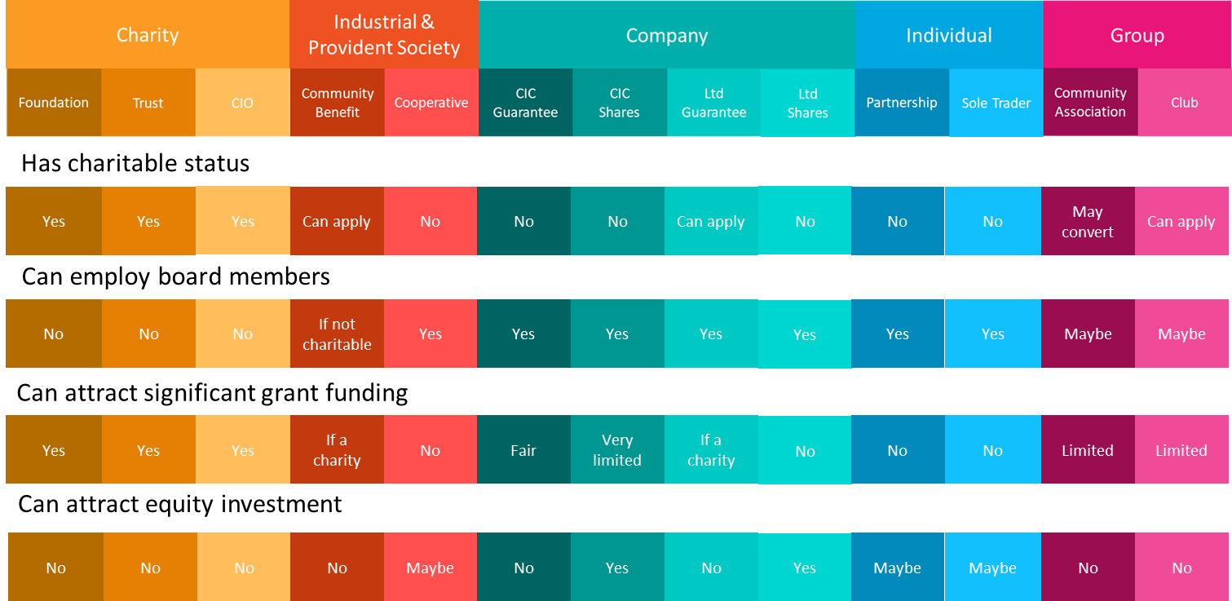
Legal Structures

Slide 7
Charity – Charitable Company / CIO
Mem and Arts
Objects
Primary Purpose
Trustees
Grants
Donations
Trading
Tax – Rate Relief, Stamp Duty, Corporation Tax
Regulator

Slide 8
CIC’s
Articles of Association
Objects
Asset Lock
Limited by – Guarantee / Shares – Members / Voting
Grants
Trading
Tax
Regulator

Slide 9
Community Benefits Society
Rules
Coop Models
Charities
Objects
Asset Lock
Grants
Trading
Flexibility – Share Capital, All Loans, Community Shares
Tax – Exemption
Regulator

Slide 10
Sole Trader
A Sole Trader is an individual who wholly owns and runs their business. Effectively the Sole Trader is self employed. It is the easiest form of business to set up and remains the most popular form of business.

Slide 11
Limited Companies
A limited company is a form of company that has its own legal identity that is separate from its owners. Companies can be limited by Shares or by Guarantee. Private “for profit” businesses are typically limited by shares.
Advantages
Limited Liability
More able to raise finance through loans and investment
Company Names are protected
Disadvantages
More complex to set up and run
Annual reporting is significantly more onerous
Less Private: you may need a business address
Directors responsibilities

Slide 12
Legal Structures- Responsibilities
Trustees/Directors/Committee Members
Ensure the organisation meets objectives and respects obligations
Ensure the rules of the organisation are followed
Manage conflicts of interest
Produce and agree accounts & annual reports
Meet legislation obligations - Health and Safety, GDPR, Environmental, Employment etc.
Insurance
Ensure resources and assets used appropriately

Slide 13



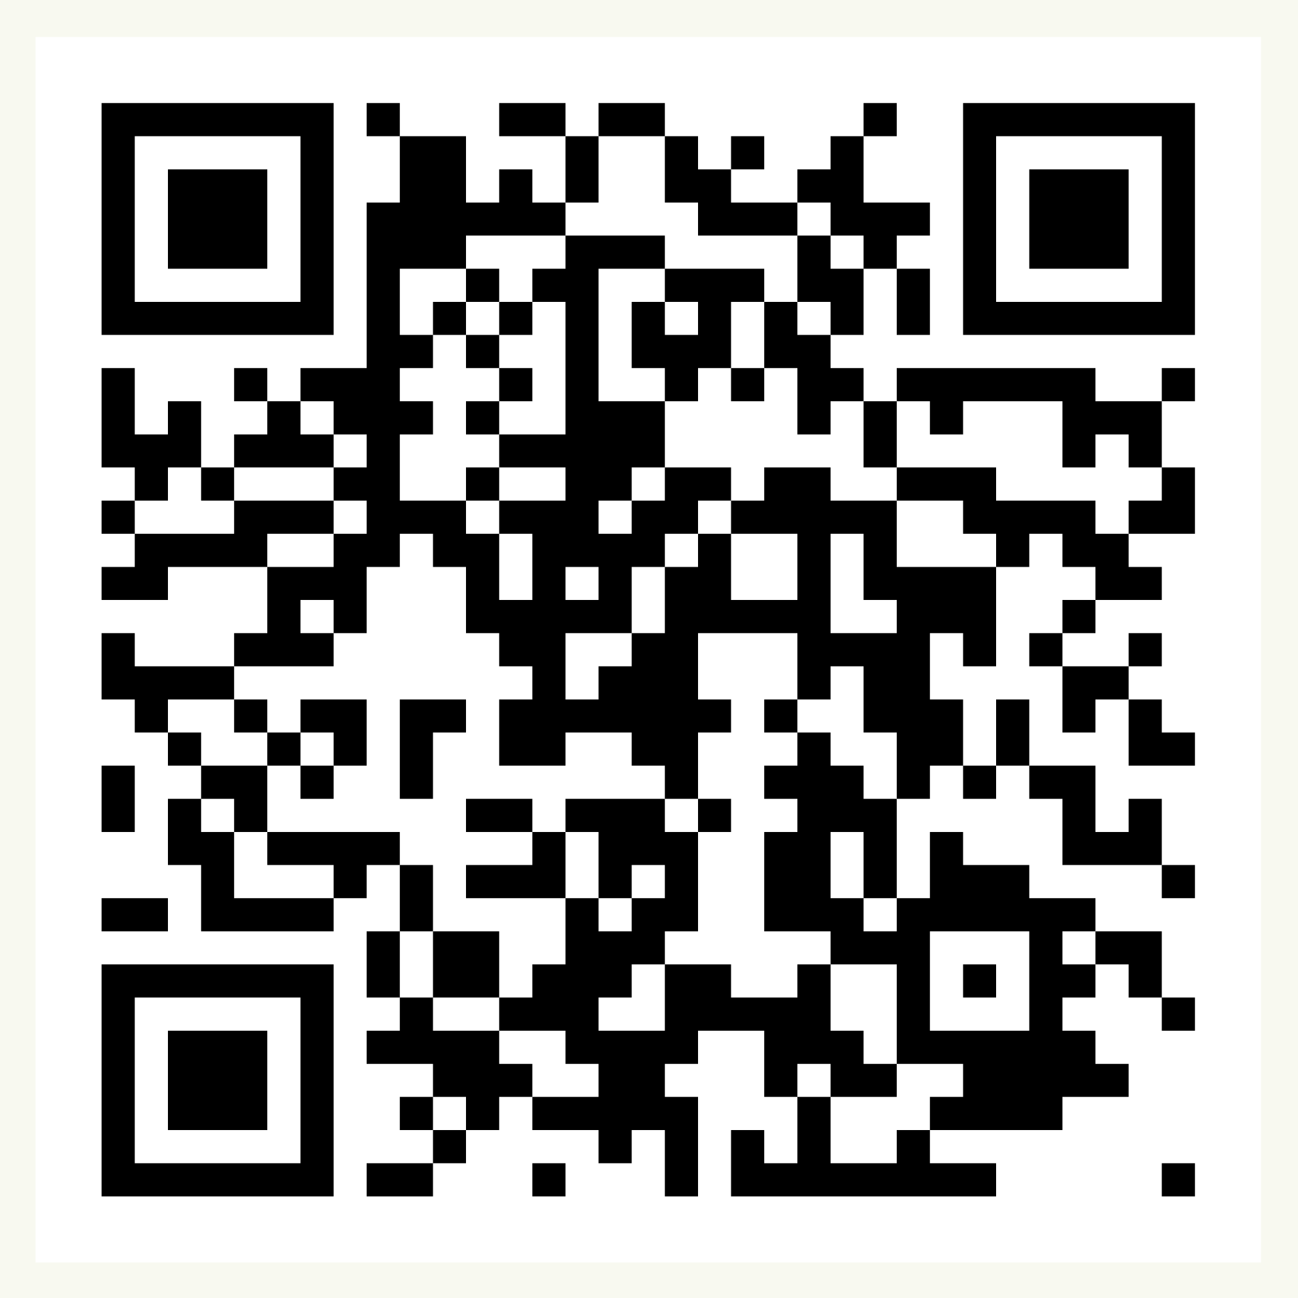
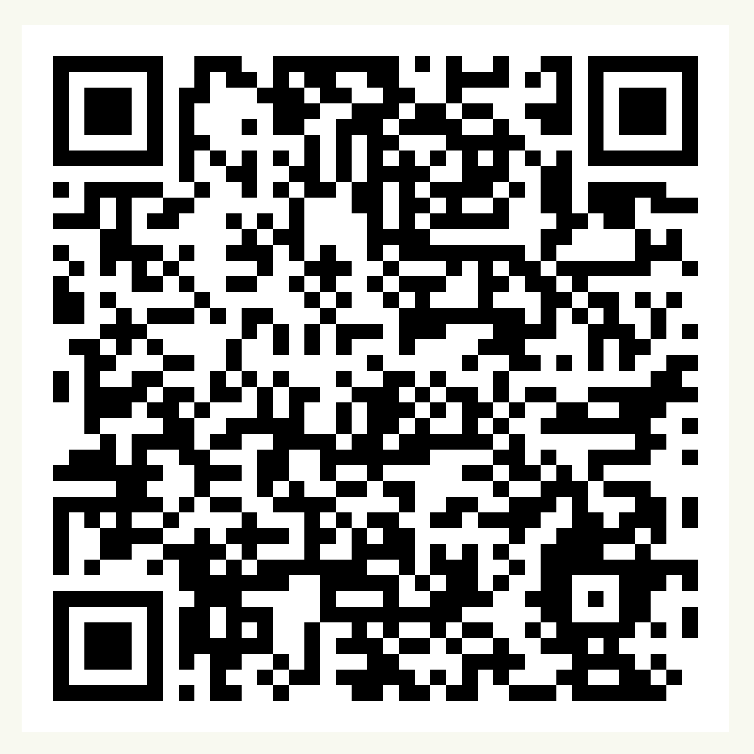
Over to you!
Soc Ent Support
Contact us at:
communitysupport@communityfirstyorkshire.org.uk
Sign up for our funding portal here:
Sign up to receive our newsletters here:
Notes:
https://forms.gle/jmTCRdr79QhnK4cb7
Link in the chat to what you can access and we will email out
We hope that has given you a flavour of our work and a clear picture of how and why we do what we do.
We are open to questions!

Slide 14
See you next time 😀
Paul Kilgallon
paul@participateprojects.org.uk

