Slide 1

Social Enterprise Support
KICK OFF SESSION
Notes:
Introductions to presenters

Slide 2









Welcome and Introductions
Things to consider before we begin
Notes:
We will be recording the meeting
Make yourself comfortable, anything you need, we will keep to time, take a break if you need. Open space to chat, contribute, network. Will send follow up notes et

Slide 3

Introductions
What 3 words?
Notes:
What .3 words. Introduce yourself: name and 3 words only to sum up your social enterprise (idea or reality). Be as cryptic as you likeEg: Carole – flour water salt

Slide 4
Aims
Today The Programme
North Yorkshire & Social Enterprise
Meet other entrepreneurs
Organisational health-check
Sign up for mentoring
Find out more about this programme
Start-up sessions
Networking events
Seed funding
Workshops
Peer support
Action learning

Slide 5
What does social enterprise mean to you?
Collectively owned and controlled community businesses: with legal forms that enable democratic governance, such as the Community Benefit Society (CBS) form
Growth-oriented Social Enterprises: a more entrepreneurial and dynamic group, often taking the Community Interest Company (CIC) form
Private enterprises that may self-define as Social Enterprises: including sole traders and ‘lifestyle businesses’ e.g. creative food, micro-breweries, and arts/crafts
Traditional non-profit organisations: numerous small community organisations that have some trading activity, often charities/company limited by guarantee (CLGs) or Charitable Incorporated Organisations (CIOs).
Notes:
Poll set up - hopefully answers shared..otherwise add to the chat
No one definition - the recent report finds:
four broad types:
Collectively owned and controlled community businesses: with legal forms that enable democratic governance, such as the Community Benefit Society (CBS) form
Growth-oriented Social Enterprises: a more entrepreneurial and dynamic group, often taking the Community Interest Company (CIC) form
Private enterprises that may self-define as Social Enterprises: including sole traders and ‘lifestyle businesses’ e.g. creative food, micro-breweries, and arts/crafts
Traditional non-profit organisations: numerous small community organisations that have some trading activity, often charities/company limited by guarantee (CLGs) or Charitable Incorporated Organisations (CIOs).

Slide 6
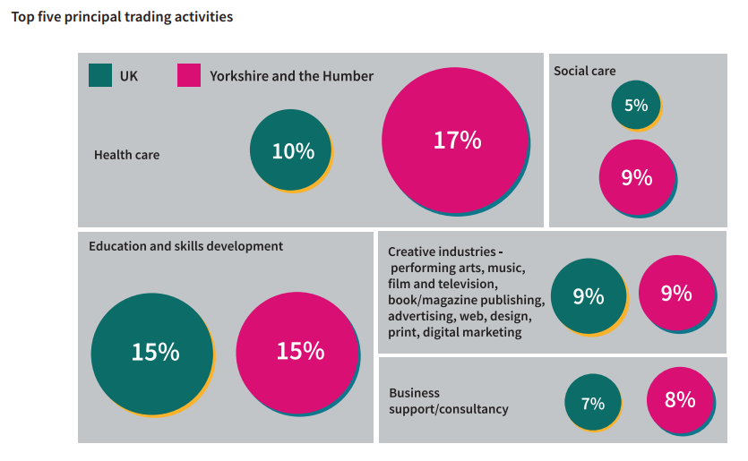
North Yorkshire and Social Enterprise
Regional State of Social Enterprise Reports 2022 | Social Enterprise UK
Notes:
In Yorkshire & Humber, Community Interest Companies (11%), Registered Societies, Cooperatives and Community Benefit Societies (6%)
In North Yorkshire, it is estimated that there are approx. 370 - which is around 5% of 7400 organisations. A report from SEYH shows the trading activities covered by Soc Ents

Slide 7
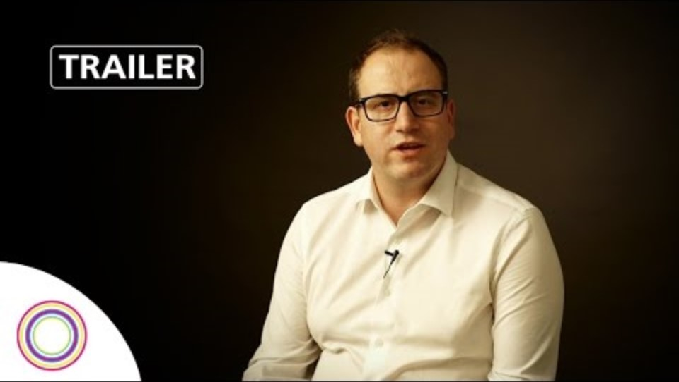
Outcomes
Personal growth
Enterprise growth
Community Impact
Notes:
Personal growth - Entrepreneurs will develop resilience, leadership, and confidence in managing their Social Enterprises
Enterprise growth - Improved business operations, financial sustainability, and clear pathways to scale their impact.
Community Impact - Social enterprises will contribute to addressing key challenges in North Yorkshire, such as improving social mobility and improved access to services and support.

Slide 8
What to expect
Healthcheck
Mentoring
Networking
Seed Funding
Peer Support
Getting Started workshop
Notes:
Paul = peer support and getting started
Su = healthcheck and mentoring
Joe = networking and seed funding

Slide 9




SOUP Project
Pitch your project for a chance to win
Notes:
Soup Project – a form of participatory funding – pitch your idea, the others vote and 3 winners get funding. Good to be able to summarise your project
Have a go ( in breakout rooms)

Slide 10
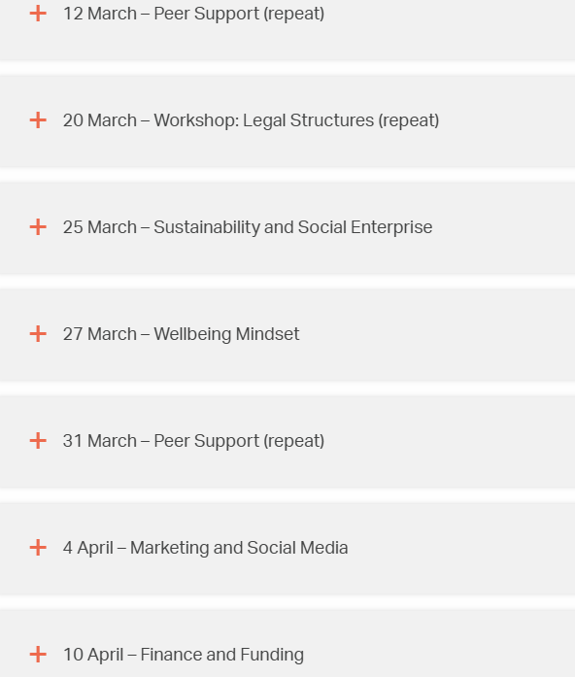
Dates
The Programme
Reserve your free spot:
Growth Hub launches programme of support for North Yorkshire Social Enterprises - Y&NY Growth Hub

Slide 11



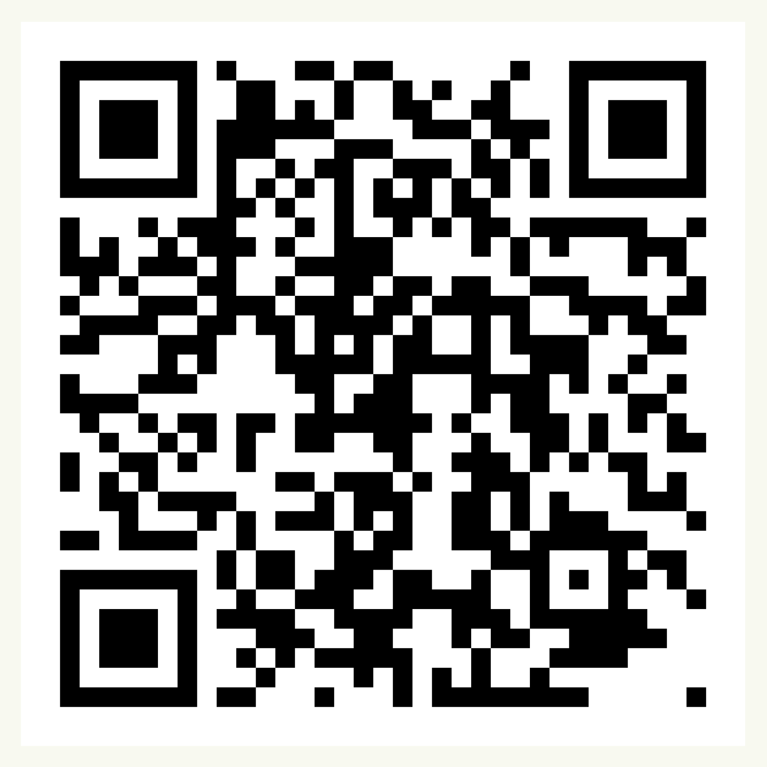
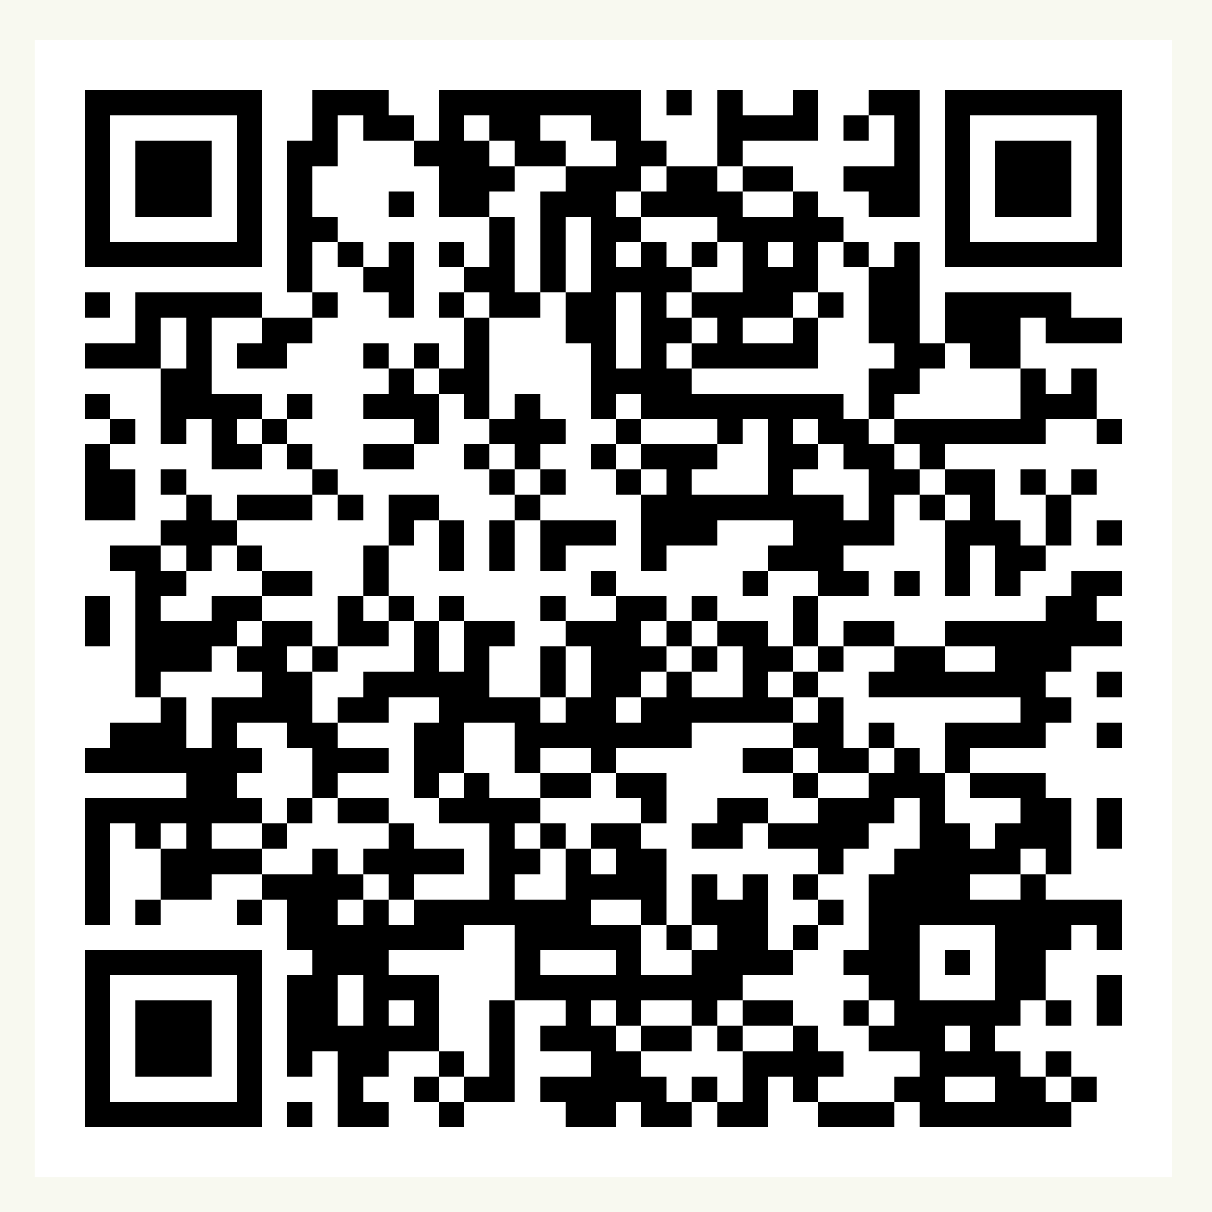
Over to you!
Soc Ent Support
Contact us at:
communitysupport@communityfirstyorkshire.org.uk
Sign up for our funding portal here:
Sign up to receive our newsletters here:
Notes:
https://forms.gle/jmTCRdr79QhnK4cb7
Link in the chat to what you can access and we will email out
We hope that has given you a flavour of our work and a clear picture of how and why we do what we do.
We are open to questions!

