Slide 1
Getting Started with Your Social Enterprise
A whistle Stop Tour

Slide 2









Welcome and Introductions
Things to consider before we begin
Notes:
We will be recording the meeting
Make yourself comfortable, anything you need, we will keep to time, take a break if you need. Open space to chat, contribute, network. Will send follow up notes et

Slide 3
What is a Social Enterprise?
An activity or organisation with the primary focus to provide a sustainable solution that achieves a social or environmental objective
Market Solution for a Social Problem
Notes:
Social ventures take many forms. They may be a charity, a social business or a community group. The common feature is that their main objective is to tackle an issue of social importance rather than to generate profits for an owner or shareholders.

Slide 4
Customers / Beneficiaries
These might be the same
These might be different
They need to be clearly identified
How do you know they need your services
What service will you provide to them?
Models
Robin Hood
B2B
B2C
Activity Time – 5 mins
Notes:
Activity – 5 mins to chat about who your customers might be and what model you are considering?

Slide 5
Vision, Mission and Values
Prism Youth Project
Vision – Aspirational, your cause
Mission – Practical, descriptive, what you do to make a difference
Values – The things you believe that underpin your idea and organisation

Slide 6

Vision
‘Unique opportunities for unique young people’

Slide 7
Mission
Provides alternative education and accredited youth work initiatives to those young people who struggle to achieve in more conventional settings. We offer guidance and support which aims to empower young people to move back into mainstream education, enter employment and undertake training opportunities.
Youth Centre – which includes a sports hall with climbing wall
City Farm – with a wide variety of large, small and exotic animals

Slide 8
Values
RESPECT – Respect for all young people and their families, for the many communities which make up our society and for all those adults and agencies who work with and on behalf of young people in difficult and demanding circumstances.
UNIQUE – Recognising all young people are unique – working together to create individual learning opportunities – working with young people individually or in small groups, being non-judgemental, inclusive and empowering.

Slide 9
Business Planning
Control and direct your Social Venture
Engage other people with your idea
Be Credible

Slide 10
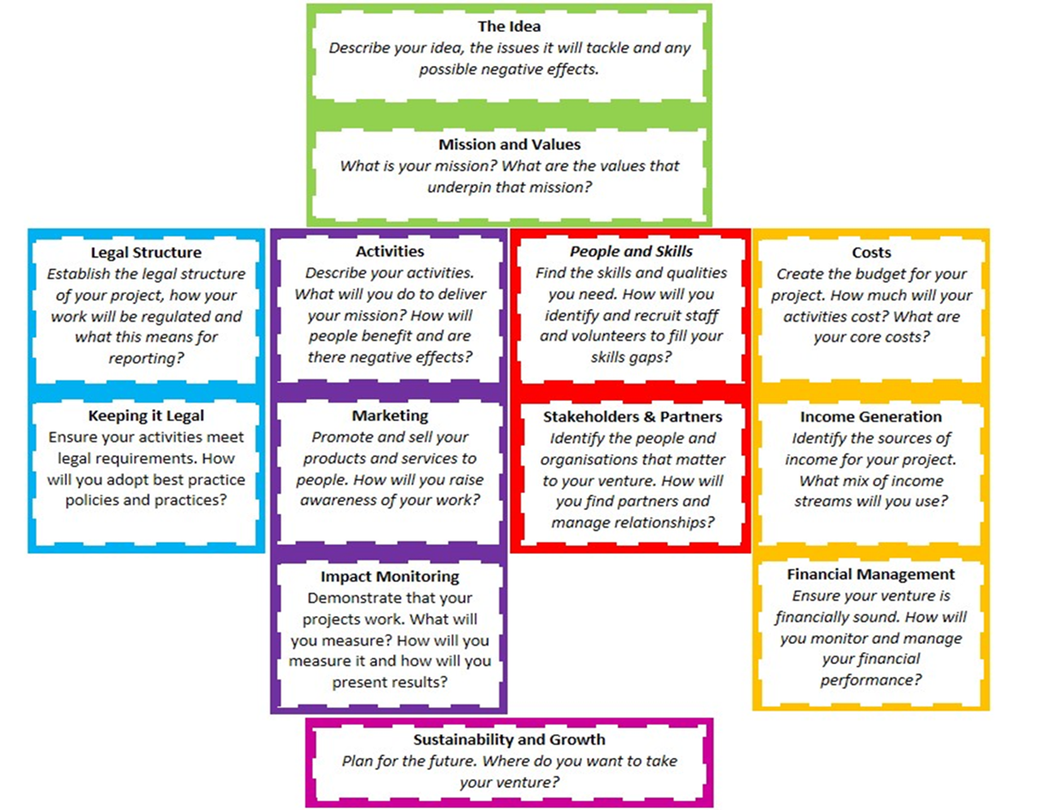

Slide 11
Your Idea
Activity Time – 5 mins
In pairs answer these questions in 2mins 30 secs each
What is the idea?
How did you come up with it?
Need and opportunity
What is the social or environmental benefit?
Unique Selling point

Slide 12
Legal Structures
What is the purpose of the organisation?
Do I need to be paid or employed AND sit on the board of the organisation?
Do I need to employ staff or take on contracts?
Will the idea require significant grant funding?
Will the organisation require significant investment?

Slide 13
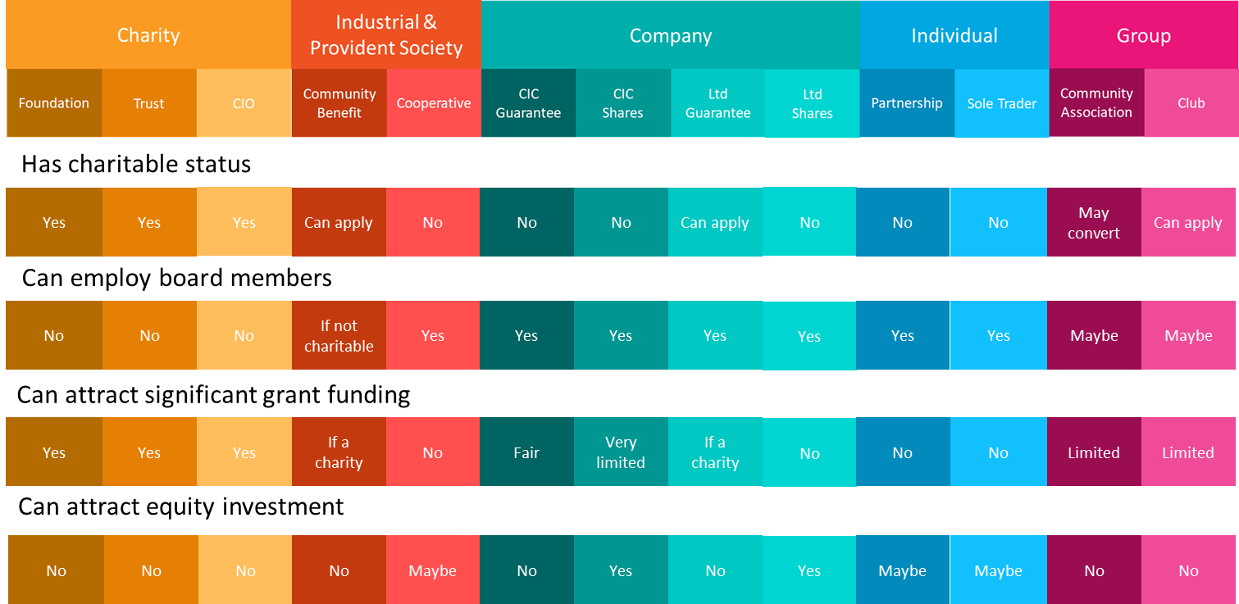

Slide 14
Legal Structures- Responsibilities
Trustees/Directors/Committee Members
Ensure the organisation meets objectives and respects obligations
Ensure the rules of the organisation are followed
Manage conflicts of interest
Produce and agree accounts & annual reports
Meet legislation obligations - Health and Safety, GDPR, Environmental, Employment etc.
Insurance
Ensure resources and assets used appropriately

Slide 15
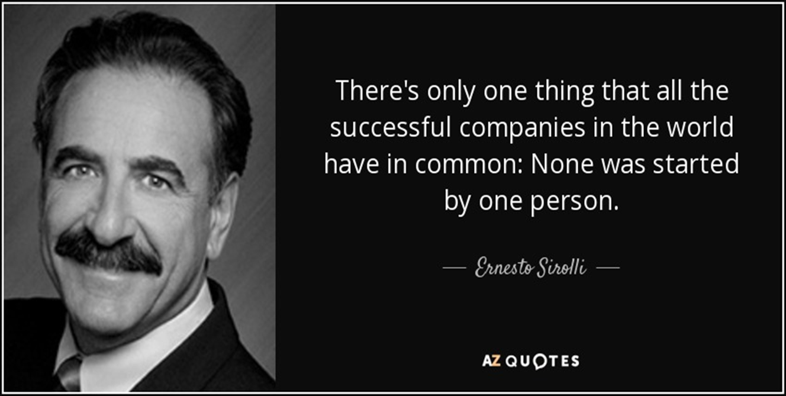
People and Skills

Slide 16
People and Skills
Marketing
Product or Service
Financial Management
Your Skills
Gaps you need to fill
Do I have the time?
Resilience

Slide 17
Stakeholders and Partners
Make a list of possible stakeholders. What categories do they fall into?
How would you go about identifying potential partners? List the things you would look for.
Activity –
Shout out!
Notes:
Social ventures take many forms. They may be a charity, a social business or a community group. The common feature is that their main objective is to tackle an issue of social importance rather than to generate profits for an owner or shareholders.

Slide 18
Communication
Market Research
Promotion of product or service
Securing support from funders and decision makers
Successful communication needs to identify who you need to hold the conversation with (stakeholder), what you want them to do and what you want to say (message) and how you will reach them (channel).

Slide 19
Impact Measurement
Why do we measure?
Who do we measure for?
What can we measure?

Slide 20
Regulators - Show you are doing what you said
Funders - Demonstrate value, attract support
Partners - Build a great reputation
Board, Staff and Volunteers - Motivate and create energy
The public - Drive support and fundraising
Politicians - Lobby for changes that support your mission

Slide 21
Keep it legal
Policies
Risk Assessments
DBS Checks
Insurance
Report filing
Good Governance

Slide 22



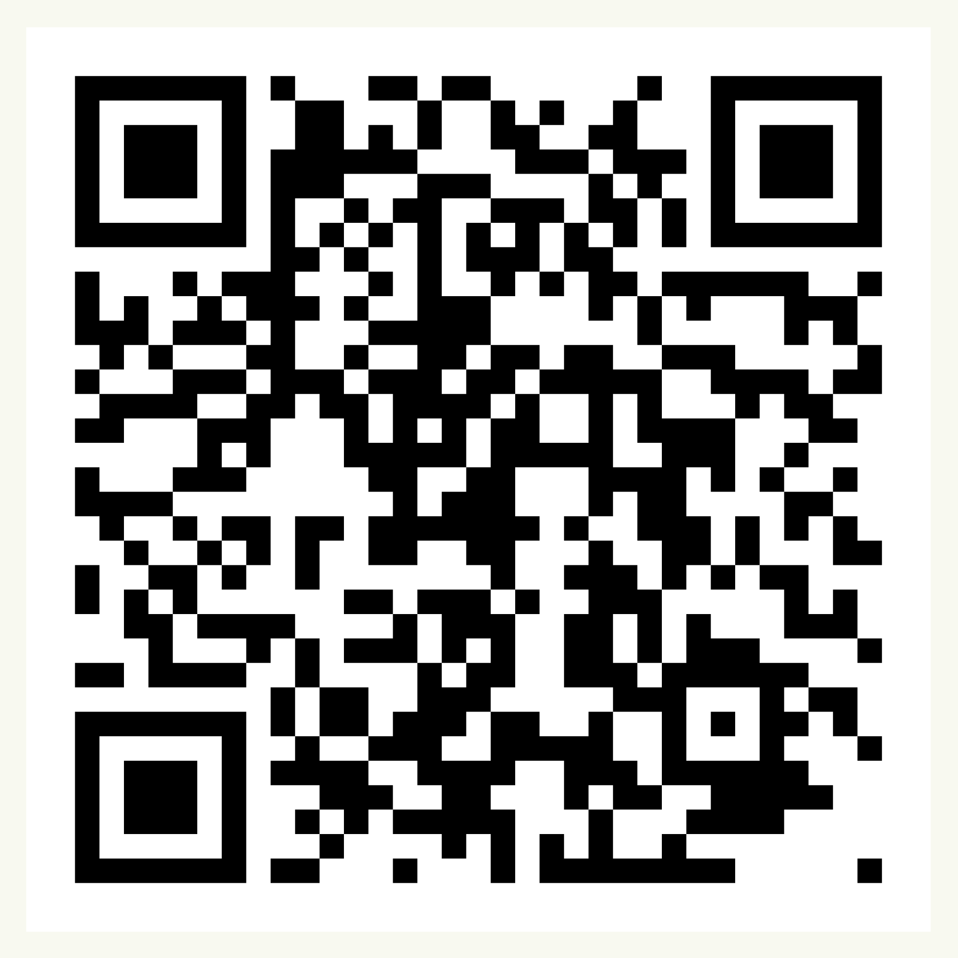
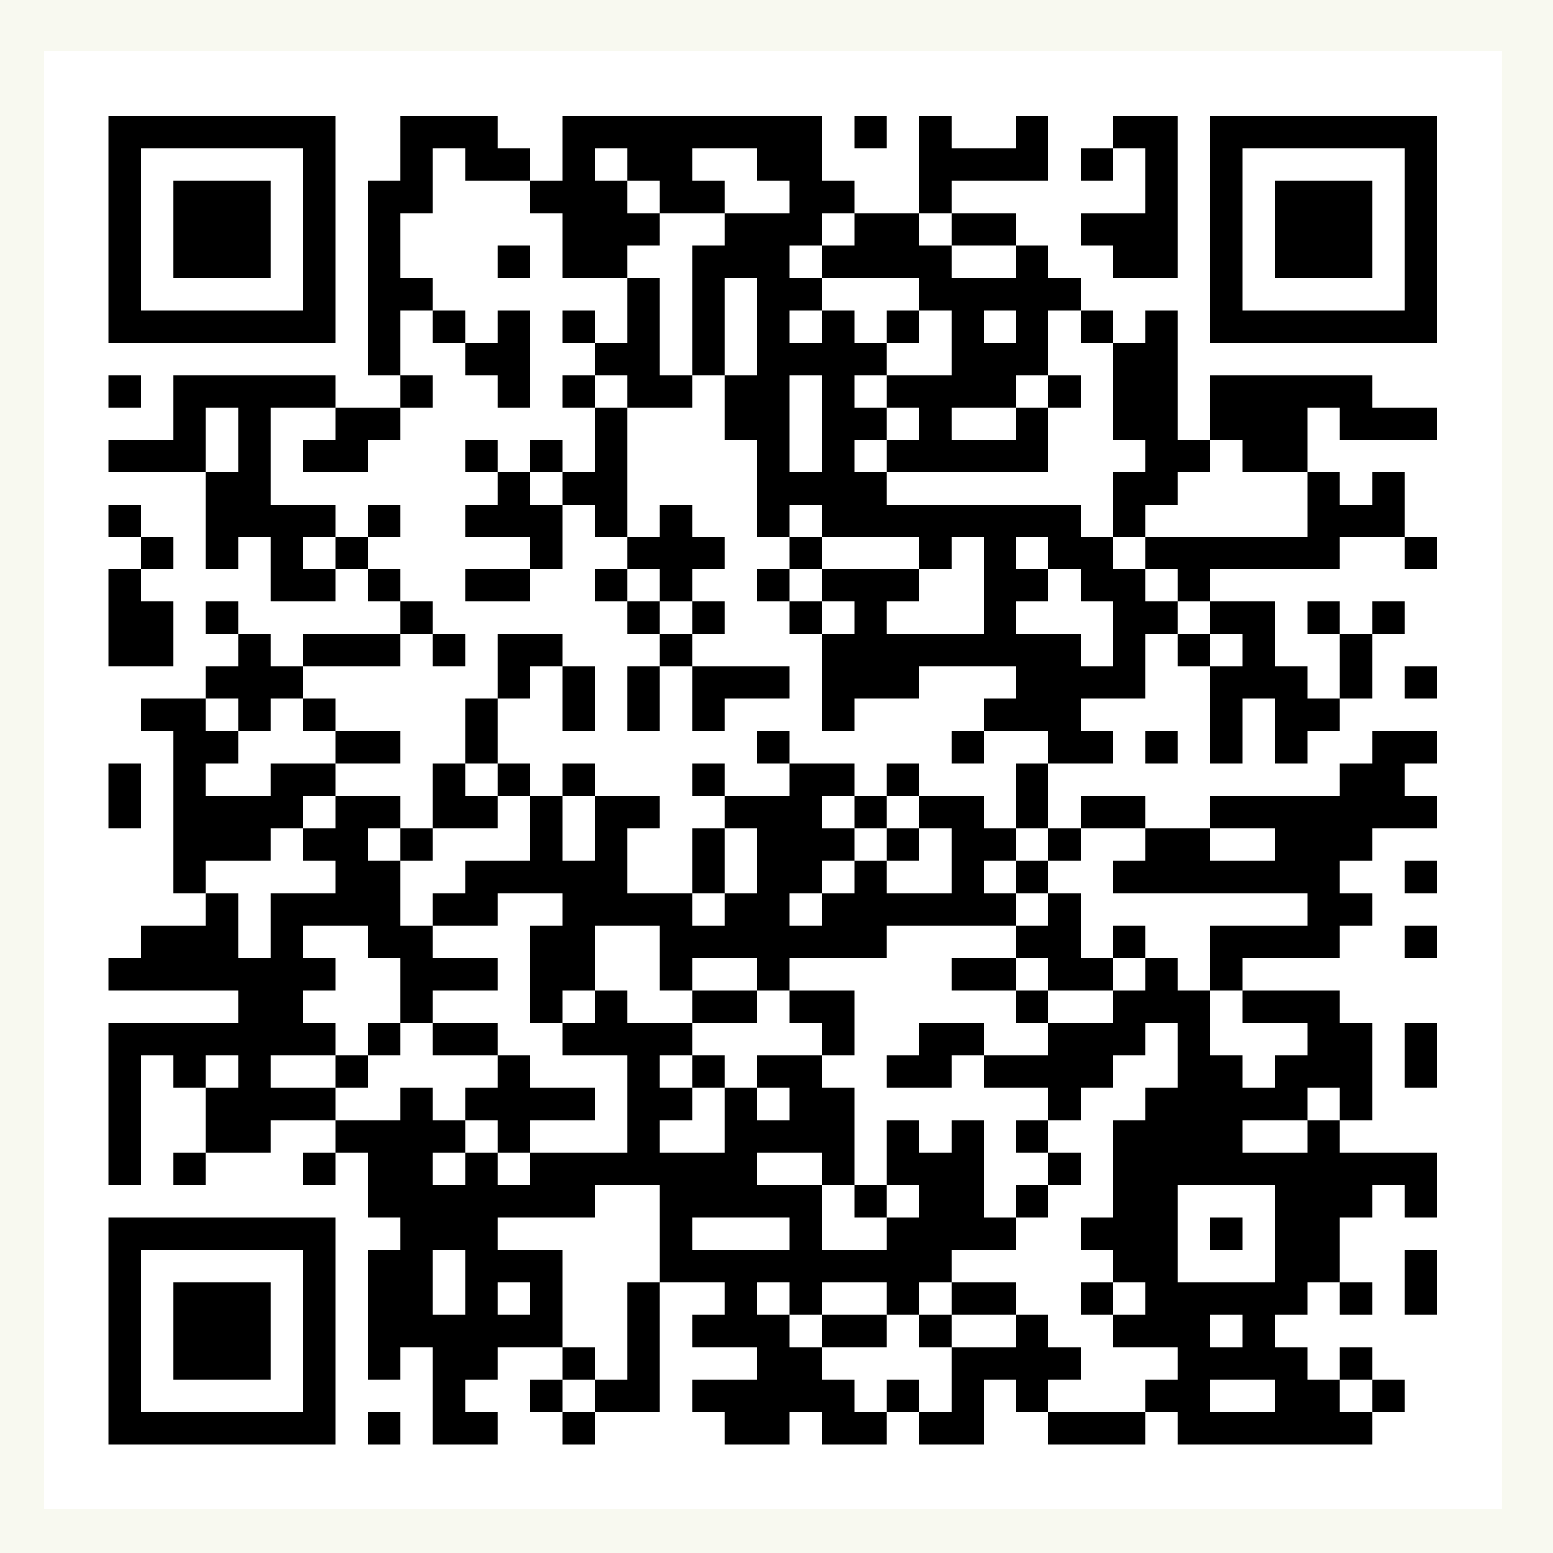
Over to you!
Soc Ent Support
Contact us at:
communitysupport@communityfirstyorkshire.org.uk
Sign up for our funding portal here:
Sign up to receive our newsletters here:
Notes:
https://forms.gle/jmTCRdr79QhnK4cb7
Link in the chat to what you can access and we will email out
We hope that has given you a flavour of our work and a clear picture of how and why we do what we do.
We are open to questions!

Slide 23
See you next time 😀
Paul Kilgallon
paul@participateprojects.org.uk

