Slide 1
Commissioning and Partnerships
Yorkshire and the Humber
May 2025

Slide 2
The Commissioning and Partnerships Team,
Yorkshire and The Humber
Liz Mills
Head of Community Integration
Elaine Colleran
Senior Contract Manager
Stephen Kerslake
Commissioning and Partnerships Manager
Clair Selman
Senior Contract Manager
Katie León Commissioning and Partnerships Manager
Darren Thompson
Commissioning and Partnerships Manager
Mary Scott
Commissioning and Partnerships Officer
Francine Clayton
Commissioning and Partnerships Officer

Slide 3


Vision: To commission services that are evidence based and meet genuine service delivery gaps
Mission: ‘Working together to protect the public and help people lead law-abiding and positive lives’
Desire: to be innovative in order to achieve better outcomes

Slide 4
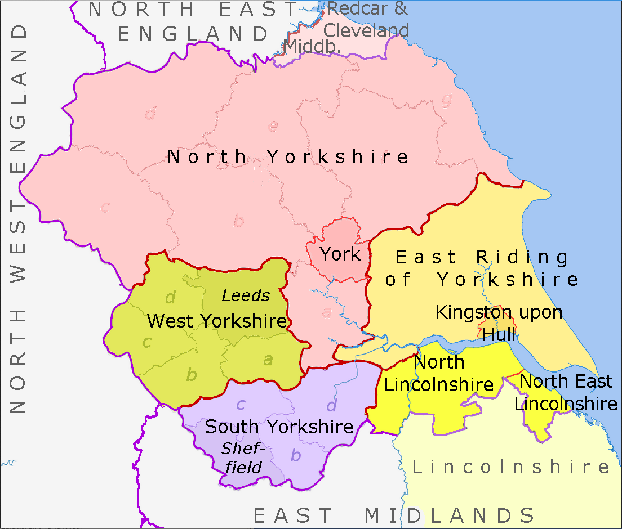
Geographical Area

Slide 5
How do we make decisions on what to commission in Yorkshire and the Humber?
Internal
Use data dashboards to identify areas of need across the region at regional and local level.
Work with our Probation Delivery Units to scope our local communities, to understand the current interventions and services available to meet these needs.
Identify genuine gaps in provision where there are no funding streams to address this.
External
Invite innovative ideas from our stakeholders
Explore options for co-commissioning

Slide 6
Commissioning Theme areas: Need based:
Accommodation
ETE
Finances
Drugs
Lifestyle and Associates
Thinking and Behaviour
Relationships
Emotional Well-being
Attitudes
Alcohol

Slide 7
To reduce re-offending, we need to enable people move…
From | To
IMPULSIVITY | Thinking of consequences, taking other people’s perspectives, and managing strong emotions
ATTITUDES THAT SUPPORT CRIME | A non-criminal identity that cares for others and feels optimistic about a life without crime.
PROBLEMATIC DRUG USE | Safe substance use or abstinence
DEPENDENT / BINGE DRINKING | Sensible drinking or sobriety
DEBT | Money management skills
HOMELESSLESS | Having and keeping suitable accommodation

Slide 8
To reduce reoffending we need to enable people move…
From | To
CRIMINAL SOCIAL NETWORKS | Having friends and social groups who aren’t involved in crime
POOR FAMILY RELATIONSHIPS | Mutually warm, caring and supportive family relationships
LACK OF WORK | Increased employability and achieving satisfying employment
POOR USE OF LEISURE TIME | Finding satisfaction in leisure activities that don’t involve crime

Slide 9
Our funding routes for commissioning services
National
Regional
Core Commissioned Rehabilitative Services (CRS) – Accommodation, Education,Training and Employment, Personal Wellbeing, Finance, benefit and Debt, Dependency and Recovery and Women’s Services.
Regional Outcomes Innovation Fund (ROIF)
Other specific funding streams (i.e. Integrated Offender Management fund)
Co-commissioning with other authorities and organisations.
Our next generation of these CRS services are currently in market engagement stage and are due to be launched……
All commissioning activity above the value of £10,000 is undertaken via open and fair competition and are accessed via the Ministry of Justice Sourcing Portal and/or via the Contracts Finder - GOV.UK and/or Find high value contracts in the public sector - GOV.UK
We advertise all opportunities via Homepage | Clinks and via a number of local VCSE Forums and Networks.

Slide 10
Commissioning Theme Areas: Potential Cohorts
Care experienced
IOM (Integrated Offender Management i.e high crime causers)
Age – younger People on Probation
Age – older People on Probation
Faith and religion
Race and ethnicity
Gender and/or Sexual Orientation
Offences types e.g. PCOSO specific type services.
Those with health conditions and/or Disability

Slide 11
Some previous commissioning examples:
We are working with local VCSE organisations to support people from ethnic minority backgrounds to thrive in education, training and employment
Horticulture intervention –Where PCOSO could attend a community provision to improve skills, self-esteem, communication – aiding their rehabilitation, whilst the Probation Service is assured that the appropriate safeguarding and risk management measures are in place
Restorative Justice – to improve the quality of victim awareness work undertaken within the Probation Service
Neurodiversity – We are working with small local VCSE Organisations to pilot interventions for People on Probation with Neurodivergent conditions

Slide 12
Useful Contacts
Local:
Yorkshire and the Humber Probation Service Commissioning mailbox: YatHPS.Commissioningenquiries@justice.gov.uk
National:
Esourcing Team (Jaggaer): Esourcing@justice.gov.uk
Probation Sourcing Team: ProbationSourcingTeam@justice.gov.uk
Prison Education Team: Commercial.PrisonEducation@justice.gov.uk

