Slide 1
CSJ and CSJ Foundation in Yorkshire
Ben Robinson, Regional Manager, Yorkshire and the Humber

Slide 2



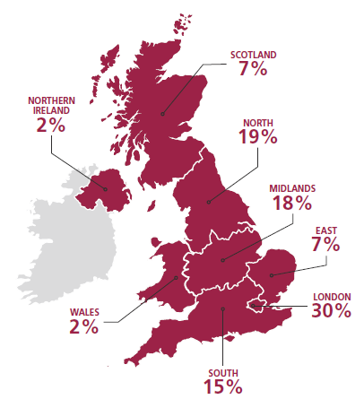

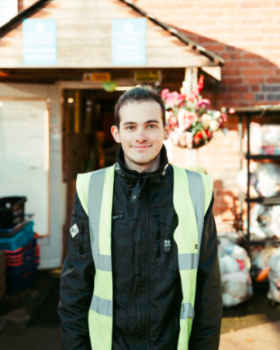

How we work
Over the last 20 years, the CSJ in conjunction with the CSJF, has developed unparalleled understanding of the root causes of poverty, identified through our alliance of over 750 UK wide small poverty-fighting frontline charities.
Understanding the frontlines
Problems are always being solved out there.
Policy Work
Poverty is about far more than just the absence of money.
Impact
Impact is everything.

Slide 3
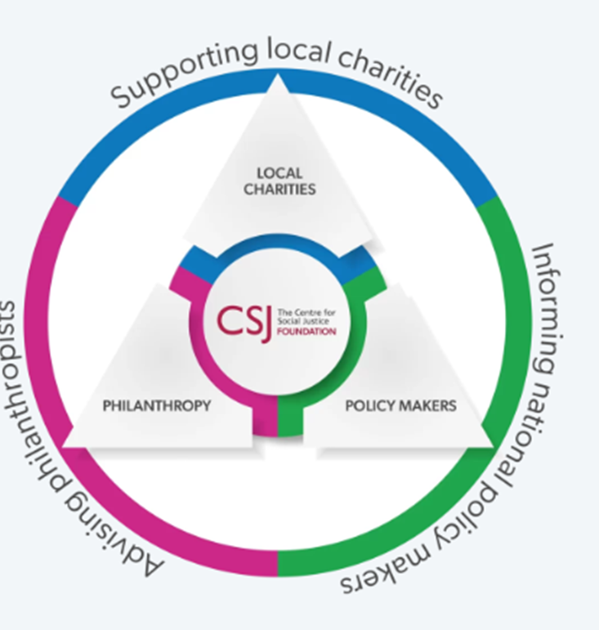
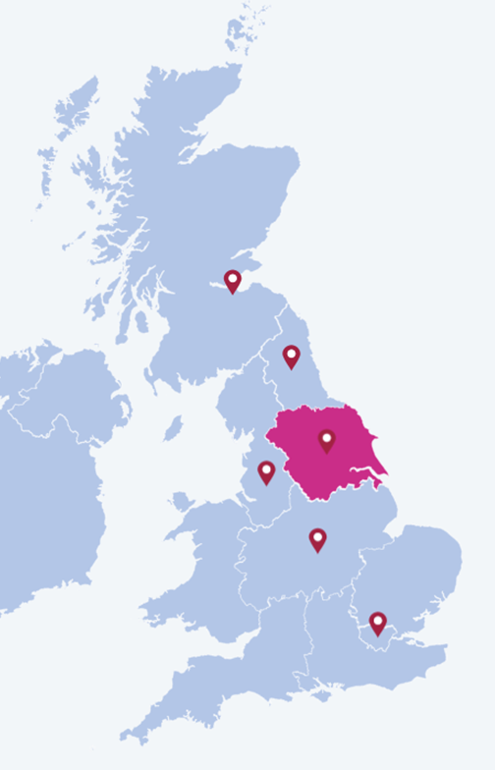

Since opening our Yorkshire office in 2023;
Our Alliance of outstanding grassroots poverty-fighting charities has grown to over 100.
£1.2 million directed into Yorkshire charities through the CSJF.
Yorkshire charities have actively shaped CSJ paper’s on:
-The future of foodbanks
-A new approach to mental health
-Labour exploitation
-Finding good work for young people
God’s own country

Slide 4
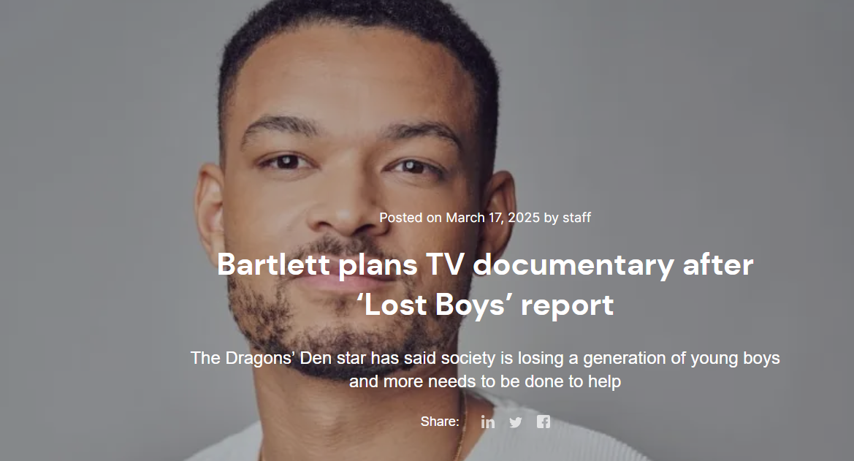
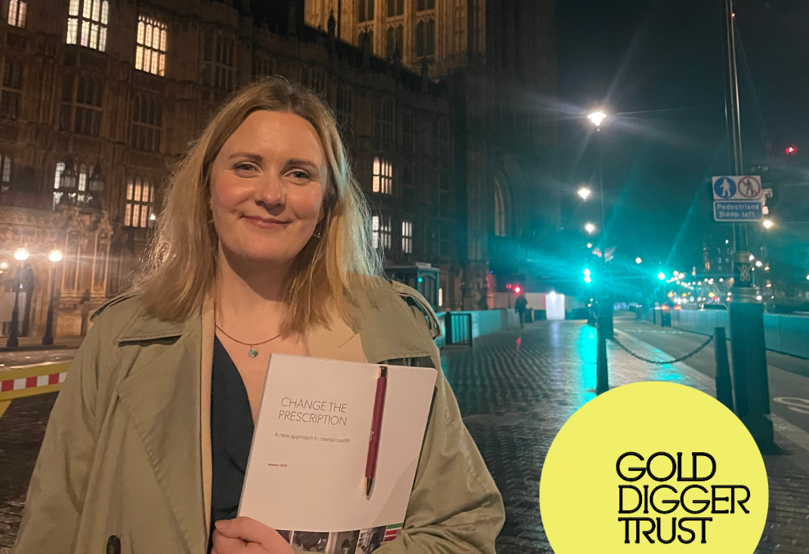
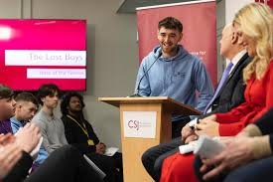
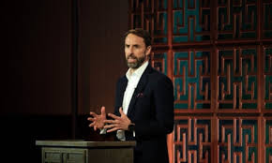
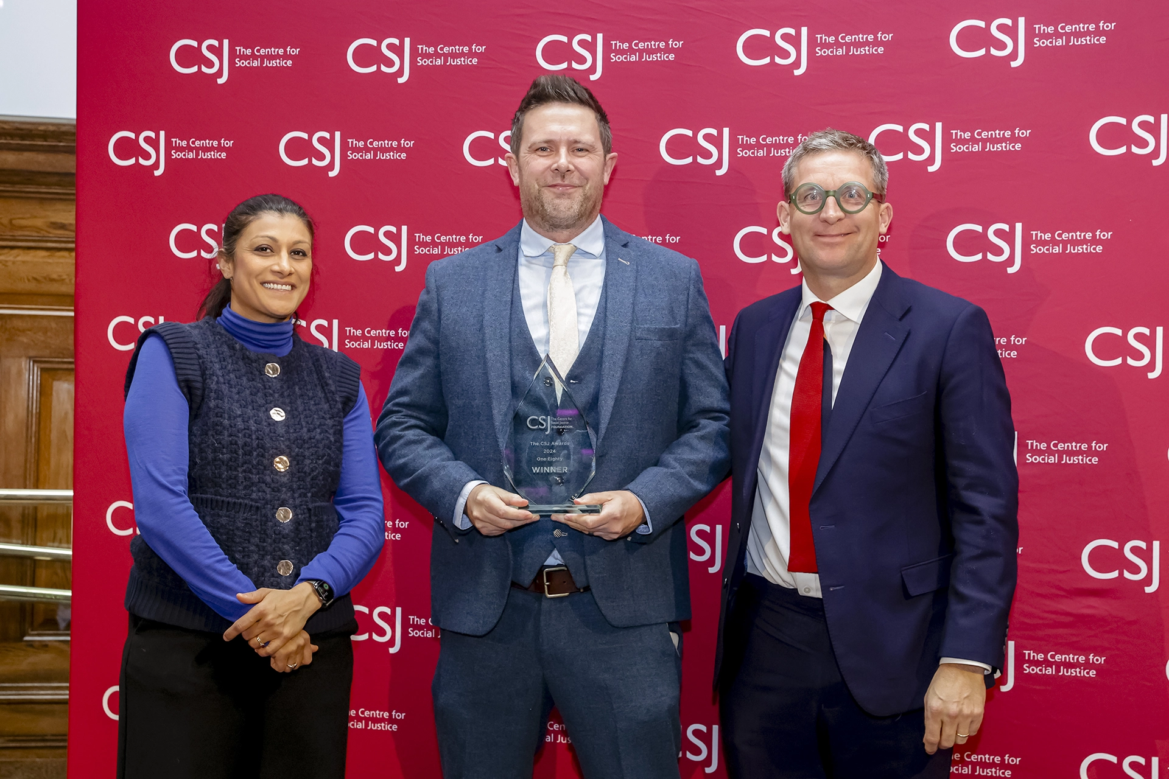
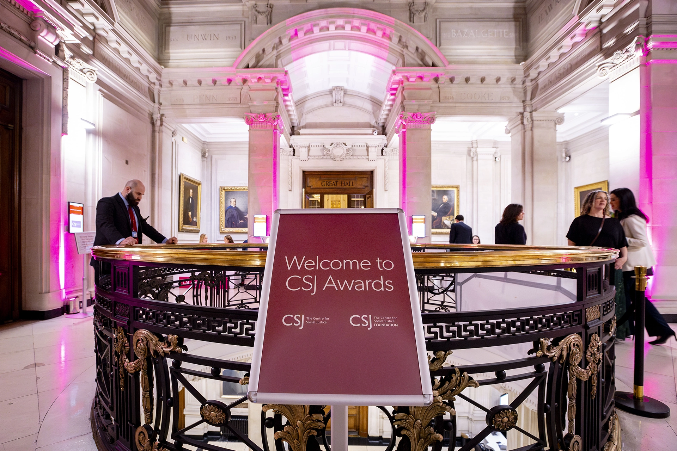
2025 so far
Policy
Connecting the backstreets of Britain with the corridors of power
-Launched our ‘Lost Boys’ state of the nation report, informed directly by charity visits in Yorkshire.
-Released ‘Change the Prescription’, a new approach to mental health. On which Yorkshire charity, Golddigger Trust, were an advisor.
Philanthropy
Putting social justice at the heart of British philanthropy
-Selected our 2025 CSJ Award finalists, including two based in Yorkshire.
-Hit nearly £1.5 million in philanthropy into Yorkshire, since our office opened in 2023.

Slide 5
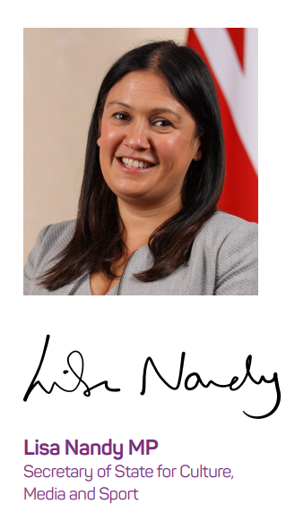
A new government, a new era?
“This Government recognises the enormous power of investment, philanthropy and the difference that purpose driven business can play…we want a new partnership with investors, business and charity.”

Slide 6


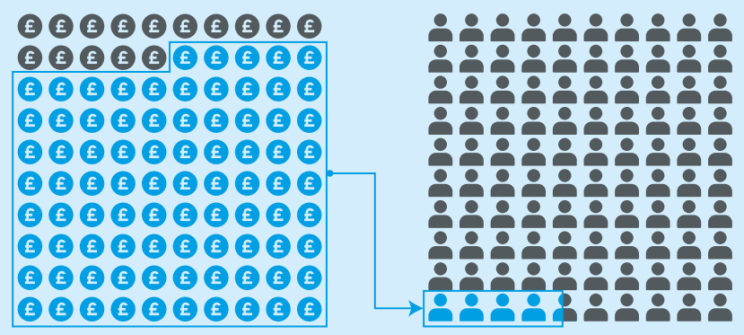




More demand, less resource
85% all charitable income goes to just 4% of charities.
Charities in London receive up to 8x more public funding.
Small charity funding dropped by £4.5 billion and rose by £4.6 billion for large charities.
1/2 of all small charities receive no public income. Government investment down over £400 million in the last decade.
44% of adults would like to discover and support more charities local to them.
Notes:
There is an uneven playing field of charity sector. 85% of all charitable income goes to just 4% of charities.
Regional disparity. Charities in London receive up to 8 times more public funding. London £120.24 per Capita; In South West: £18.68
Still recovering from the pandemic. Rising demand over time – therefore squeeze on existing resources and rising requests for funding. I am sure as funders and grantmakers you have seen this.
4. Squeeze on resources - half of all small charities do not receive any public income. Government investment fallen by over £400 m over last decade.
Over £1.1 billion is spent by charities each year applying for grants. Over two-thirds of applications are unsuccessful leading to over £700 million in wasted effort.
5. Public support see charitable work as the future. We know there are people willing to give, and we know there are good charities and enterprises doing life changing work. How do we match the two and supercharge philanthopy.

Slide 7
Any Questions?
Notes:
Upcoming policy on Education, Housing Lost Boys and more

Slide 8
Find out more about our work in Yorkshire:
Ben.Robinson@centreforsocialjustice.org.uk
Twitter (X): @csjthinktank and @CSJFoundation

