Slide 1

How to use this slide deck (Not to be presented)
This slide deck is not intended to be presented in its entirety, more as a tool to draw data from, including tables and figures to support your presentation.
You’ll find additional information in the notes section on the slides where context is needed, and please refer to the full report or summary report if you would like further information. Please get in touch with anna.boad@yorkcvs.org.uk if you require any additional slides.
Full Report - https://www.stchads.ac.uk/wp-content/uploads/2022/03/The-contribution-of-the-VCSE-sector-to-health-and-wellbeing-in-Humber-Coast-and-Vale-February-2022.pdf
Summary Report - https://www.stchads.ac.uk/wp-content/uploads/2022/03/Summary-report-The-contribution-of-the-VCSE-sector-to-health-and-wellbeing-in-Humber-Coast-and-Vale-February-2022.pdf

Slide 2


VCSE Collaborative
The Contribution of the VCSE Sector to Health and Wellbeing in Humber and North Yorkshire - Report Findings 2022

Slide 3
Background:
The ‘Contribution of the VCSE Sector to Health and Wellbeing in Humber and North Yorkshire’ report was commissioned by the Humber and North Yorkshire Health and Care Partnership and the VCSE Collaborative to understand more about the sector and how our geography and the places that make up Humber and North Yorkshire are served.
Professor Tony Chapman, St Chad’s College, Durham University has worked with the VCSE Collaborative to complete an initial look at the size, scale and value of the sector, and the contribution it makes in relation to the health and wellbeing of our people.
The findings within this report begin to plot the VCSE sector alongside the differences we see across Humber and North Yorkshire in terms of deprivation, health inequalities and our geography.
Notes:
Full Report – The-contribution-of-the-VCSE-sector-to-health-and-wellbeing-in-Humber-Coast-and-Vale-February-2022.pdf (stchads.ac.uk)
Summary Report - Summary-report-The-contribution-of-the-VCSE-sector-to-health-and-wellbeing-in-Humber-Coast-and-Vale-February-2022.pdf (stchads.ac.uk)

Slide 4
The VCSE Sector in local context
Area profile of Humber and North Yorkshire
Distribution of VCSE organisations

Slide 5
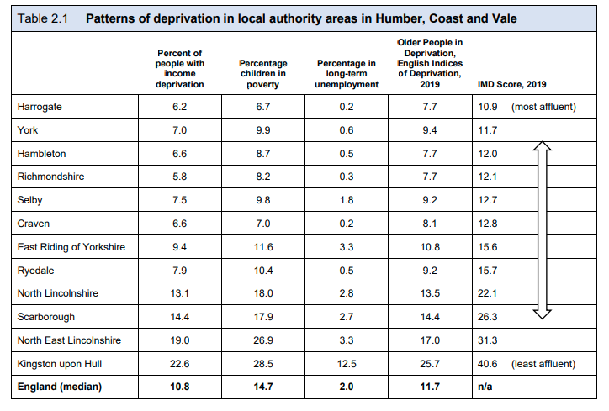
Patterns of deprivation
The table shows the wide disparities in affluence across Humber and North Yorkshire.
Long-term employment is a strong indicator of income deprivation.
Notes:
Variations in local socio-economic circumstances are likely to shape patterns of demand for services provided by the public, private and VCSE sectors.
Long-term employment is a strong indicator of income deprivation. In Hull, over 12 per cent of the population are in such a situation compared with fewer than 1 per cent in every North Yorkshire district apart from Scarborough (2.7 per cent) and Selby (1.8 per cent). Variations in the percentage of older people living in deprivation follows a similar pattern. Over a quarter of older people have income deprivation in Hull compared with only 8 per cent in Harrogate.

Slide 6
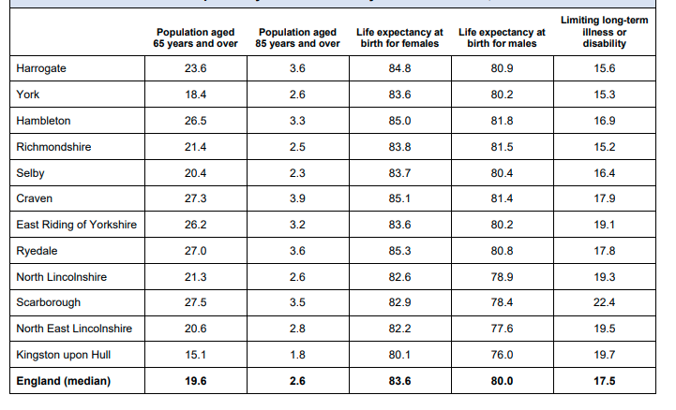
Patterns of life expectancy
The life expectancy of males and females tends to be much higher in more affluent areas.
This tends to produce a higher concentration of people over the age of 85 in more affluent areas – which in turn may shape patterns of demand for health and social care support.

Slide 7
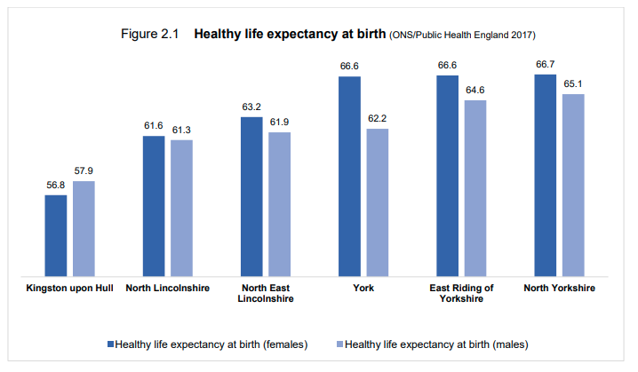
Healthy life expectancy at birth
Health life expectancy is highest in North Yorkshire at 67 for females and 65 for males.

Slide 8
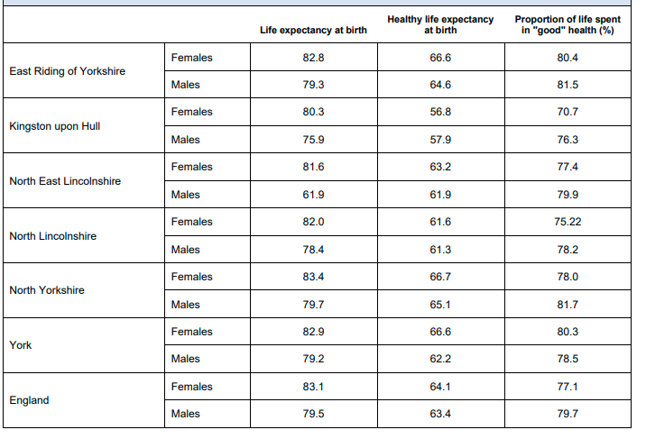
Life expectancy and healthy life expectancy at birth
Notes:
As Table 2.3 demonstrates, the proportion of the life span with ‘good health’ varies considerably across areas. The likelihood is, however, that variations in statistics will be much more pronounced in each local authority area when comparing the most and least affluent neighbourhoods.

Slide 9
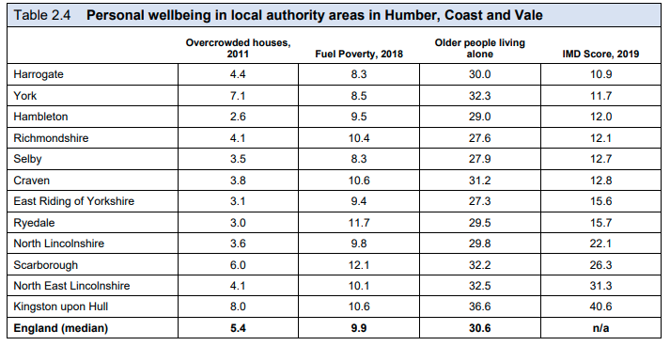
Personal wellbeing

Slide 10
Personal wellbeing
Levels of personal wellbeing are shaped by the living conditions of individuals.
Affluence or deprivation has an impact on levels of demand for services in localities.
For example, overcrowding in houses tends to be more prevalent in the less affluent areas of Hull (8%) and Scarborough (6%), but also in York which has significant pockets of deprivation together with high levels of demand for urban accommodation.
Notes:
Levels of personal wellbeing are shaped by the living conditions of individuals. As shown in Table 2.4, there are variations in this aspect of wellbeing according to levels of area affluence – but not to the same extent as when comparing income deprivation.
For example, overcrowding in houses tends to be more prevalent in the less affluent areas of Hull (8 per cent) and Scarborough (6 per cent), but also in York which has significant pockets of deprivation together with high levels of demand for urban accommodation. Fuel poverty is almost equally common across all areas, running between 8 and 12 per cent.
Similarly, variations in the percentages of older people living alone are not heavily pronounced, ranging between 27 and 32 per cent in all areas apart from Hull where 37 per cent of older people live alone. This indicates that support for socially isolated people may be high across the whole of Humber and North Yorkshire.

Slide 11
Personal wellbeing
Levels of personal wellbeing are shaped by the living conditions of individuals.
Fuel poverty is almost equally common across all areas, running between 8% and 12%.
Variations in the percentages of older people living alone range between 27% and 32% in all areas apart from Hull where 37% of older people live alone. This indicates that support for socially isolated people may be high across the whole of Humber and North Yorkshire.

Slide 12
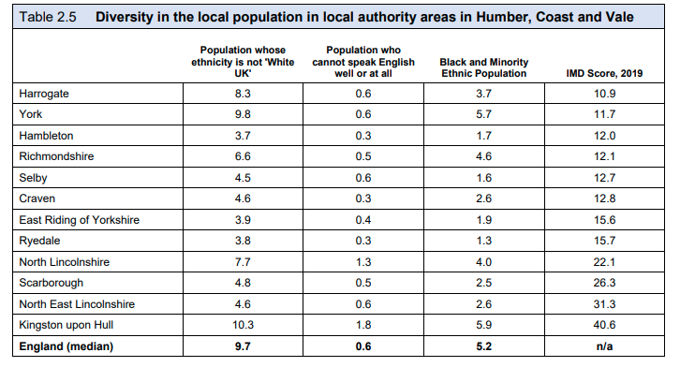
Diversity
*English Indices of Deprivation (IMD) 2019

Slide 13
Diversity
Patterns of social diversity can shape levels of demand for services.
The situation in Humber and North Yorkshire is quite complex.
The highest concentration of ‘none White UK’ residents are in Hull, York, Harrogate and North Lincolnshire.
The Black, Asian and Minority Ethnic population tends to be quite low in Humber and North Yorkshire compared with other parts of Yorkshire.

Slide 14
Distribution of Voluntary, Community and Social Enterprise (VCSE) Sector organisations
Notes:
Affluence or deprivation has an impact on levels of demand for services in localities. It is necessary to look at the distribution of VCSE organisations across unitary local authorities and county council districts, coastal and inland areas, and in rural and urban areas.

Slide 15
VCSE organisations across Humber and North Yorkshire
There are an estimated 13,512 VCSE organisations operating across Humber and North Yorkshire.
The majority of VCSE organisations in Humber and North Yorkshire are registered charities, but about a quarter are organisations with other legal forms, such as Community Interest Companies (CICs) and Cooperatives, and Community Benefit Societies (CCBS).
‘Unregistered’ organisations, associations, societies and groups could number over 7,500 across Humber and North Yorkshire.

Slide 16
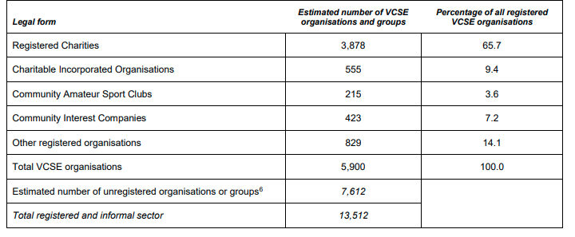
Distribution of VCSE organisations
Table 2.6 Estimated number of VCSE organisations and groups in Humber and North Yorkshire
Notes:
The majority of VCSE organisations are registered charities, but about a quarter of the registered sector is comprised of organisations with other legal forms, such as Community Interest Companies (CICs) and Cooperatives and Community Benefit Societies (CCBS).
There are proportionally fewer charities in the poorest quintiles than in more affluent areas. There are many more VCSE sector organisations in more affluent areas than in more deprived areas. (See figure 2.2 in the full report for more indepth data)
Estimates suggest that ‘unregistered’ organisations, associations, societies and groups could number over 7,500. Evidence suggests that such entities are likely to be small, informal in structure and address issues of interest to their members or participants. Little is known about their activities, however, so this report focuses entirely upon registered organisations about which much more data are available.

Slide 17
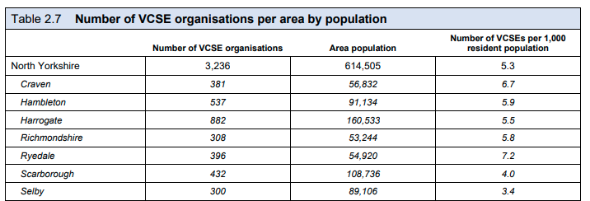
VCSE organisations in North Yorkshire

Slide 18
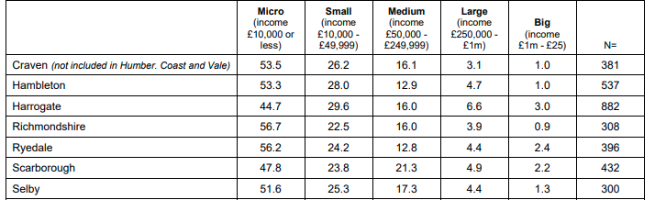
VCSE organisations in North Yorkshire by size
Table 2.8 Number of VCSEs by size

Slide 19
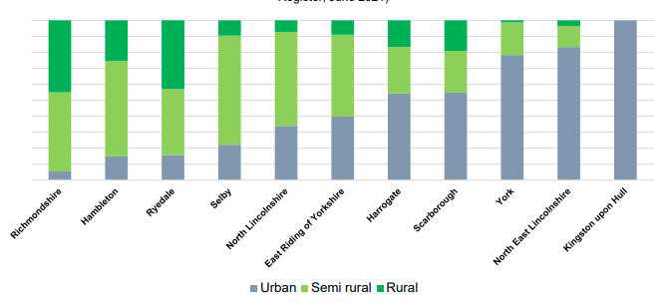
Percentage of VCSE organisations in rural and urban areas
Notes:
Figure 2.4 shows how organisations are distributed by spatial characteristics in each local authority or district in Humber and North Yorkshire. The most rural districts and authorities feature to the left of the graph and the most urban to the right.
The main urban centres are located in Hull, York, Harrogate, Scunthorpe, Grimsby and Scarborough. But there are also many smaller market towns which serve large rural hinterlands, such as Whitby, Richmond, Northallerton, Thirsk, Ripon and Pickering. The neighbouring metropolitan areas of Bradford and Leeds will have an impact on area dynamics in close-by districts of Humber and North Yorkshire due to commuter flows into cities.

Slide 20
VCSE organisations in rural and urban areas
In urban areas there is a much larger proportion of larger or big VCSE organisations (14%) when compared with market towns (4%) or rural areas (5%).
In rural areas there is a much larger proportion (57%) of very small ‘micro’ VCSE organisations (with annual income below £10,000).
These variations will have a substantial impact on the extent to which the local VCSE sector has the capacity to tackle specific activities.

Slide 21
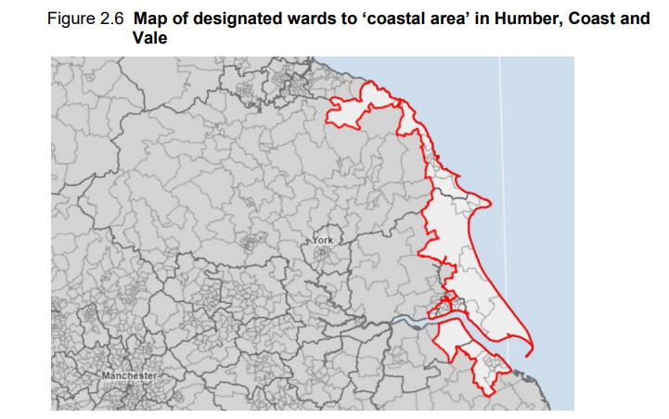
VCSE organisations in coastal areas
In the Humber and North Yorkshire Health and Care Partnership area, there is a concern that local needs may be particularly pronounced in coastal areas.
61 wards were identified as ‘coastal areas’ (Figure 2.6)
Notes:
There is no nationally agreed definition of ‘coastal areas’ in England: see Whitty, C. (2021) Chief Medical Officer’s Annual Report 2021: health in coastal communities – summary and recommendations. Chief Medical Officer's Annual Report 2021 - Health in Coastal Communities – Summary and recommendations (publishing.service.gov.uk)
. In this report, the definition adopted by Scotland’s CMO is adopted which stipulates that a coastal community area is defined as 5km inland area from the coast. Unfortunately this cannot be achieved precisely, due to variations in ward size, but as close an approximation as possible is adopted as shown in Figure 2.5. See for more detail on the definition of coastal areas in Scotland, James Hutton Institute (no date) Scotland’s Coastal Assets.
hutton_coast_booklet_web.pdf
Distinctions between ‘coastal’ and ‘non-coastal’ areas may be affected by the inclusion of Kingston upon Hull in these areas. Because the city has a large VCSE sector and a larger than average proportion of bigger VCSE organisations, there is a likelihood that this may skew data and affect findings. Unfortunately, there are too few respondents in the remaining areas to make reliable comparisons. It is hoped that this may be rectified in the next round of the Third Sector Trends study which is scheduled to take place in the summer of 2022.

Slide 22
VCSE organisations in coastal areas
VCSE sector structure appears to be broadly similar in coastal and inland areas. However, there is a larger number of VCSE organisations with income above £250,000 in coastal areas which has a significant bearing on overall sector resources.
In coastal areas, nearly 32% of VCSE organisations are located in the poorest quintile of deprivation compared with just 4% in non-coastal areas.
Only 5% of VCSE organisations in coastal areas are located in the most affluent areas compared with 33% in inland areas.

Slide 23
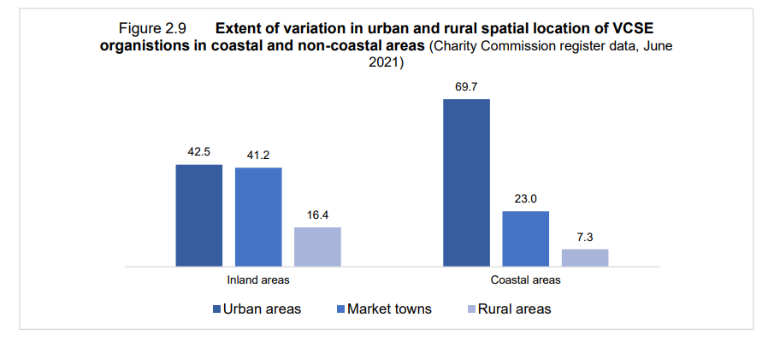
VCSE organisations in coastal areas
These wide variations in VCSE organisational location are due to the geographical characteristics of coastal and non-coastal areas.
Figure 2.9 shows that 69% of VCSE organisations in coastal areas are located in urban areas compared with just 43% in non-coastal areas.

Slide 24
VCSE Sector Capacity
Income
Employees
Volunteers
Interactions

Slide 25
VCSE Sector Capacity across Humber and North Yorkshire
In 2020, the VCSE sector in Humber and North Yorkshire had an income of nearly £1billion and expenditure of £948 million.
Income and expenditure is not distributed evenly across the sector. The biggest organisations command the largest share of the sector’s income.

Slide 26
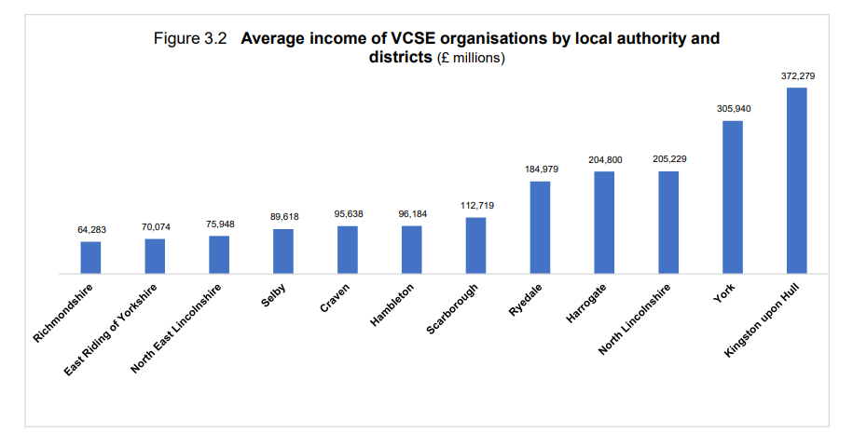
VCSE Sector Capacity across Humber and North Yorkshire
The distribution of VCSE organisations in local authority areas varies considerably – with bigger organisations based mainly in larger urban areas. This has a significant impact on the average income of VCSE organisations in local authorities and districts.

Slide 27
VCSE Sector Employees – Humber and North Yorkshire
Around 23,200 VCSE sector employees deliver 38 million hours of work annually.
The staff costs of VCSE organisations amount to £613 million.
There are significant variations in the number of employees in local authorities due to differences in the size of organisations in those areas. Average numbers of employees tend to be much higher in the urban areas of Harrogate, York, Hull and North East Lincolnshire.

Slide 28
VCSE Sector Volunteers – Humber and North Yorkshire
It’s estimated that around 128,000 volunteers provide 9 million hours of work which represents about 25% of additional resource to the sector.
The replacement cost of this work would amount to between £80 million and £125 million if delivered by paid employees.
There are many more regular volunteers in more affluent districts of North Yorkshire and York. Levels of regular volunteering for VCSE organisations in North and North East Lincolnshire and Hull are much lower.

Slide 29
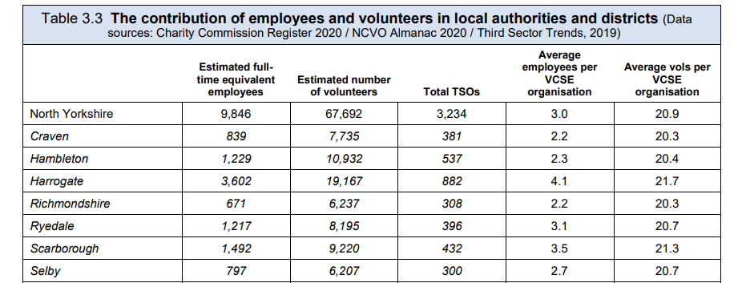
Contribution of employees and volunteers in North Yorkshire

Slide 30
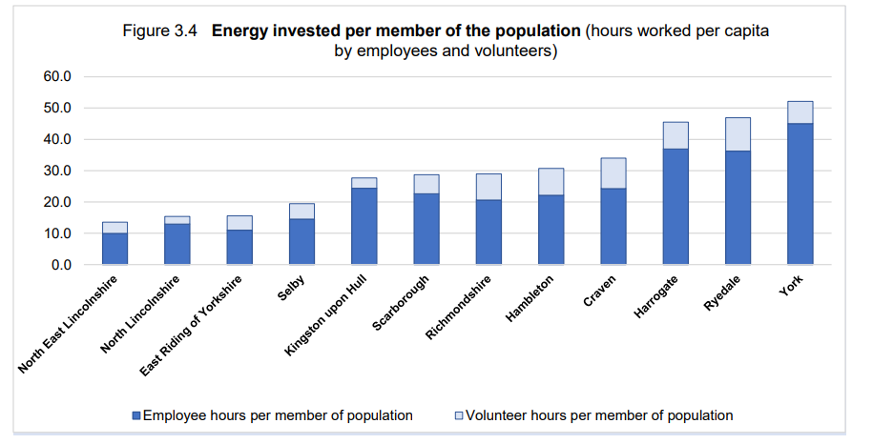
‘Energy’ invested by VCSE
Sector Employees and Volunteers
Notes:
When interpreting these data, it should be noted that VCSE organisations do not necessarily limit the range of their activity to their immediate locality.
The cumulative energy of employees and volunteers is uneven across local authorities and districts. As shown in Figure 3.4, the average number of hours invested in the resident population by VCSE sector employees and regular volunteers varies considerably.
About 28% of VCSE organisations which are based in Humber and North Yorkshire work at sub-regional or regional level in Yorkshire and Humber. Only 9% of organisations work across regions, at national or international level.

Slide 31
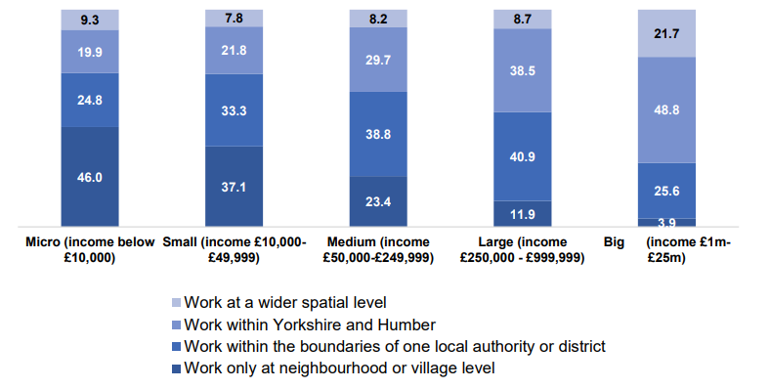
VCSE Sector Interactions
Figure 3.6
Variations in the extent to which VCSE organisations work within or across spatial boundaries in Humber and North Yorkshire
(Third Sector Trends, North of England, n=2,935)
Notes:
The above analysis looks at the activities of VCSE organisations at an individual level. It is important also to take into account the extent to which organisations work together in informal or formal ways.
Larger VCSE organisations are much more likely to work across spatial boundaries and have the greatest capacity to deliver work across communities. As shown in Figure 3.6, only 4 per cent of the biggest organisations work at neighbourhood or village level. By contrast, smaller VCSE organisations are much more likely to work at a local level. For example, 46 per cent of micro VCSE organisations work only at village or neighbourhood level.

Slide 32
VCSE Sector Interactions
80% of VCSE organisations stated that they have useful informal relationships with other voluntary organisations and groups and a further 7% show a willingness to do so in the future.
Nearly 70% of organisations work quite closely, but informally, with other voluntary organisations and groups, and about 12% more show an interest in doing so in future.
Fewer VCSE organisations work in formal partnership arrangements - only 30 per cent do so, but many more are considering this prospect (around 21%)

Slide 33
VCSE Sector Interactions – Grants and Contracts
Formal relationships are often forged when VCSE organisations are working on bids for grants and contracts but general interest in partnership bidding, and the percentage of successful VCSE organisations has fallen from 21% to 17%.
The percentage of VCSE organisations which have been successful in winning partnership bids fell from 21% in 2013 to 15% in 2019.
VCSE organisations which are not considering the prospect of partnership bidding rose from 47% in 2013 to 64% in 2019. This could be due to the size of organisations as larger organisations are much more likely to be interested in or successfully delivering contracts.
Notes:
General interest in bidding for grants or contracts in partnership seems to have declined to some extent in Humber and North Yorkshire in recent years. The percentage of VCSE organisations which have been successful in winning partnership bids fell from 21 per cent in 2013 to 15 per cent in 2019. Perhaps of greater concern is the percentage of VCSE organisations which are not considering the prospect of partnership bidding – which rose from 47 per cent in 2013 to 64 per cent in 2019.
The steepest decline appears to be amongst VCSE organisations with income between £250,000 and £1million. For the largest VCSE organisations, participation in contract delivery has remained broadly similar (falling only slightly from 67 per cent in 2013 to 64 per cent in 2019).

Slide 34
Engagement with
Health and Wellbeing

Slide 35
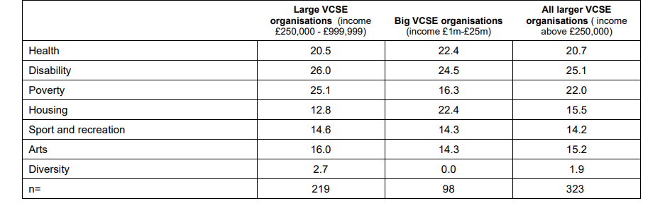
Public Health Related Issues
Table 4.1
Percentage of charities engaging with public health related issues in Humber and North Yorkshire (Charity Commission Register data 2021)
Notes:
It is not easy to determine how VCSE ‘energy’ is distributed across the range of social, environmental and economic issues within Humber and North Yorkshire. This is because most VCSE organisations work across thematic areas such as health, personal wellbeing, community wellbeing and personal financial security.
Data from the Charity Commission on organisational purpose amongst smaller VCSE organisations is only of limited value because of high levels of non-completion of categories, especially by smaller VCSE organisations. The available data for larger and big organisations provides a reasonable indication of levels of engagement with public health associated issues such as addressing poverty, housing, sport and recreation and so on.
As shown in Table 4.1, amongst the 323 larger registered charities in Humber and North Yorkshire (with income above £250,000), about 20 per cent directly engage with health issues (together with 25 per cent who address issues associated with disability). Many other organisations work on associated public health issues such as poverty (22 per cent), housing (16 per cent), sport and recreation (14 per cent) and the arts (15 per cent). Very few organisations report that they address issues surrounding diversity (2 per cent).

Slide 36
Public Health Related Issues – VCSE Impact
Many VCSE organisations feel that they make a ‘strong’ or ‘important’ contribution to public health by addressing issues such as:
Health and Wellbeing – 61%
Giving people the confidence to manage their lives – 45%
Tackling Social Isolation – 59%
Improving access to basic services – 30%
Notes:
It is clear that bigger organisations tend, in general terms, to claim higher levels of impact than smaller ones. This requires careful interpretation. VCSE organisations would be expected to claim that they have a stronger impact because their scale of activity helps them to achieve more. It may be that larger VCSE organisations are more familiar with policy narratives surrounding social impact. From an interpretive point of view, therefore, there may be a risk that smaller VCSE organisations under-estimate their impact for those people they support.

Slide 37
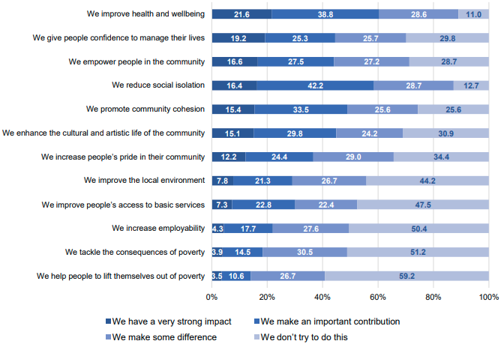
Public Health Related Issues –
VCSE Impact
Figure 4.1 Humber and North Yorkshire Health and Care Partnership area - VCSE organisations' perceptions of impact (Third Sector Trends 2019)

Slide 38
Meeting critical personal and social needs
Across Humber and North Yorkshire, the VCSE sector is structured in such a way as to meet critical local needs.
This means that there tends to be a concentration of provision in areas where needs are greatest.
There is a concentration of VCSE capacity in urban and poorer areas to meet ‘critical needs’, while provision for aspects of personal and social development is higher in rural and more affluent areas.

Slide 39
Meeting critical, personal and social needs
Table 4.3 Percent of charities working in domains of social benefit (Charity Commission Register 2021)
 | Health | Disability | Poverty | Housing | Sport and Recreation | Arts and Heritage | Diversity | Number of charities
Richmondshire | 6.3 | 6.3 | 8.1 | 4.1 | 31.1 | 23.4 | 0.5 | 222
Harrogate | 9.7 | 11.4 | 10.2 | 3.9 | 24.7 | 25.8 | 1.2 | 596
Hambleton | 7.7 | 11.3 | 9.3 | 2.8 | 28.3 | 22.4 | 1.0 | 389
Ryedale | 7.6 | 8.4 | 8.4 | 2.5 | 29.1 | 22.9 | 0.7 | 275
Selby | 8.0 | 9.4 | 11.3 | 2.4 | 22.6 | 13.2 | 1.4 | 212
Notes:
Table 4.3 presents Charity Commission register data on organisational purpose of registered charities and CIOs in each local authority or district (data are not available for other types of VCSE organisations). It should also be noted that data refer to where organisations are based, but does not necessarily mean that they concentrate services in just one area.

Slide 40
Meeting critical, personal and social needs
Table 4.3 Percent of charities working in domains of social benefit (Charity Commission Register 2021)
 | Health | Disability | Poverty | Housing | Sport and Recreation | Arts and Heritage | Diversity | Number of charities
York | 13.3 | 13.5 | 17.9 | 6.2 | 13.9 | 16.0 | 3.0 | 563
East Riding of Yorkshire | 11.1 | 13.0 | 12.5 | 3.8 | 27.2 | 19.8 | 1.8 | 849
Kingston upon Hull | 18.5 | 22.2 | 21.1 | 8.8 | 19.1 | 16.8 | 5.7 | 351
North Lincolnshire | 12.5 | 12.9 | 12.5 | 2.7 | 27.1 | 17.6 | 1.0 | 295
North East Lincolnshire | 17.2 | 18.4 | 16.7 | 8.6 | 23.0 | 19.0 | 1.7 | 174
Notes:
Table 4.3 presents Charity Commission register data on organisational purpose of registered charities and CIOs in each local authority or district (data are not available for other types of VCSE organisations). It should also be noted that data refer to where organisations are based, but does not necessarily mean that they concentrate services in just one area.

Slide 41
Perceptions of Social Impact
Assessments of impact tend to be much stronger amongst VCSE organisations based in the poorest areas (with the exception of impact on enhancing the cultural and artistic life of the community and improving the local environment).
More than twice as many VCSE organisations based in the poorest areas (41%) feel that they have a strong impact on giving people confidence to manage their lives as in the richest areas (17%).
Almost twice as many VCSE organisations based in the poorest areas (37%) perceive that they have a strong impact on social isolation compared with 21% in the most affluent areas.
Notes:
These findings should not be surprising because people in more affluent areas have higher levels of social capital. The data show, therefore, that the VCSE sector’s focus on critical need is stronger in poorer areas.

Slide 42
Report Summary – Area Profile
The report demonstrates that there are wide disparities in affluence across Humber and North Yorkshire. The differences between areas can be stark and these disparities are reflected in health and wellbeing statistics.
Levels of healthy life expectancy are affected and there are higher levels of long-term limiting illnesses in poorer areas. Differences are masked to some extent due to variations in population profiles e.g. there are higher concentrations of people over the age of 85 in more affluent areas – which shapes patterns of local demand for health and social care support.
Areas of affluence or deprivation and geographical location impact on levels of demand for vital services from VCSE organisations.

Slide 43
Report Summary – VCSE Capacity
There are approximately 5,900 registered VCSE organisations in Humber and North Yorkshire with an estimated 7,600 unregistered groups.
The structure of the VCSE sector differs across areas. In most rural areas, there is a much higher proportion of small organisations. While in more urban areas there is a concentration of larger VCSE organisations.
The number of VCSE organisations is shaped by levels of local affluence or deprivation. In the richest areas there are 2.8 VCSE organisations per 1,000 population whereas in the poorest areas, there are only 1.5 but these tend to be larger VCSE organisations meeting aspects of critical need.

Slide 44
Report Summary – VCSE Resources
There are 28,800 full-time equivalent employees and volunteers in the VCSE sector in Humber and North Yorkshire, providing 47 million hours of work annually.
The number of volunteers per 1,000 resident population varies by area. There are bigger concentrations of regular volunteers in more affluent areas.
In 2020, the VCSE sector in Humber and North Yorkshire had an income of nearly £1billion and expenditure of £948 million. Income and expenditure are not distributed evenly across the sector.

Slide 45
Report Summary – Sector Interactions
In Humber and North Yorkshire, around 80% of VCSE organisations have useful informal relationships with other voluntary organisations and groups and about a further 7% show a willingness to do so in future.
Success and interest in partnership bidding for grants or contracts has declined from 21% in 2013 to 15% in 2019. The steepest decline appears to be amongst medium-sized VCSE organisations with income between £250,000 and £1million. In the largest VCSE organisations, participation in contract delivery has remained broadly similar.

Slide 46
Report Summary – VCSE Activity
There is a close relationship between area affluence and the extent to which local VCSE organisations engage in different types of service provision.
Provision to meet critical social needs is concentrated in more deprived areas where demand is the greatest.
In more affluent areas, there is a stronger emphasis on the promotion of personal and social development needs. For example, sport and recreation activities are more prevalent in affluent areas.

Slide 47
Report Summary – Discussion Points
There is a shifting emphasis toward reducing demand for critical services in health care systems by focusing resources effectively on preventative measures (using data on healthy life expectancy)
There needs to be a clear distinction and understanding between ‘buying services’ (usually from larger VCSE organisations to deliver tangible and measurable outcomes) and ‘investing’ in VCSE sector activities that deliver ‘soft outcomes’.

Slide 48
Report Summary – Discussion Points
The willingness of VCSE organisations to join debates about local priorities and securing their commitment to contribute towards strategic plans is shaped by their priorities, the scale of their resources and spatial range of their activities.
The evidence suggests that systematic and consistent area-wide strategic plans to work collaboratively with the VCSE sector, if too strictly defined, would be difficult to achieve. It is recommended that distinctions are drawn between formal contractual approaches to collaborative working to deliver ‘harder outcomes’ and investing in less formal complementary approaches to working to achieve ‘softer outcomes’.

Slide 49
Report Summary – Discussion Points
In the field of health and social care VCSE organisations have often led the way in identifying beneficiary needs that had been neglected by public bodies and devised pioneering ways of addressing problems. Often this has led to support for specific health conditions being brought into the mainstream of public health provision.
The VCSE sector plays an important role in shaping policy priorities rather than just responding to them.
To bridge the gap between higher level and local level debate, infrastructure organisations can help facilitate discussion across the whole sector.

Slide 50
Report Summary – Discussion Points
The key thing to remember is that all VCSE activities tend to have some things in common. They bring people together who might not otherwise interact with each other, they give people things to think about and look forward to, they encourage at some level or another physical activity and mental acuity, and they make communities feel like good places to live.
Such activities cannot, on their own, solve intractable problems associated with social deprivation but those communities which have a lot of social activity going on tend to be healthier and more confident places.

Slide 51
VCSE Collaborative
If you have any questions for the VCSE Collaborative, please get in contact with Gary Sainty, VCSE Programme Lead via: gary.sainty@nhs.net
Visit Humber and North Yorkshire Health and Care Partnership’s website: https://humberandnorthyorkshire.org.uk/our-work/vcse/
Full Report - https://www.stchads.ac.uk/wp-content/uploads/2022/03/The-contribution-of-the-VCSE-sector-to-health-and-wellbeing-in-Humber-Coast-and-Vale-February-2022.pdf
Summary Report - https://www.stchads.ac.uk/wp-content/uploads/2022/03/Summary-report-The-contribution-of-the-VCSE-sector-to-health-and-wellbeing-in-Humber-Coast-and-Vale-February-2022.pdf

